Slide 1
Fundamentals of Bronchoscopy:
ENDOBRONCHIAL BIOPSY
www.Bronchoscopy.org
5/10/17
BI, All Rights Reserved, 2017

Slide 2
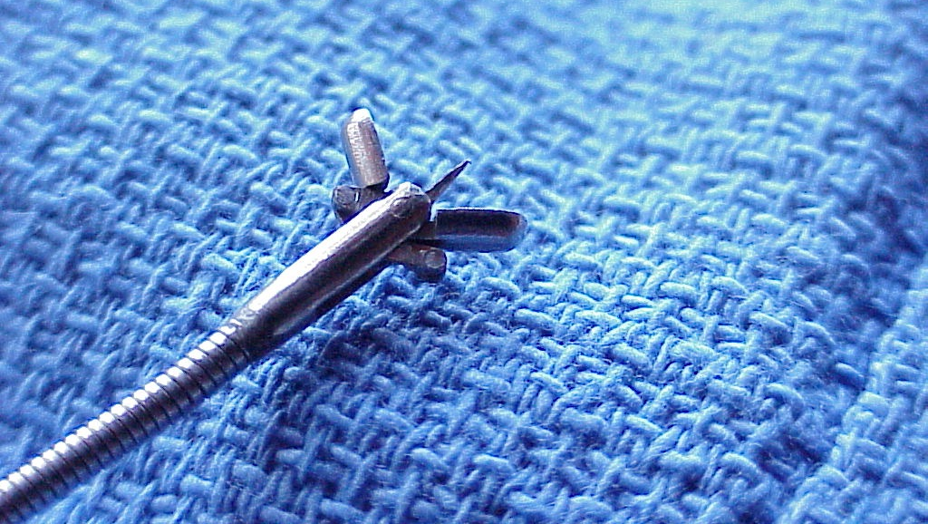
Strategy and planning
Techniques and results
Response to complications
bronchoscopy.org

Slide 3
When to perform endobronchial biopsy
Visible airway mucosal abnormalities
Visible airway nodules or masses
In case of suspected sarcoidosis (even if airway mucosa appears normal)
In case of abnormal autofluorescence to diagnose intraepithelial lesions (dysplasia, metaplasia, carcinoma in-situ)
BI

Slide 4
Training is essential in order to
Learn proper techniques and indications
Avoid procedure-related complications.
Learn to protect the equipment and the patient
To obtain adequate tissue for diagnosis
To avoid damaging the working channel
To avoid excess patient discomfort (cough, anxiety, shortness of breath).
To avoid bleeding, that might also prompt cough and patient agitation.
BI

Slide 5
Endobronchial Biopsy
Indications
Visible intraluminal or mucosal abnormality
Suspected Sarcoidosis (even if mucosa appears normal)
Early lung cancer detection (based on findings of autofluorescence and other imaging modalities)
BI

Slide 6
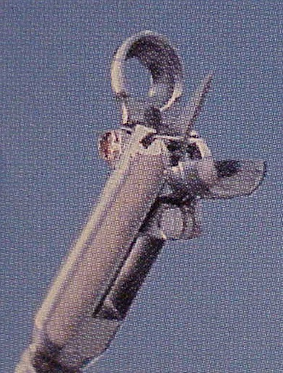
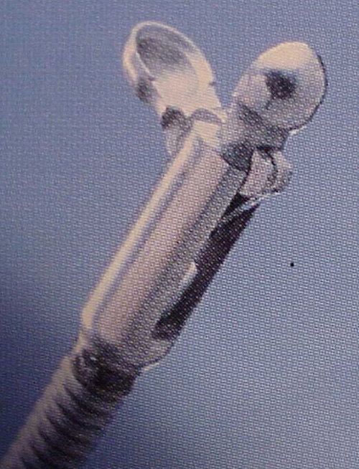
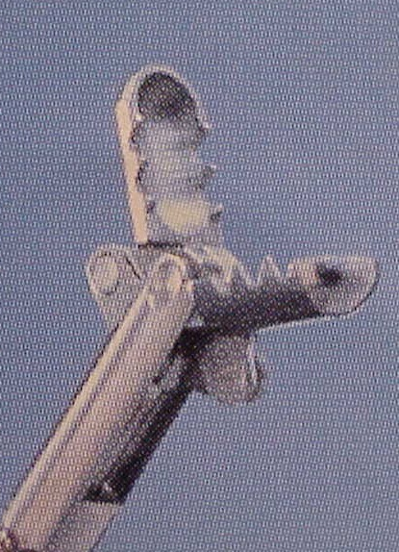
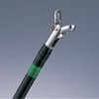
Biopsy instruments
Small reduction in bleeding using hot forceps: 39 patients with 6 biopsies each (Eur Respir J 2007; 29:108-111
Forceps with spike can be used to anchor forceps on lesion.
Open cup
Alligator (serrated)
BI

Slide 7
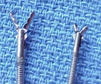
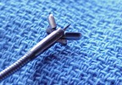
Examples of biopsy forceps
Serrated forceps and cup forceps
Cup forceps with central tooth
Forceps may be single use or reusable
BI

Slide 8
Endobronchial biopsy: Electrocautery forceps can be useful
Hot biopsy forceps in the diagnosis of endobronchial lesions
39 patients with 6 biopsies each (hot and cold)
Pathologic concordance between hot and cold biopsies was 92.5% and 87% (2 pathologists)
Small reduction in mild bleeding episodes with hot forceps (at 40-60-80-100 W)
Authors: routine use not warranted – can use as cold with set up for EC if significant bleeding occurs
(from Olympus America)
Eur Respir J 2007; 29:108-111
BI

Slide 9
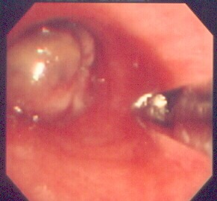
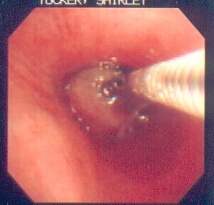
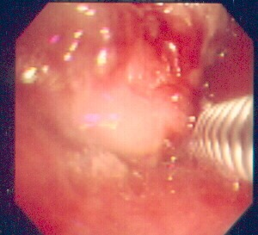
Biopsy techniques
Engage as much tissue as possible
Keep scope as close to target tissue as possible
May feel tugging sensation as forceps retracted
Approach
Open forceps
Close and biopsy
BI

Slide 10
Obtaining the best specimen possible
Use forceps with central tooth, especially if lesion is along lateral wall of trachea or bronchi.
Obtain deep submucosal biopsies to increase yield for small cell carcinoma, Amyloidosis, Sarcoidosis and other infiltrating processes.
Get close to the target area with the bronchoscope.
Click here for video
BI

Slide 11
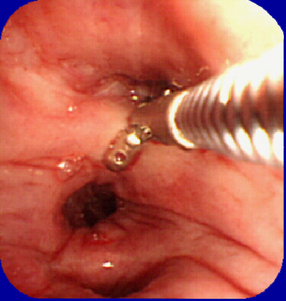
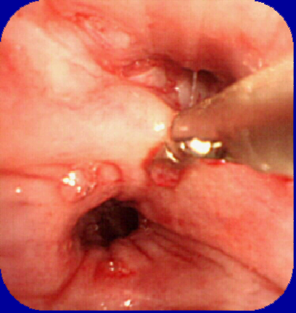
Deep, submucosal biopsy
A
B
Wedge the forceps onto the target area, push on the forceps to dig into the tissues, then close forceps

Slide 12
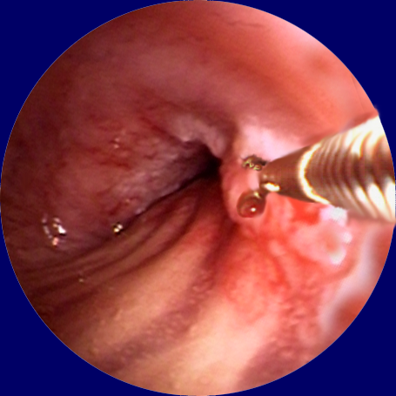
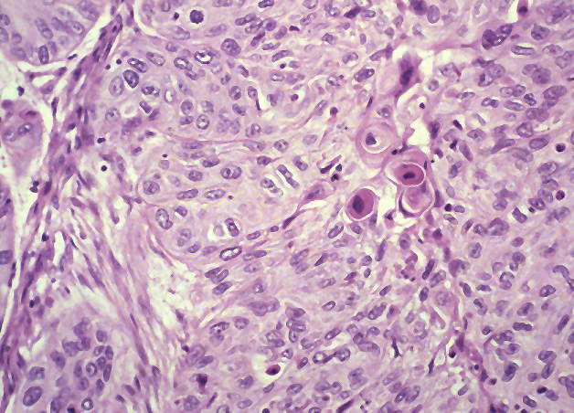
Use cup forceps or forceps with central tooth to anchor forceps onto lateral wall lesions
Grade 4 Squamous Cell Carcinoma in LMB

Slide 13
Yield of endobronchial biopsy
Respir Med 1998;92:1110-5
82% yield for malignancy if disease visible
Best yield probably with combination of brushings, washings, and biopsy material
Optimum sequence of procedures unknown
Thorax 1982;37:684-7
4-5 biopsy samples from visible lesion achieves at least a 90% positive rate for malignancy²
EBNA and TBNA probably superior to forceps biopsy in submucosal and peribronchial carcinoma
BI

Slide 14
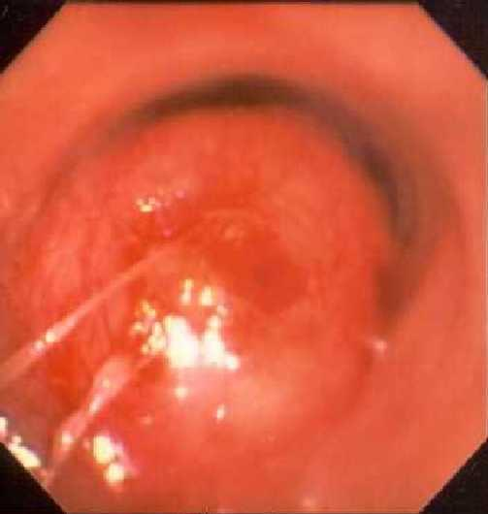
Diagnosis of Lung Cancer
Endobronchial Biopsy:
3-5 biopsies for 90 – 100 sensitivity in lung cancer
Variable yield 67 – 100% d/t:
Sampling error,
crush artifacts, surface necrosis, inadequate tissue
submucosal disease
extrinsic compression
BI

Slide 15
Endobronchial biopsy: Biopsy or wash first ?
Yield: Effect of different bronchial washing sequences on diagnostic yield in endoscopically visible lung cancer
75 patients underwent washing pre/post endobronchial biopsy and brushing
Arch Bronconeumol. 2006;42(6):278-82
BI

Slide 16
Endobronchial biopsy: Sarcoidosis
Yield: Endobronchial biopsy (EBB) for sarcoid
34 patients underwent TBBX and EBB
If airways appeared normal – biopsies from main and a secondary carina
EBB positive in 62%
TBBX positive in 59%
Addition of EBB increased yield by 21%
EBB positive in 30% of patients with normal airway
No additional complications from EBB
CHEST 2001;120:109-114
BI

Slide 17
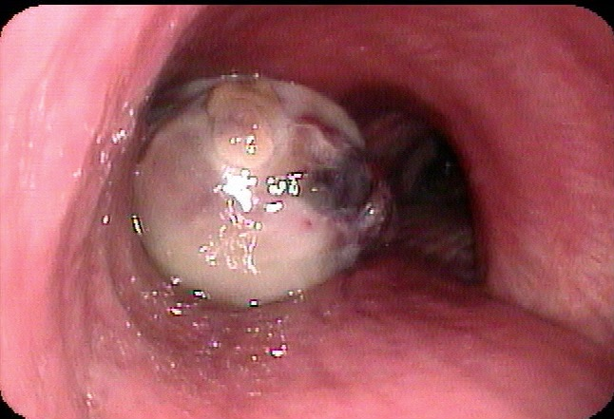
False negatives do occur
Due to necrotic surface or if process 2-3 mm below mucosal surface
Absence of blood suggests necrosis
Therefore, take biopsies until the core is reached
BI

Slide 18
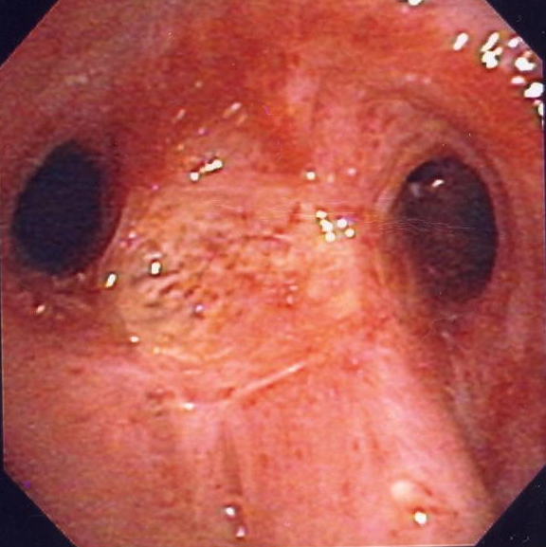
Case example: 72 year old with hemoptysis
72 year old, non-smoker female with Diabetes, on 50 mg/d Prednisone presents with hemoptysis, fever and wheezing.
ANCA negative
ANA negative
PPD negative
BI

Slide 19
Your diagnosis is ?
Endobronchial Wegener's
Endobronchial tuberculosis
Tracheobronchitis from inflammatory bowel disease
Squamous cell carcinoma
Endobronchial Cryptococcosis
BI

Slide 20
The answer is Endobronchial Cryptococcosis
Rare, Incidence unknown
Presentation: Mass, plaque, sub-mucosal infiltration, Ulcer
From: JOB 2005; 12(4): 236-238
BI

Slide 21
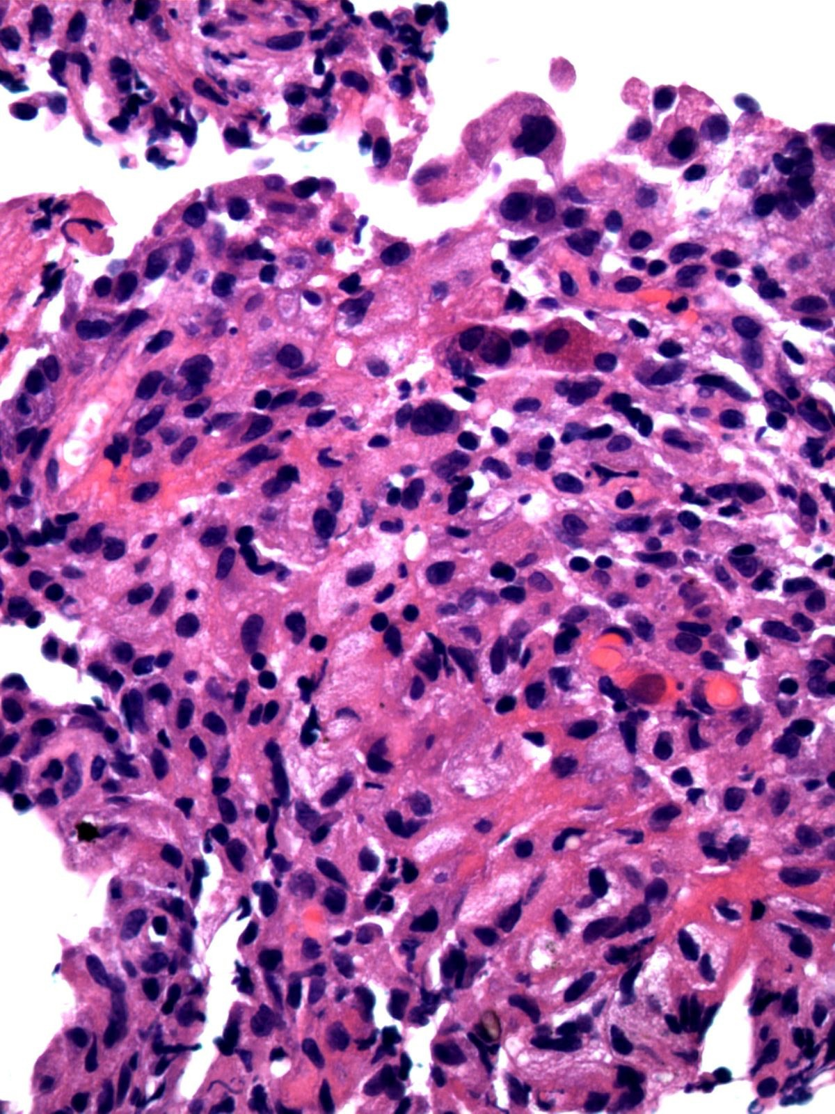
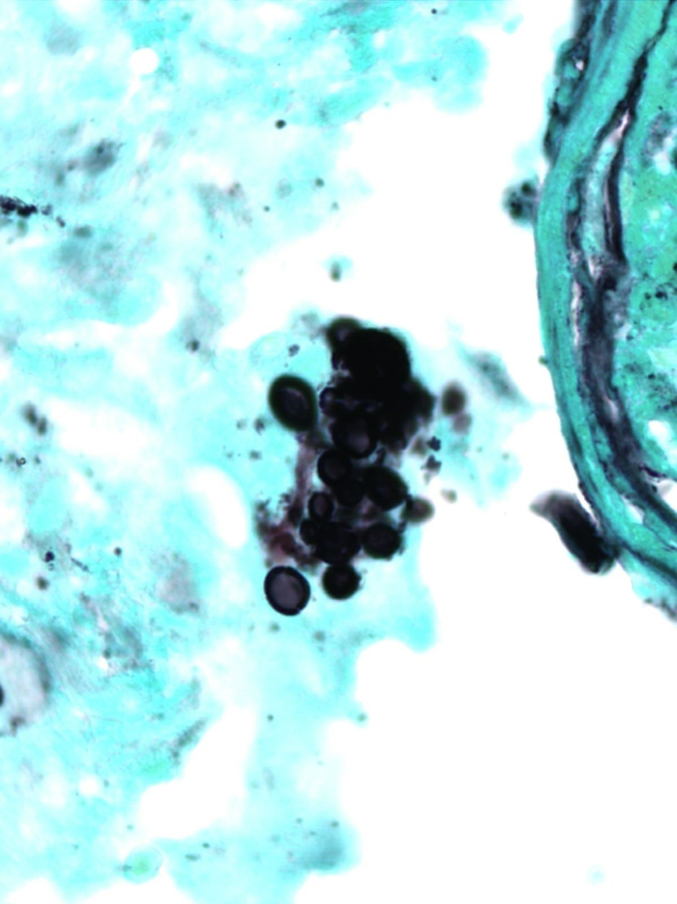
Fungal elements
BI

Slide 22
Complications of endobronchial biopsy
Chest 1991;100:1141-7
Profuse bleeding less likely than in Transbronchial biopsies
Increased risk in Uremia, pulmonary hypertension, liver disease, thrombocytopenia and immunosuppression
Superior vena cava syndrome – no literature on risk of biopsy bleeding
BI

Slide 23
Complications of endobronchial biopsy
Thorax 2001;56(suppl I)i1-i21 British Thoracic Society guidelines
Routine PT/PTT/platelet counts not indicated unless known risk factors
It is unclear whether there is a safe level of INR or platelets
BI

Slide 24
www.Bronchoscopy.org
Prepared with help from Udaya Prakash M.D. (USA), Atul Mehta M.D. (USA), and Wes Shepherd M.D. (USA)

