Slide 1
Fundamentals of Flexible Bronchoscopy Conventional Transbronchial Needle Aspiration
TECHNIQUES
www.Bronchoscopy.org

Slide 2
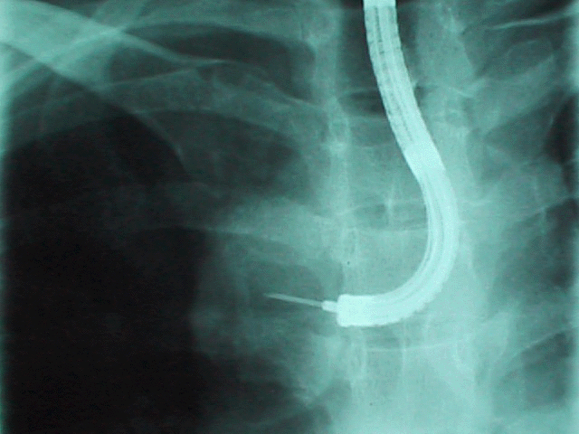
Techniques
bronchoscopy.org

Slide 3
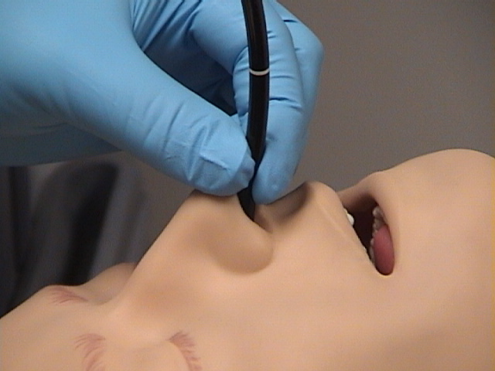
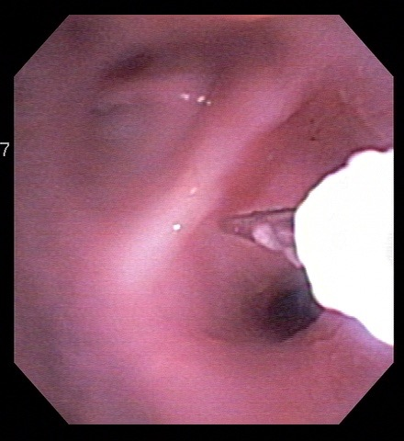
cTBNA Jab Technique
Jabbing
Needle out.
Hold scope firmly at the mouth or nostril and push the needle through the tissues.
(Image from Uptodate)
Courtesy H. Colt
www.bronchoscopy.org

Slide 4
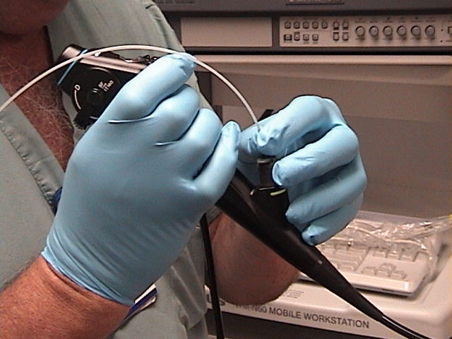
cTBNA Piggyback Technique
(Photo from UptoDate)
Piggyback
Needle out.
Hold catheter against insertion channel using fingers.
Advance scope and catheter together in order to penetrate airway wall with needle. Hub against wall
www.bronchoscopy.org

Slide 5
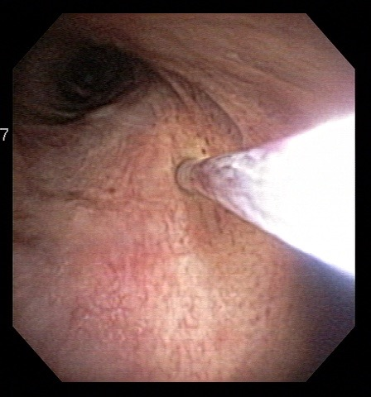
cTBNA Hub-against-wall Technique
Hub against wall
Needle in.
Push catheter hub against airway wall.
Hold catheter against airway wall
Needle out so that it penetrates into the target.
(Photo from UptoDate)
Photo courtesy H. Colt
www.bronchoscopy.org

Slide 6
Cough facilitates needle entry
Asking the patient to cough creates greater force with which the needle penetrates through the airway wall.
Cough prompts carina to move proximally (Photo from UptoDate)
www.bronchoscopy.org

Slide 7
Improving diagnostic yield
cTBNA is performed after complete airway examination, but before other diagnostic bronchoscopic procedures to avoid contaminating specimens.
Suction is minimized during scope insertion to avoid contaminating specimens.
The target area can be rinsed with saline prior to needle insertion.
If suction is used to pull material into the needle, release suction before withdrawing the needle from the airway wall.
On-site cytology is ideally available.
www.bronchoscopy.org

Slide 8
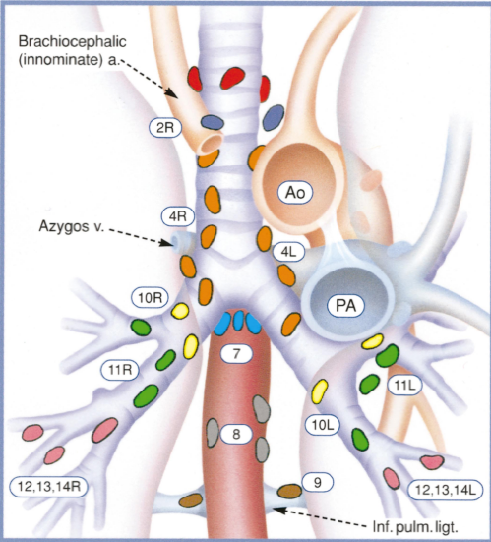
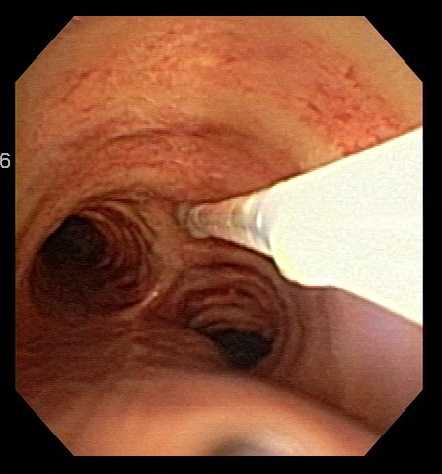
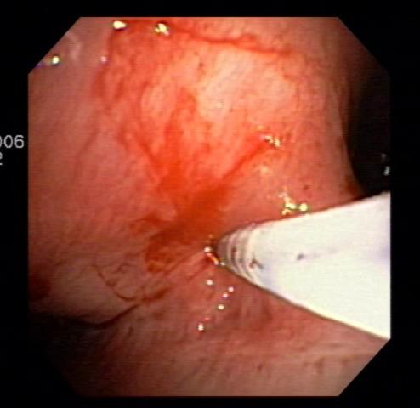
Sampling level 7 lymph nodes
Subcarina
3-10 mm below the carina, insert needle inferior-medially.
Although needle insertion through the carina may sample precarinal and subcarinal nodes as well
From Mountain CF et al, Chest 1997
www.bronchoscopy.org

Slide 9
Sampling level 4R lymph nodes
Right paratracheal nodes
2 cm above the carina, insert needle antero-laterally at the 1-2 0’clock position.
From Mountain CF et al, Chest 1997
www.bronchoscopy.org

Slide 10
Sampling level 4L lymph nodes
Left paratracheal nodes
At the level of the origin of the left main bronchus and the main carina, insert the needle laterally at the 9 o’clock position.
From Mountain CF et al, Chest 1997
www.bronchoscopy.org

Slide 11
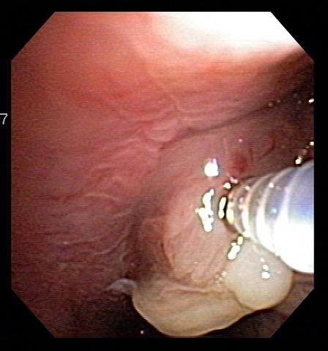
Needle aspiration of an endobronchial lesion
Sometimes used instead of endobronchial biopsy
Endobronchial Needle aspiration (EBNA)
www.bronchoscopy.org

Slide 12
Helpful hints for performing cTBNA
Tell patients “there are no nerve endings in the airway, so the needle insertion itself will not hurt”.
Use moderate sedation to improve patient comfort.
Carefully examine airway-computed tomography correlations to plan the procedure.
Inform bronchoscopy assistants of procedure plan.
Use instructions such as “needle out”, “needle in” , “remove catheter”, “hold scope at nose” to communicate with assistants.
Send copies of bronchoscopy report to assisting cytopathologists.
www.bronchoscopy.org

Slide 13
More helpful hints for cTBNA
Begin by sampling the nodal station with the worst prognosis (n3 followed by n2 followed by n1).
Cytology samples should be processed in the bronchoscopy suite using smear techniques.
Core tissues should be submitted in 10% formaldehyde.
Histology needles (19 gauge) can also be flushed with normal saline to obtain a cytology sample.
Samples are acceptable when there is a predominance of lymphocytes and few or no respiratory epithelial cells.
www.bronchoscopy.org

Slide 14
www.Bronchoscopy.org
Prepared with help from Udaya Prakash M.D. (USA), Atul Mehta M.D. (USA), Stefano Gasparini, and Wes Shepherd M.D. (USA)

