Slide 1
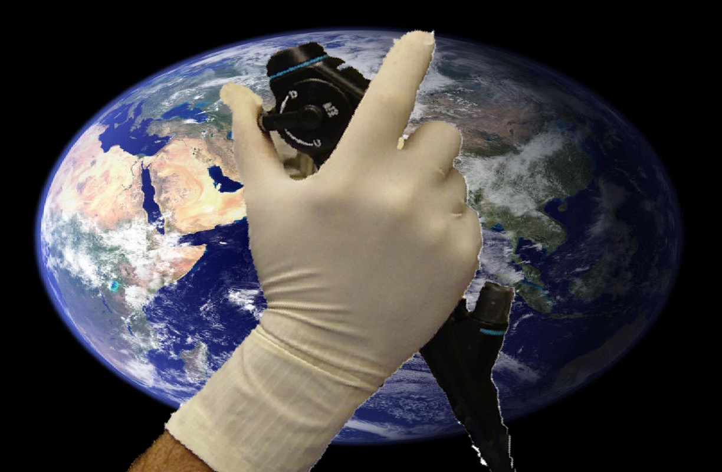
Part 2A: Normal Anatomy Upper airway and Larynx
BRONCHATLAS©
Prepared By
www.Bronchoscopy.org
All Rights Reserved, 2017

Slide 2
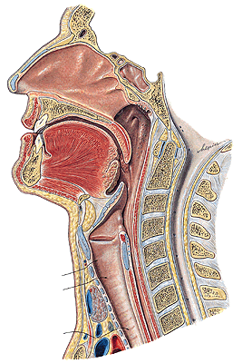
The Upper Airway
The upper airway starts :
At the nostrils, extends through the nasal conchae to the nasopharynx, over the uvula to the hypopharynx and larynx, or,
At the lips, extends through the oral cavity, over the tongue and below the hard and soft palates, to the hypopharynx and larynx.
All Rights Reserved, 2017

Slide 3
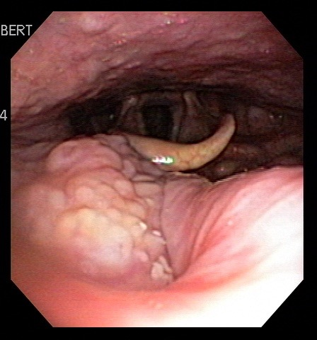
Upper Airway: From Pharynx to Larynx
Larynx
Epiglottis
Lingual
Tonsil
Uvula
Midline guidance:
“The uvula points to the epiglottis, the epiglottis leads into the larynx”.
All Rights Reserved, 2017

Slide 4
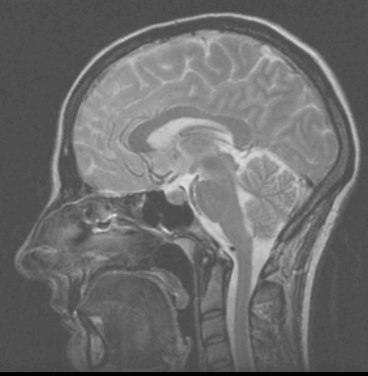
The Larynx
The larynx is a 5-7 cm long structure.
Its upper boundary starts at the tip of the epiglottis, opposite the 3rd to 4th, cervical vertebra.
Its lower end is at the lower border of the cricoid cartilage.
This lies opposite the 6th cervical vertebra.
www.phon.ox.ac.uk
All Rights Reserved, 2017

Slide 5
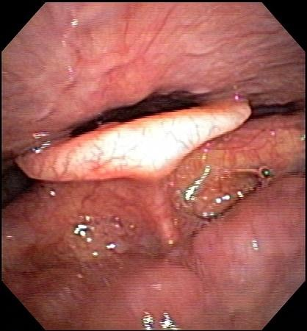
The Larynx
Posterior Wall of
Hypopharynx
(Leading to
Esophagus)
Lateral
Glossoepiglottic
Folds
Superior surface anatomy:
Major Landmarks I
Superior
Surface of
Epiglottis
Median
Glossoepiglottic
Fold
Vallecula
Base of
Tongue
http://www.nyee.edu/top#top
All Rights Reserved, 2017

Slide 6
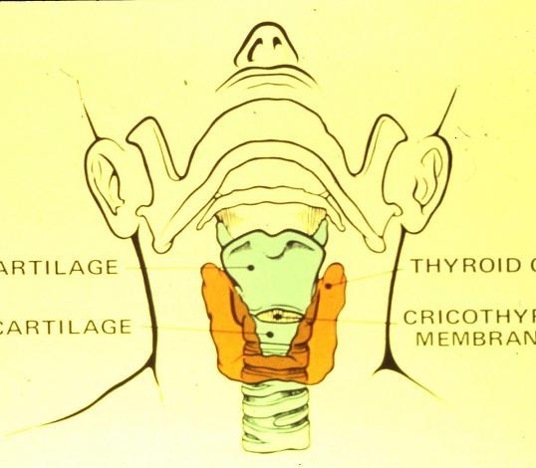
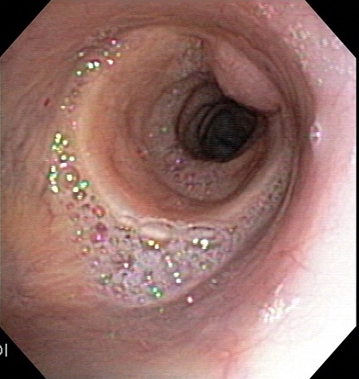
The Cricoid cartilage
Thyroid gland
Thyroid cartilage
Cricoid cartilage
Cricothyroid membrane
Cricoid Cartilage
All Rights Reserved, 2017

Slide 7
Surface anatomy is important
We are responsible to report any nasal, oral, pharyngeal or laryngeal pathology observed en-route to the lungs.
We know we are correctly positioned and in the midline, when we know exactly where we are.
In patients with difficult airways, knowledge of surface anatomy ensures timely intubation, intervention and saves lives.
In a variety of conditions, such as GERD, changes in laryngeal anatomy might be a clue to pulmonary pathology.
All Rights Reserved, 2017

Slide 8
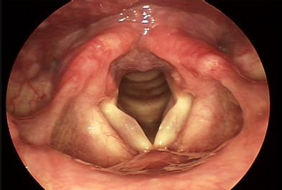
The Larynx
Pyriform
Sinus
Superior surface anatomy:
Major Landmarks - II
Posterior Wall of
Hypopharynx
(Leading to
Esophagus)
Laryngeal
Surface of
Epiglottis
Ventricle
http://www.nyee.edu/top#top
All Rights Reserved, 2017

Slide 9
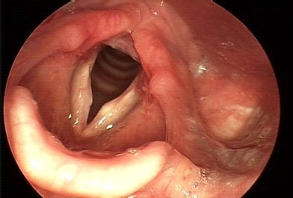
The Larynx
Pyriform
Sinus
Superior surface anatomy:
Major Landmarks - III
Epiglottis
Vallecula
http://www.nyee.edu/top#top
All Rights Reserved, 2017

Slide 10
The Larynx
Posterior
Commissure
Superior surface anatomy:
Major Landmarks - IV
True
Vocal
Cords
Ventricle
False
Vocal
Cords
Anterior
Commissure
Aryepiglottic
Fold
http://www.nyee.edu/top#top
All Rights Reserved, 2017

Slide 11
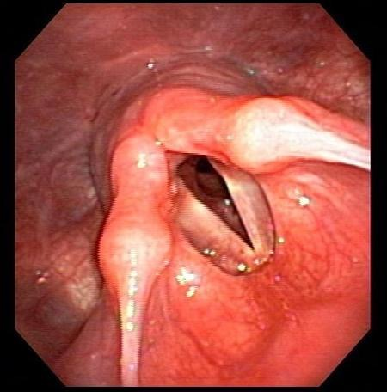
The Larynx
Posterior Wall
Of Hypopharynx
Superior surface anatomy:
Major Landmarks - V
Corniculate
Tubercle on
Arytenoid
Cartilage
Cuneiform
Tubercle
Aryepiglottic
Fold
All Rights Reserved, 2017

Slide 12
The Larynx
Arytenoid
Cartilage
Superior surface anatomy:
Major Landmarks - VI
True
Vocal
Cords
Ventricle
False
Vocal
Cords
All Rights Reserved, 2017

Slide 13
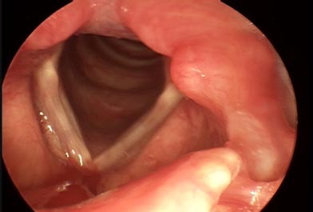
The Larynx
Cartilaginous
Rings of
Trachea
Superior surface anatomy:
Major Landmarks
to look for - VII
Vocal Cord
Sulcus (on
True Vocal
Cords)
False
Vocal
Cords
True
Vocal
Cords
Cricoid
Ring
All Rights Reserved, 2017

Slide 14
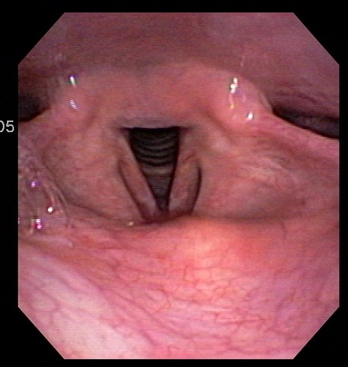
This is the..
The epiglottis
The ventricle
The arytenoid cartilage
The true vocal cord
The false vocal cord
Click for correct answer:
B
All Rights Reserved, 2017

Slide 15
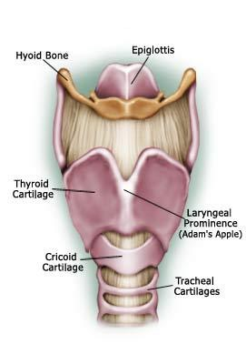
The Larynx: Anatomy
The structural rigidity of the larynx is provided by the three median cartilages:
The epiglottis
Thyroid cartilage
Cricoid cartilage ,
along with the hyoid bone.
The thyrohyoid membrane forms a C-shaped barrier around the anterior and lateral walls of the supraglottis, and inferiorly becomes confluent with the connective tissue in the perichondrium of the tracheal cartilaginous rings.
www.throat-cancer-symptoms.com/
All Rights Reserved, 2017

Slide 16
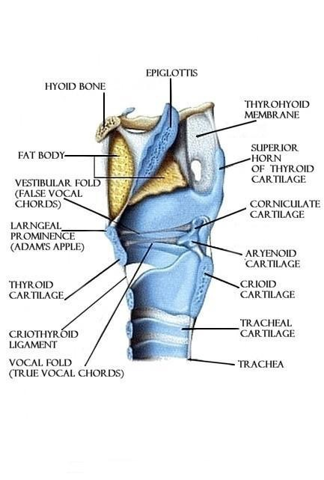
The Larynx: Anatomy
The six smaller cartilages of the larynx ( 3 pairs) are functionally involved with the movements of the vocal cords. These are:
The arytenoids
The corniculates
The cuneiforms
The arytenoid cartilages are pyramid-shaped and articulate with the superior margin of the cricoid lamina. On their summit, are the corniculate cartilages; on their anterior aspect, the cuneiform cartilages
www.polychondritis.com
All Rights Reserved, 2017

Slide 17
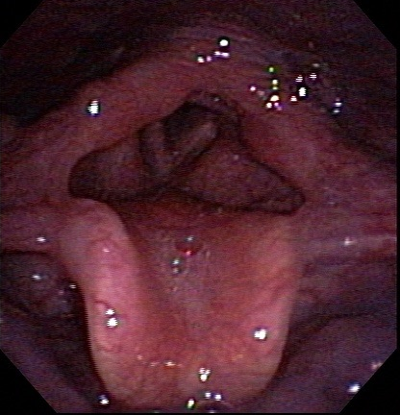
The Larynx: Anatomy
The vocal ligaments, are attached posteriorly to the apex of the arytenoids and corniculates. The cuneiforms extend laterally, between the layers of the vocal cords, from the anterior aspect of the arytenocorniculate complex.
The epiglottis is attached to the base of the tongue by a median and two lateral glossoepiglottic folds.
All Rights Reserved, 2017

Slide 18
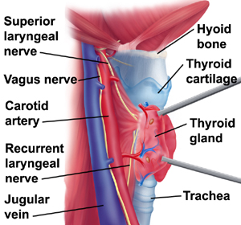
The Larynx: Critical Structures
The Larynx neighbors major critical structures:
Carotid arteries and jugular veins, and the vagus nerve
Superior and inferior thyroid arteries
Superior and recurrent laryngeal nerves
www.yoursurgery.com
All Rights Reserved, 2017

Slide 19
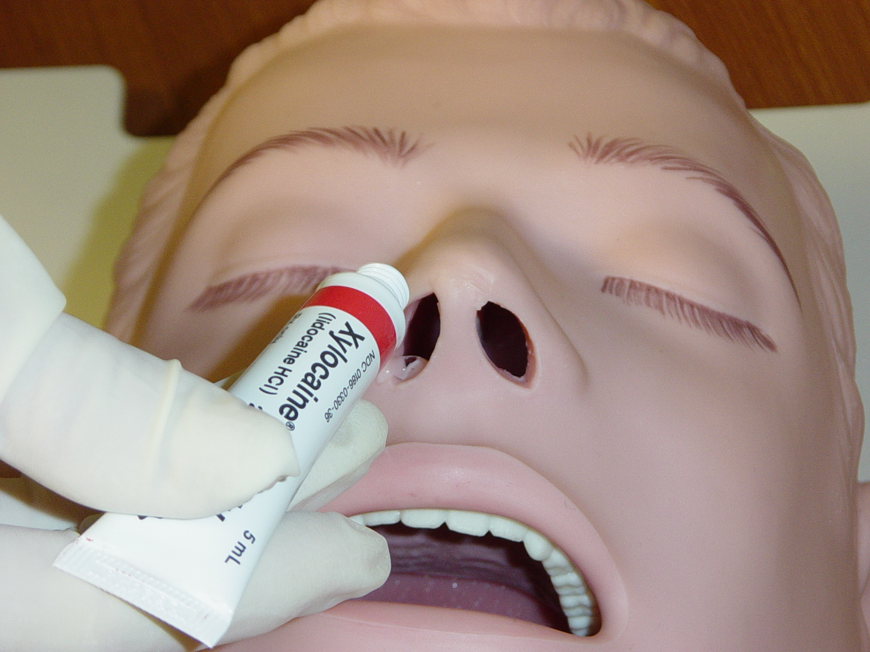
The Larynx: Topical Anesthesia
Bilateral nasal administration of anesthetic provides partial posterior pharyngeal anesthesia by affecting the Sphenopalatine nerve fibers, thus diminishing the gag reflex.
Ask patient to inhale deeply through nostril
All Rights Reserved, 2017

Slide 20
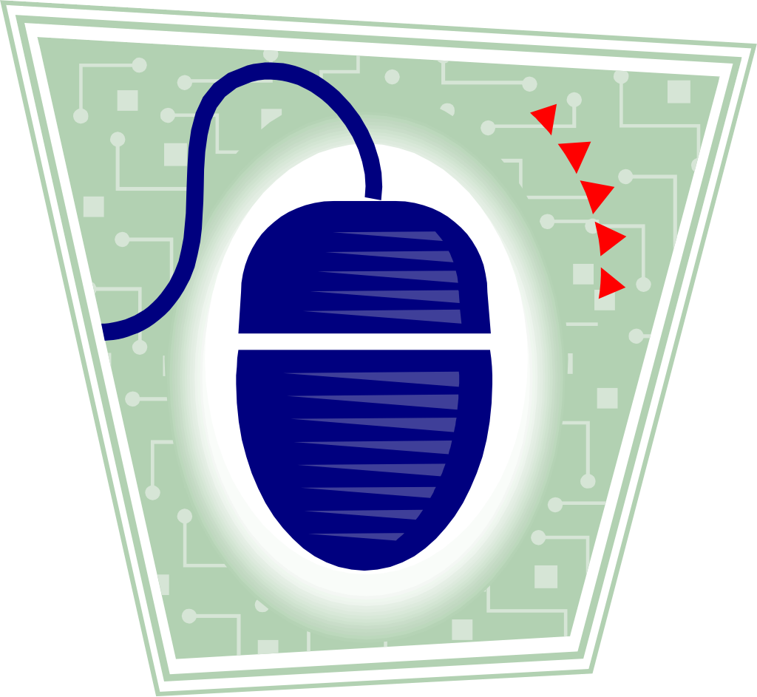
The Larynx: Topical Anesthesia
Topical anesthetic usually affects the superior laryngeal nerve and blocks sensory innervation to the base of the tongue epiglottis, pyriform fossa, and valleculae.
Click here to view video presentation
Click to continue
All Rights Reserved, 2017

Slide 21
The Larynx: Topical Anesthesia
The topical instillation of Lidocaine with the
“Spray as you go” method numbs the submucosal plexus of the larynx, derived from the external and internal branches of the superior laryngeal nerve.
Click here to view video presentation
All Rights Reserved, 2017

Slide 22
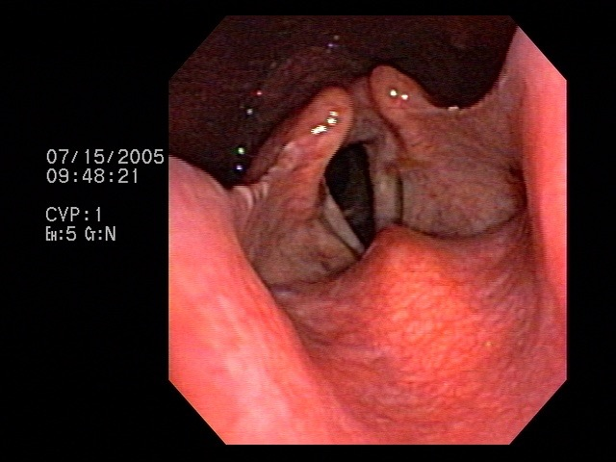
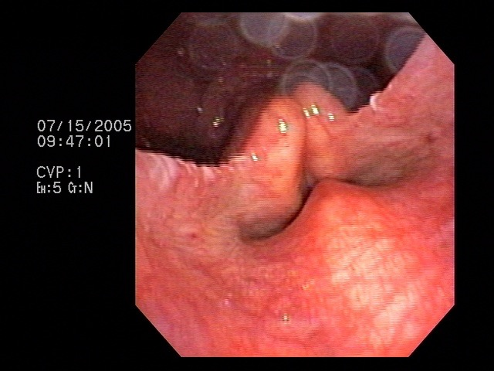
Laryngeal function: Airway Protection
The glottis: open for inspiration and closed for swallowing
Open Closed
All Rights Reserved, 2017

Slide 23
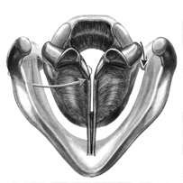
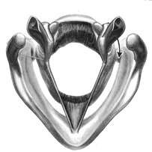
Laryngeal function: Phonation
The vocal cords: Adducted for phonation; abducted for inspiration
Adducted: Talking Abducted: Breathing
www.voice.northwestern.edu
All Rights Reserved, 2017

Slide 24
Laryngeal function: Phonation
The vocal cords open and close while talking
Click here to view video presentation
All Rights Reserved, 2017

Slide 25
Which of the following defends against aspiration?
The epiglottis
The false cords
The true cords
The ventricle
All of the above
Click for correct answer:
E
All Rights Reserved, 2017

Slide 26
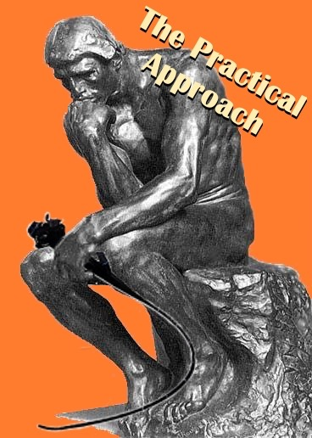
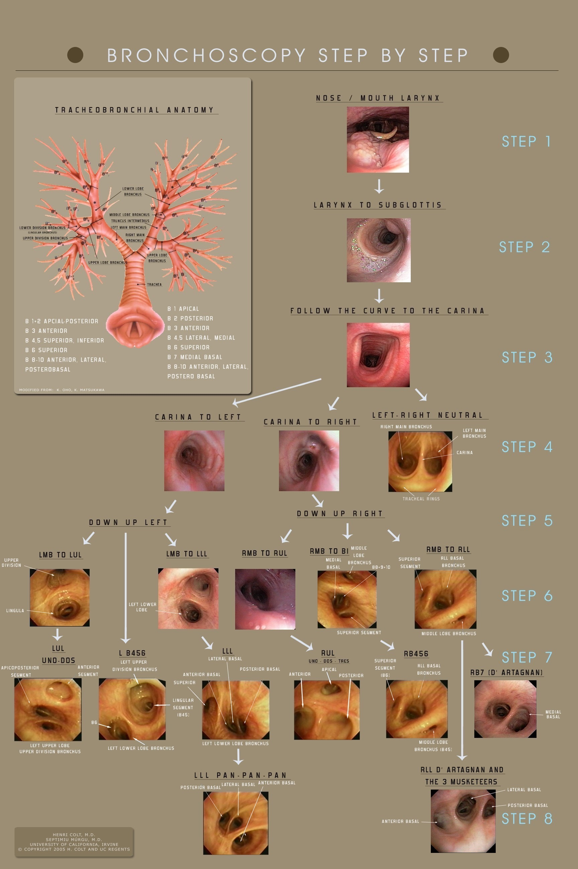
This presentation is part of a multidimensional competency-oriented curriculum for Flexible Bronchoscopy.
Our goal is to eliminate patient suffering caused by unequal physician expertise and on-the-job training.
Step by Step©
BRONCHATLAS©
& YouTube Instructional videos
5/26/17
All Rights Reserved, 2017

Slide 27
Thank you
All efforts are made by Bronchoscopy International to maintain currency of online information. Multimedia presentations and videos can be cited as:
Bronchoscopy International: BronchAtlas©, an Electronic On-Line Multimedia Slide Presentation. http://www.Bronchoscopy.org/Bronchatlas/htm. Published 2017 (Please add “Date Accessed”).
BRONCHATLAS©
5/26/17
All Rights Reserved, 2017

Slide 28
www.Bronchoscopy.org

