Slide 1
Part 6A: Abnormalities of The Bronchi
BRONCHATLAS©
Prepared By
www.Bronchoscopy.org
5/26/17
BI, All Rights Reserved

Slide 2
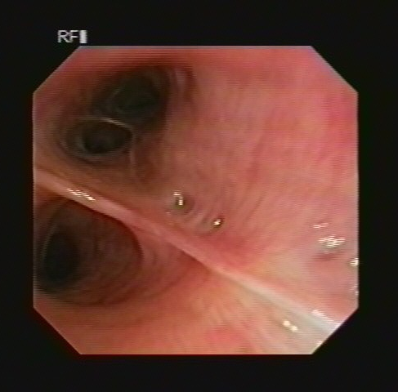
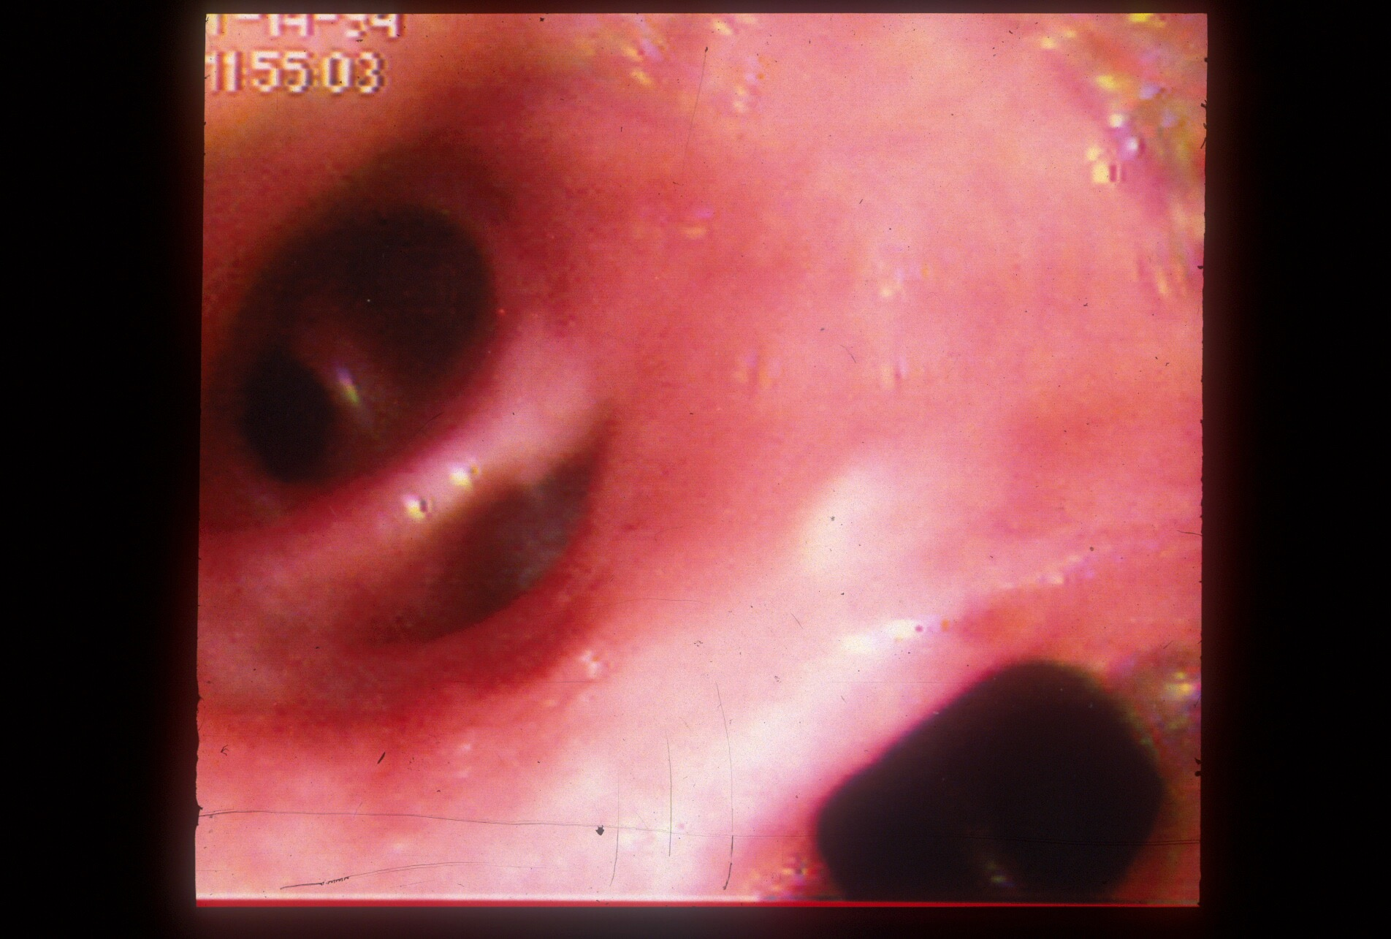
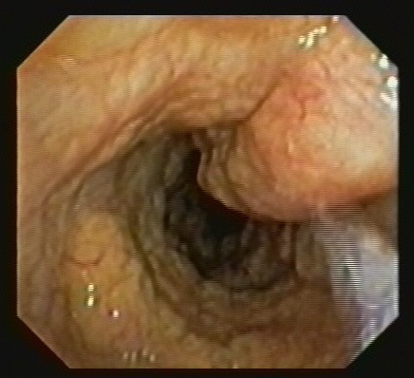
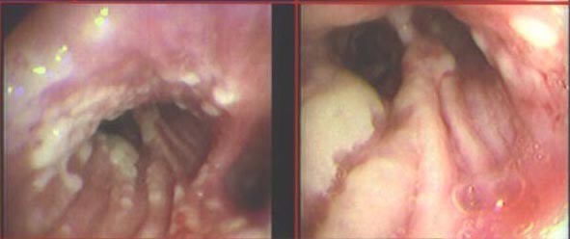
Bronchial mucosal abnormalities d
Pitting Herpes Cancer
Necrotizing tracheobronchitis Amyloidosis
5/26/17
BI, All Rights Reserved

Slide 3
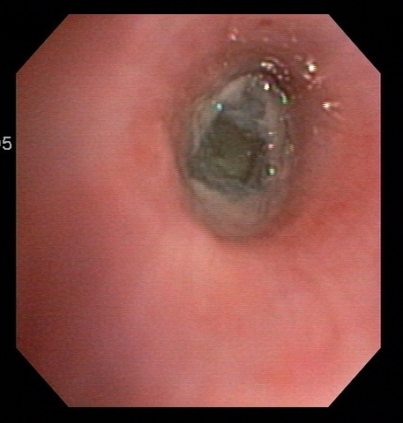
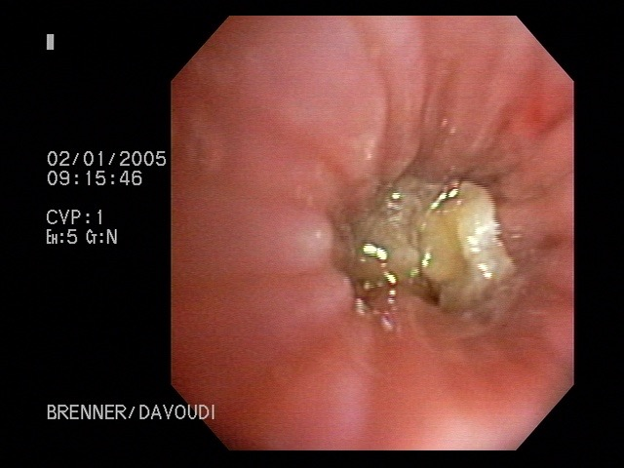
Segmental Bronchial Obstruction
Foreign body
Windshield glass in trauma victim
Aspergillus infection
glass
5/26/17
BI, All Rights Reserved

Slide 4
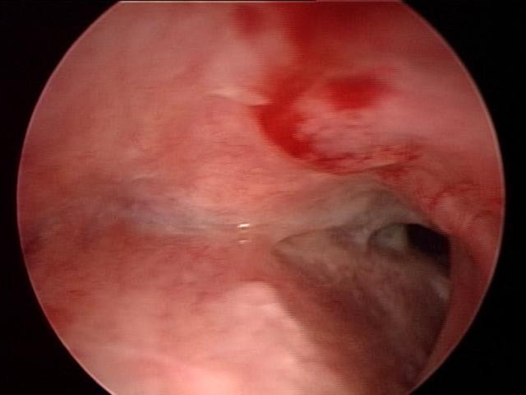
Complete left main bronchial obstruction
Secondary to inflammation and chronic fibrous stricture from limited Wegener’s Granulomatosis
5/26/17
BI, All Rights Reserved

Slide 5
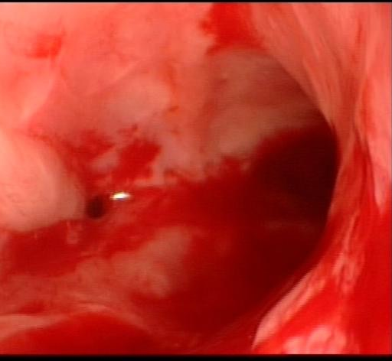
Near total left main bronchial stricture
Draining pus from near total left main bronchial obstruction
Patient with Tuberculosis, hemoptysis, and inflammed bronchi.
5/26/17
BI, All Rights Reserved

Slide 6
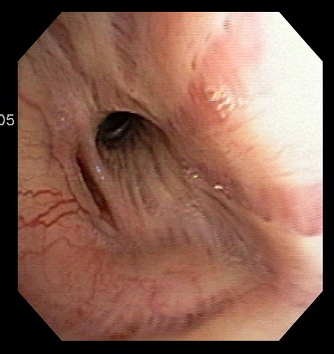
Right Middle Lobe Stricture
Stricture in patient with recurrent RML infiltrate on chest radiograph
5/26/17
BI, All Rights Reserved

Slide 7
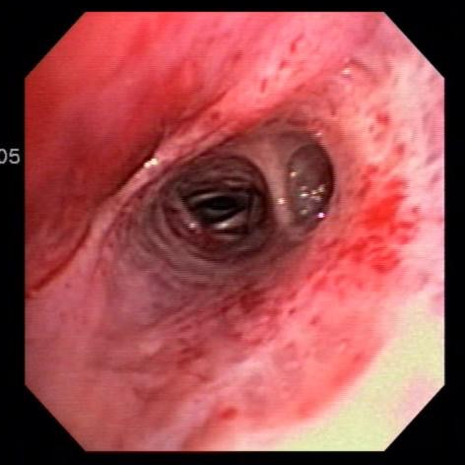
Right Middle Lobe Syndrome
Caused by
Extrinsic compression
Tumor
Volume loss
Chronic infection
Congenital
Closed Middle Lobe Bronchus
5/26/17
BI, All Rights Reserved

Slide 8
Mucus plug with near total bronchial obstruction
Fungal stains positive
Cultures positive for Aspergillus
5/26/17
BI, All Rights Reserved

Slide 9
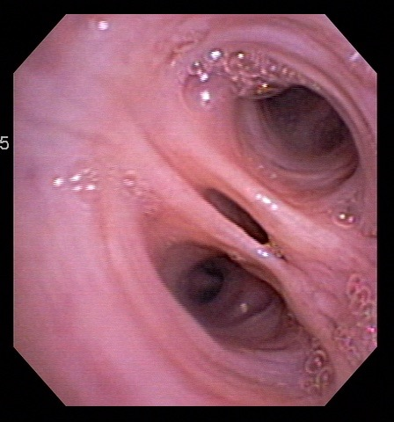
Focal narrowing
Focal narrowing of lateral basal segment, etiology unknown
5/26/17
BI, All Rights Reserved

Slide 10
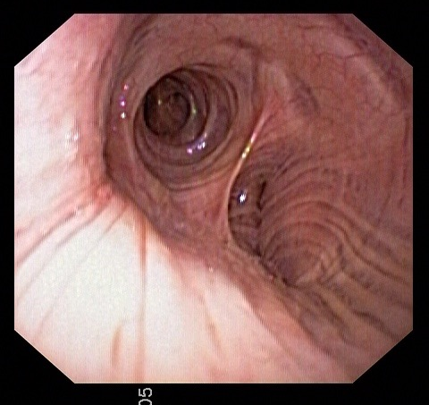
Left lower lobectomy bronchial stump
Area of resection
5/26/17
BI, All Rights Reserved

Slide 11
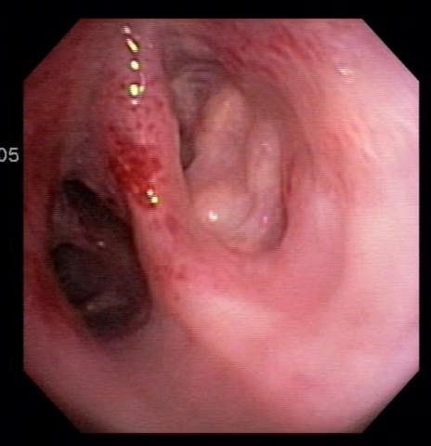
Bronchial lymph nodes
Adjacent to posterobasal segment Right lower lobe bronchus
5/26/17
BI, All Rights Reserved

Slide 12
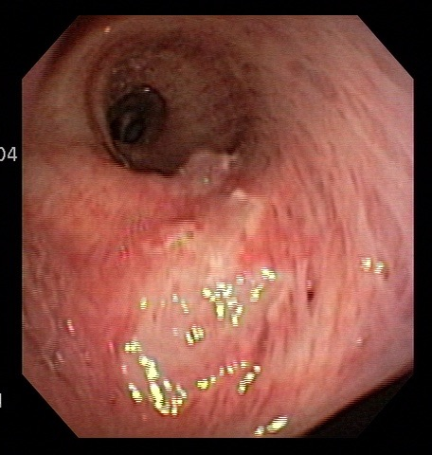
Suction trauma
Trauma and scarring
5/26/17
BI, All Rights Reserved

Slide 13
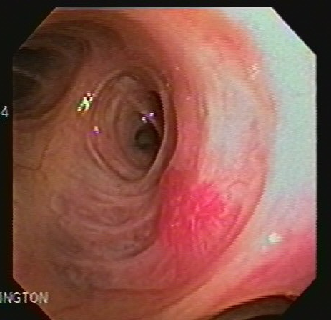
Telangectasia left upper lobe bronchus
Possible source of hemoptytis
5/26/17
BI, All Rights Reserved

Slide 14
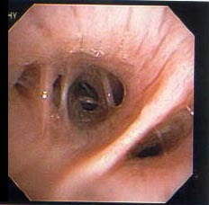
Normal subapical segment right lower lobe bronchus
Subapical segment
Medial basal segment
Superior segment
Middle lobe bronchus
5/26/17
BI, All Rights Reserved

Slide 15
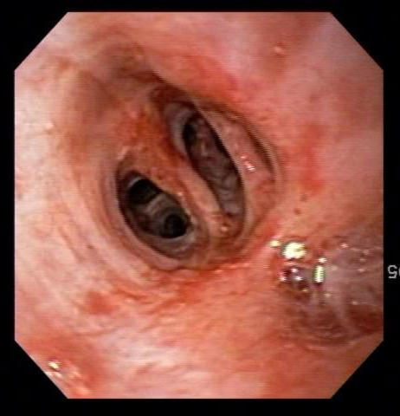
Unformed medial basal segment right lower lobe bronchus
5/26/17
BI, All Rights Reserved

Slide 16
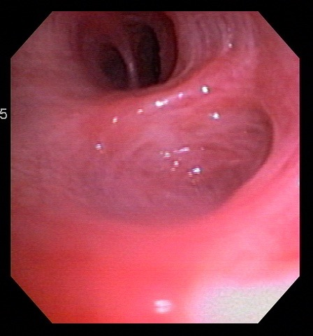
Unformed bronchial segment
Unformed subapical segment right lower lobe bronchus
5/26/17
BI, All Rights Reserved

Slide 17
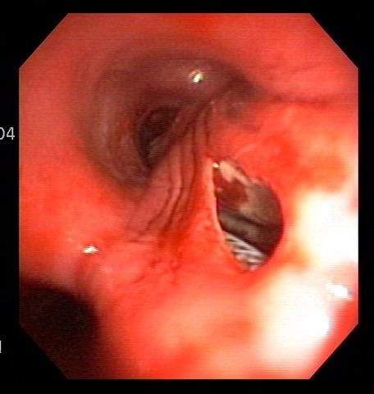
Broncho-esophageal fistula
Fistula, posterior wall right main bronchus.
Esophageal stent visible through the fistula.
5/26/17
BI, All Rights Reserved

Slide 18
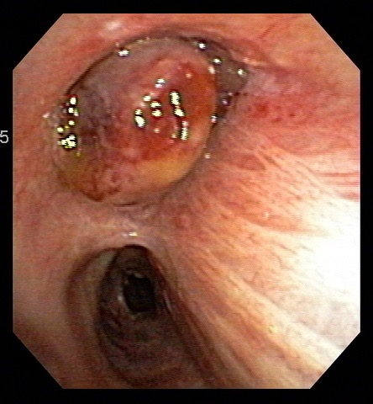
Sarcoma after external beam radiation therapy
Right upper lobe bronchial obstruction
5/26/17
BI, All Rights Reserved

Slide 19
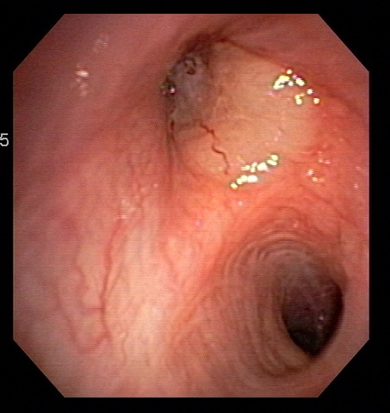
Adenocarcinoma Left Upper Lobe
Raised, indurated, whitish infiltrating lesion
5/26/17
BI, All Rights Reserved

Slide 20
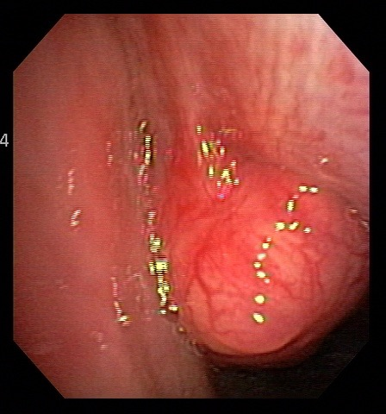
Nodular squamous cell carcinoma
Partial obstruction of right main bronchus
Anterior-lateral wall right main bronchus
5/26/17
BI, All Rights Reserved

Slide 21
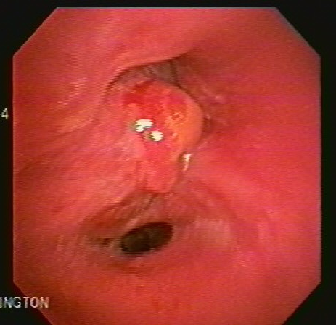
Nodular carcinoid tumor
Wide infiltrating base
5/26/17
BI, All Rights Reserved

Slide 22
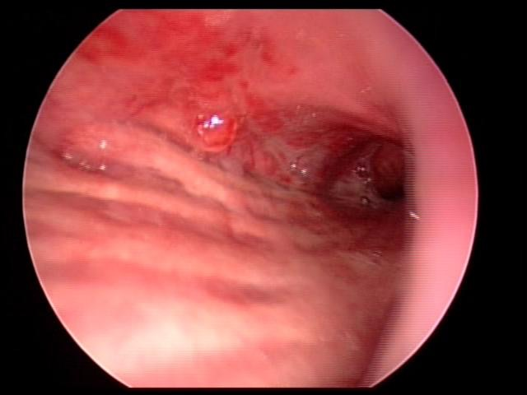
Infiltrative and nodular small cell carcinoma
Nodular small cell infrequently seen, here on medial wall right main bronchus
Thick deformed posterior longitudinal fibers suspicious for infiltrating neoplasm and volume loss
5/26/17
BI, All Rights Reserved

Slide 23
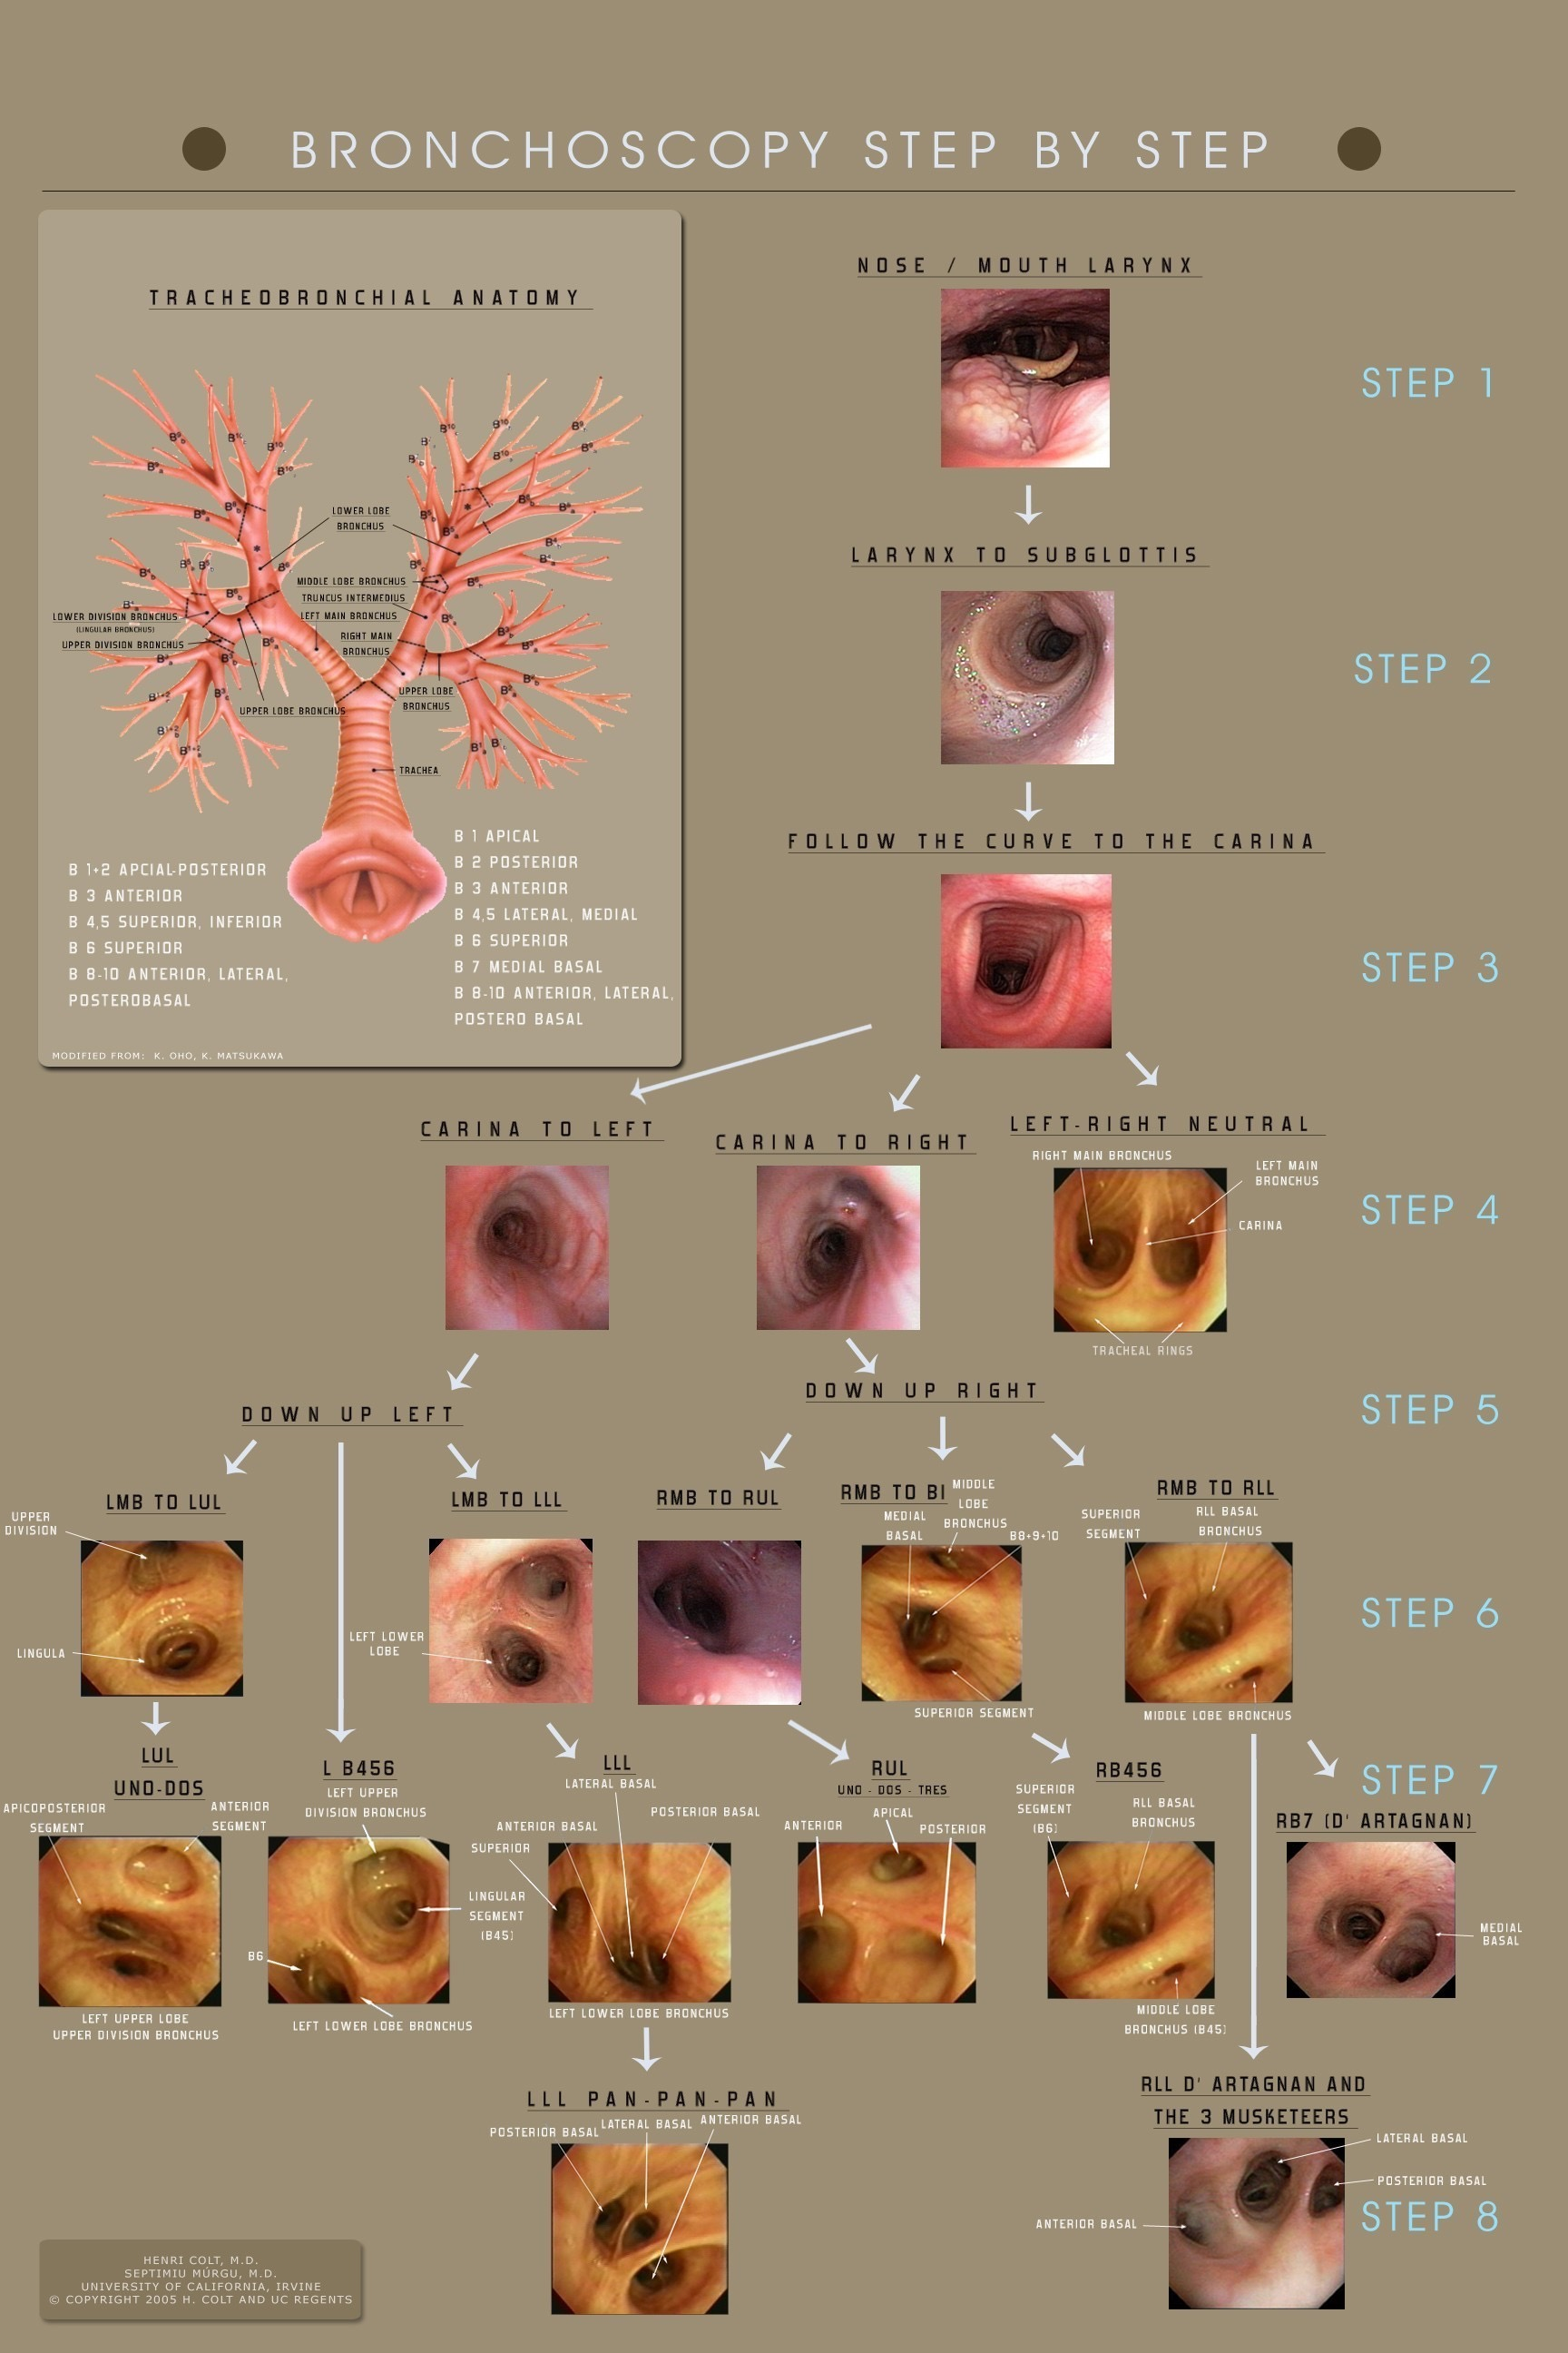
This presentation is part of a multidimensional competency-oriented curriculum for Flexible Bronchoscopy.
Our goal is to eliminate patient suffering caused by unequal physician expertise and on-the-job training.
Step by Step©
BRONCHATLAS©
& YouTube Instructional videos
5/26/17
All Rights Reserved, 2017

Slide 24
Thank you
All efforts are made by Bronchoscopy International to maintain currency of online information. Multimedia presentations and videos can be cited as:
Bronchoscopy International: BronchAtlas©, an Electronic On-Line Multimedia Slide Presentation. http://www.Bronchoscopy.org/Bronchatlas/htm. Published 2017 (Please add “Date Accessed”).
BRONCHATLAS©
5/26/17
All Rights Reserved, 2017

Slide 25
www.Bronchoscopy.org

