Slide 1
Fundamentals of Bronchoscopy:
BRONCHOALVEOLAR LAVAGE (BAL)
www.Bronchoscopy.org
5/10/17
BI, All Rights Reserved, 2017

Slide 2
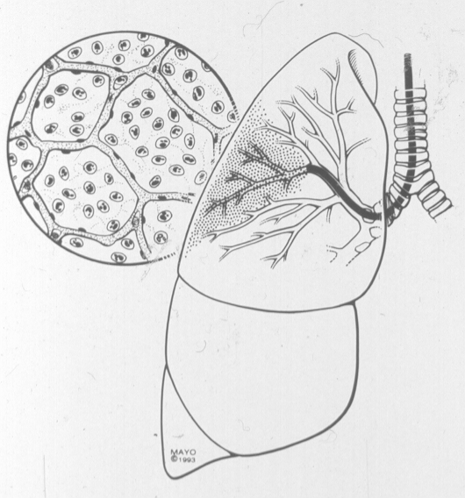
History
BAL
Originally described in the 1970s
Originally referred to as a “Liquid lung biopsy”
A BAL samples the contents of millions of alveoli
Yield is therefore greatest for alveolar filling processes
This is NOT a bronchial wash !
bronchoscopy.org

Slide 3
BAL today
Performed routinely in patients with pulmonary infiltrates of presumed infectious etiology.
Performed also in patients with history or suspicion of neoplasm.
Performed for other alveolar filling processes
Alveolar proteinosis
Alveolar hemorrhage
Fat embolism and lipoid pneumonia
bronchoscopy.org

Slide 4
Learning about Bronchoalveolar lavage
Techniques and indications
How to avoid and respond to procedure-related complications.
How to protect the equipment
How to maintain patient safety
Maximize fluid return
Avoid scope-related trauma
Avoid patient discomfort (cough, anxiety, shortness of breath)
BI

Slide 5
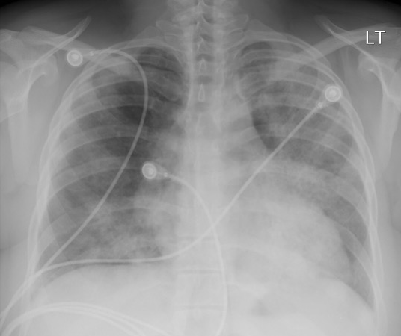
Strategy and planning
Techniques and results
Response to complications
bronchoscopy.org

Slide 6
Clinical indications
Peripheral Malignancy
Infection (Pneumocystis in HIV 96-98%)
Alveolar proteinosis, alveolar hemorrhage
Fat embolism and Lipoid pneumonia
Silicosis/berylliosis/asbestos
Eosinophilic lung disease
BI

Slide 7
Research-related indictions
- Characteristic cellular patterns in numerous diseases (asthma, ARDS)
- Several interstitial lung diseases have distinct findings on BAL
- There are well-defined cellular patterns for smokers, former smokers, and nonsmokers
bronchoscopy.org

Slide 8
Contraindications to BAL
No contraindications, but
- BAL-induced hypoxemia may last several hours
- BAL may exacerbate respiratory insufficiency.
- Therefore use caution in ventilated patients.
- Therefore minimize duration of the bronchoscopy.
- In unstable patients with severe hypoxemia, large volume BAL may be enough to prompt intubation.
bronchoscopy.org

Slide 9
Techniques
Record location of BAL in the procedure note
Increased yield in gravity dependent areas
Target involved segment in focal disease
RML and lingula are also preferred sites
Wedge the scope in the target segment
Suction channel should be in the airway lumen, not against the wall
Confirmed by slight airway wall collapse with gentle suction
Fluid instillation gently dilates segmental airway
bronchoscopy.org

Slide 10
BAL technique
Saline instillation (room temperature)
Small aliquots (20-60 each) via syringe
More than 100 cc total per segment sampled
Usually done after biopsy or brushing to increase cellular content of BAL sample for diagnosis of infection or malignancy
In ILD, changes in cell population of recovered fluid occurred only after at least 120 cc is instilled.
Am Rev Respir Dis 1985;132:390-392
Am Rev Respir Dis 1982;126:611-616
BI

Slide 11
Bronchoalveolar lavage is also called Bronchioloalveolar lavage
Video of BAL Example
bronchoscopy.org

Slide 12
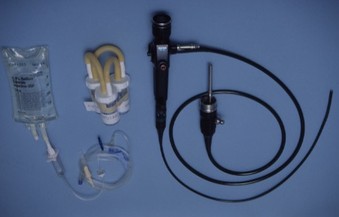
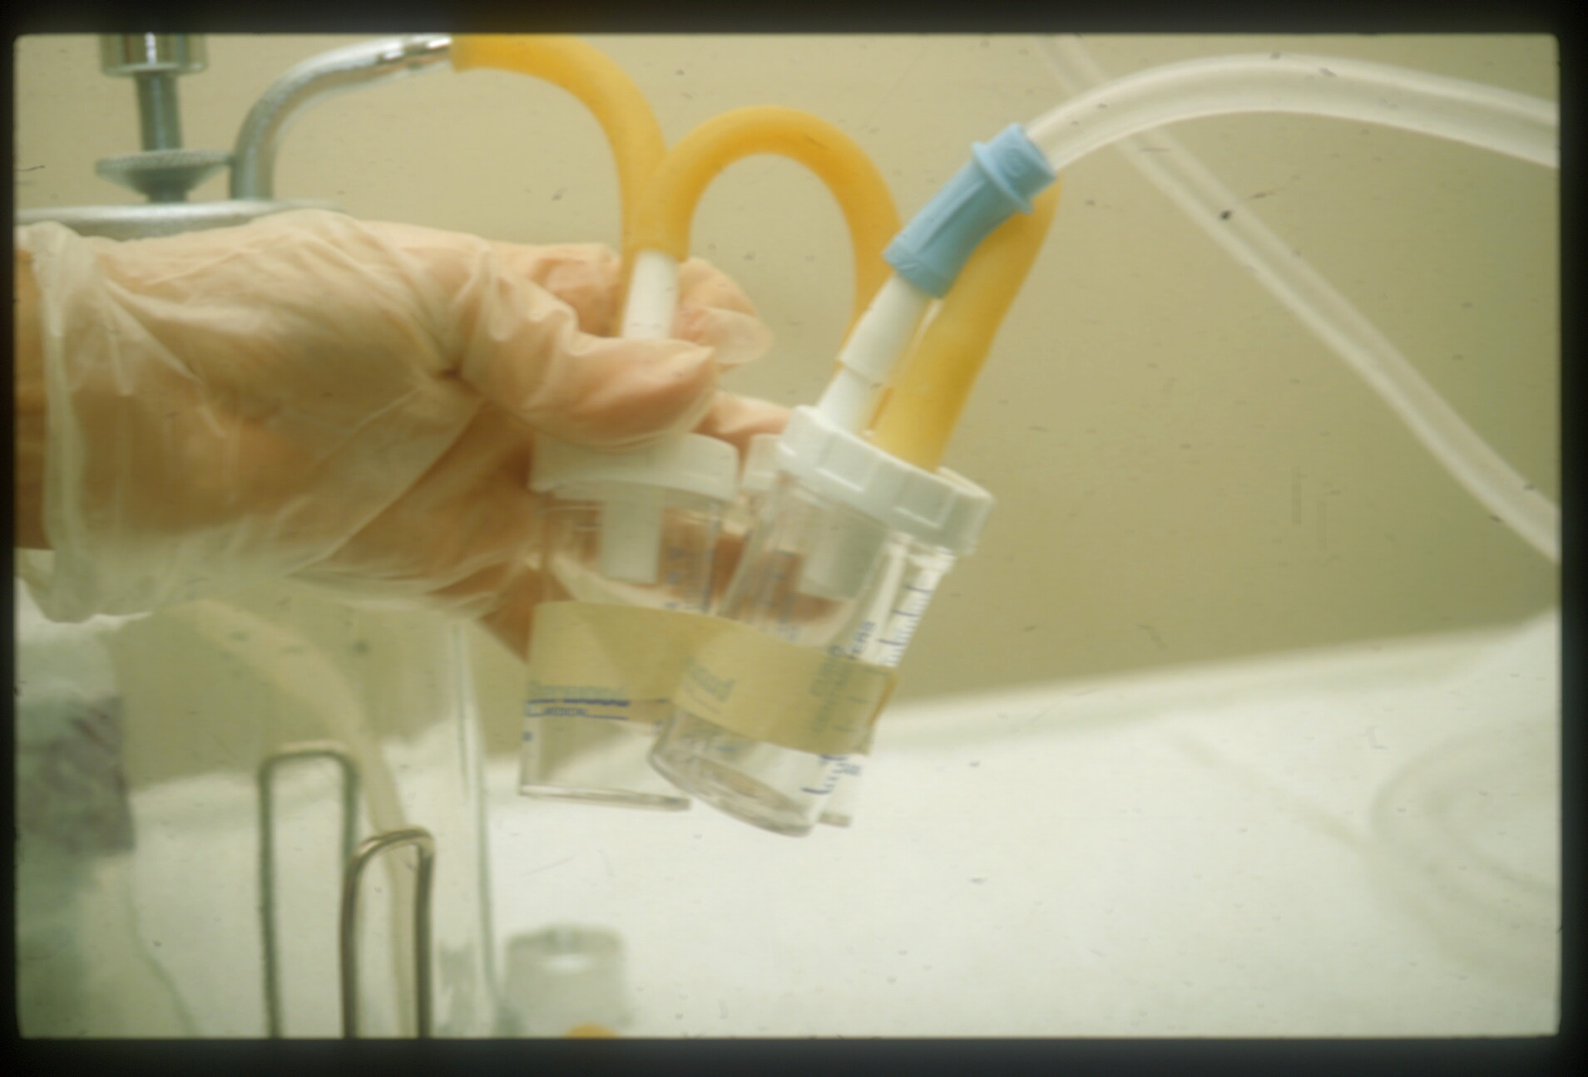
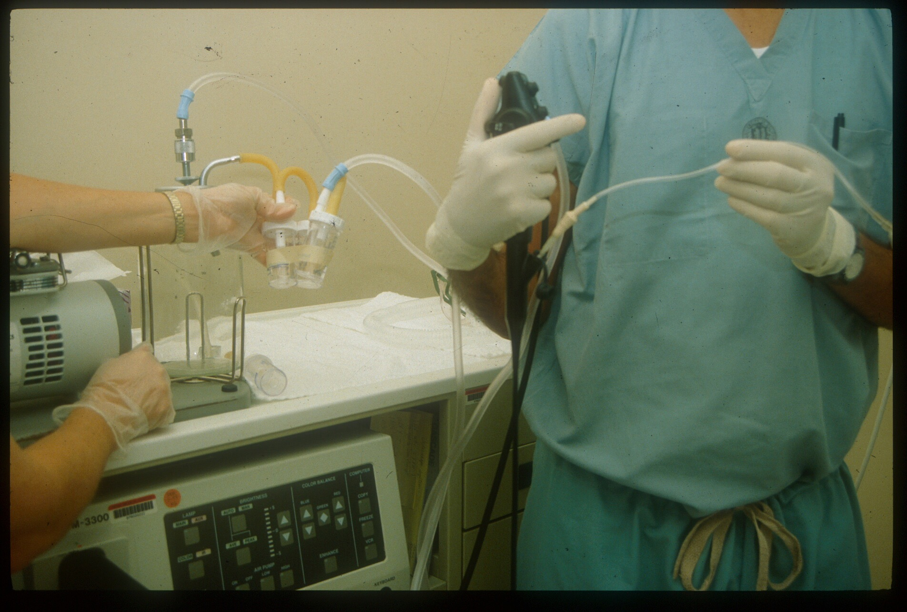
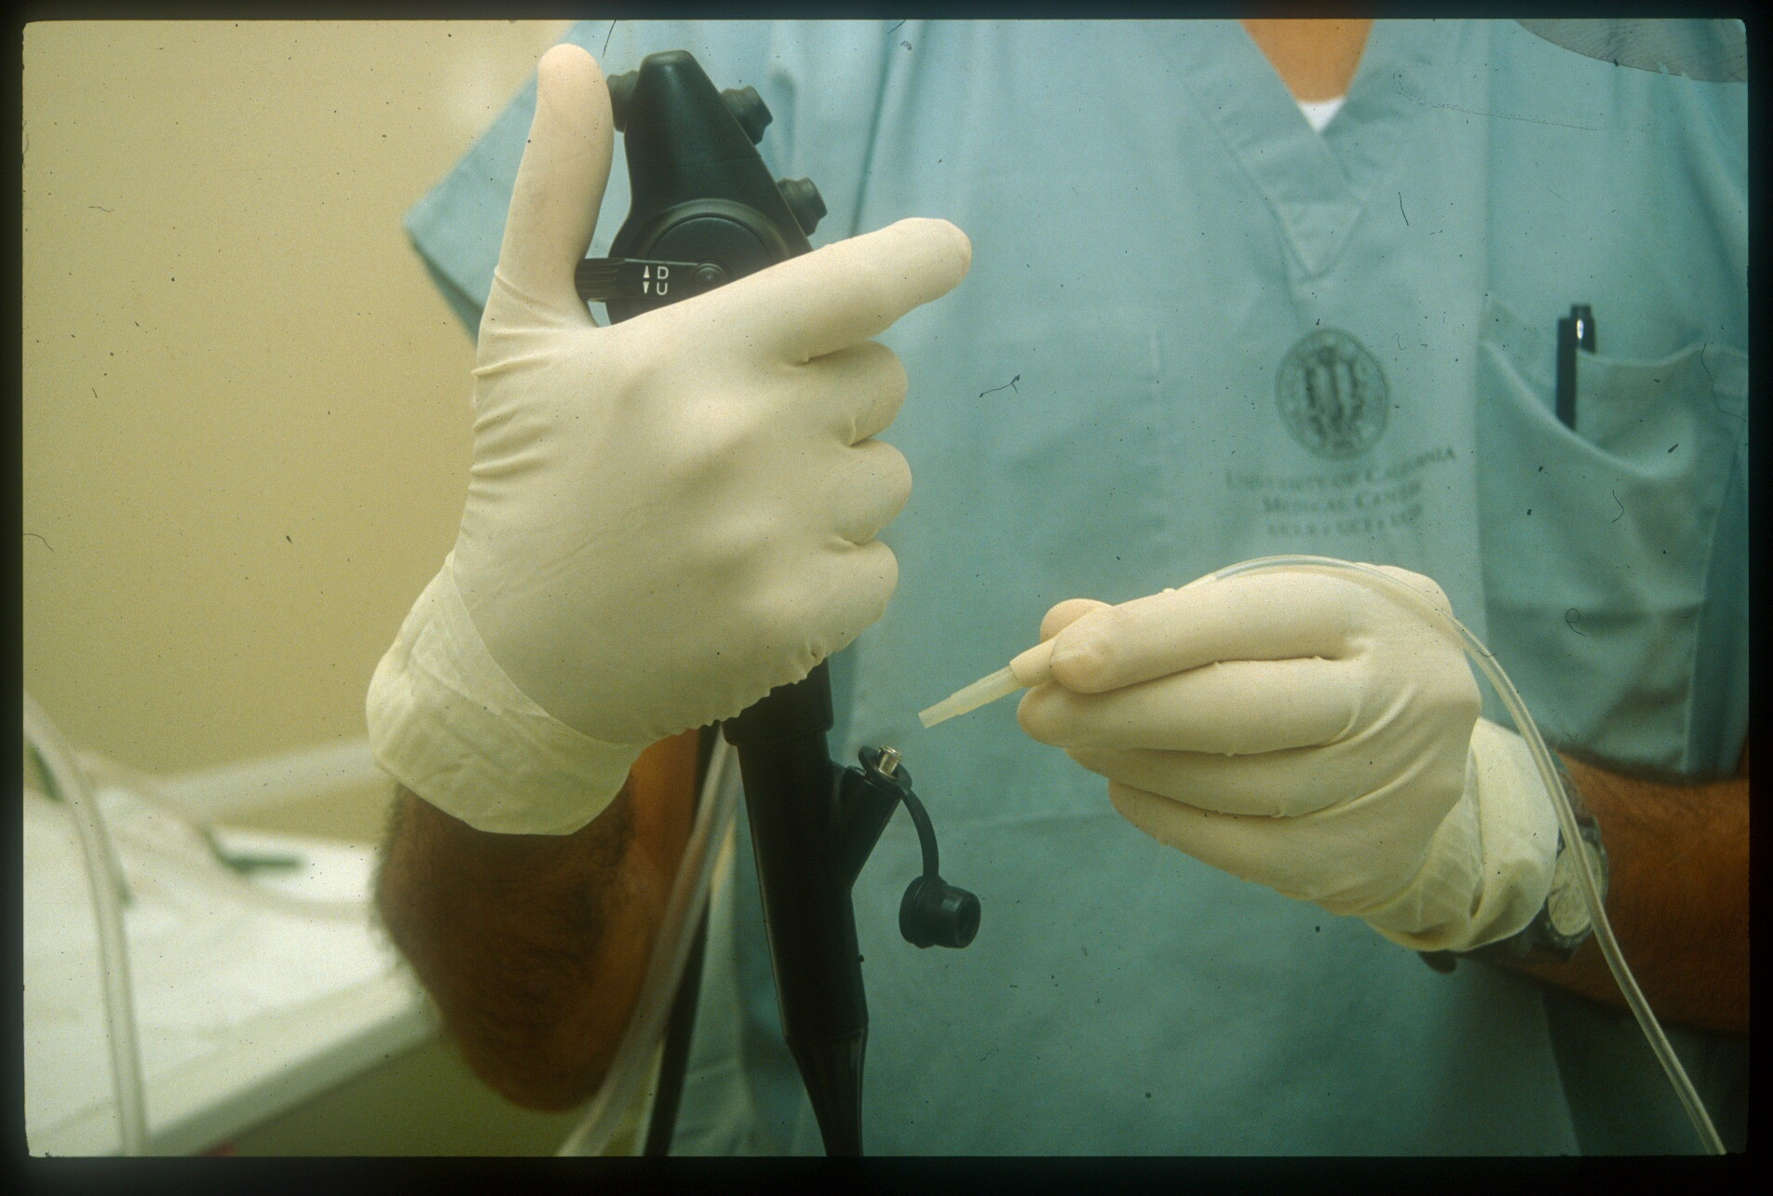
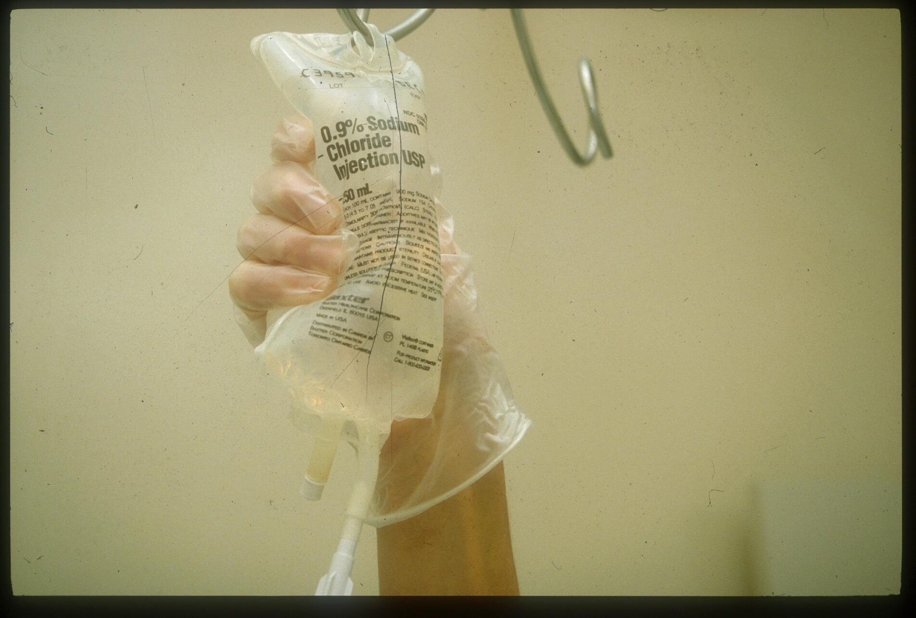
Example of gravity bag technique for BAL
Saline solution is hung, and bag is squeezed to gently deliver saline into target segment
bronchoscopy.org

Slide 13
BAL Techniques
Fluid recovery via suction channel
Hand suction into syringe, gravity flow into a dependent container, or gentle wall suction into a specimen container
Optimal dwell time is unknown
Some use slow deep inspiration with instillation and slow exhalation with recovery
Recovery is better with larger instilled volumes
First aliquot often recovers < 20% of volume
Subsequent aliquots recover 40-70% of volume
Aliquots are usually pooled together (often excluding the first aliquot because it contains mostly bronchial cells)
bronchoscopy.org

Slide 14
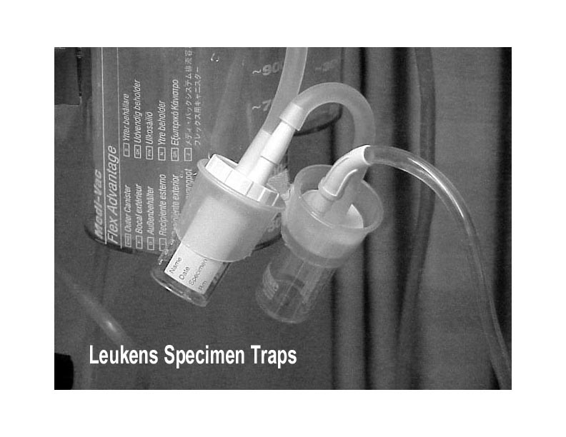
TRUE or FALSE: Bronchoalveolar Lavage Fluid return is usually greatest in smokers
bronchoscopy.org

Slide 15
FALSE
BAL fluid return is less is smokers than in nonsmokers (in whom one might expect to retrieve about 40-60 percent of the fluid instilled).
Techniques to help maximize fluid return:
Instruct patients to breathe deeply during fluid instillation and suctioning
Wedge the bronchoscope deep inside the segmental bronchus
Use suction pressures less than 120 cm H₂O (consider manual suction rather than wall suction for example)
bronchoscopy.org

Slide 16
BAL fluid return is also enhanced by
Targeting the middle lobe or the lingula in case of diffuse disease
Preferential selection of nondependent abnormal areas in case of localized disease
BAL fluid return video
bronchoscopy.org

Slide 17
Diagnostic yield for BAL
Characteristic cellular patterns in numerous diseases
Several ILD have distinct findings on BAL
Well-defined cellular patterns for smokers, former smokers, and nonsmokers
More specific yields in:
Malignancy
Infection (Pneumocystis in HIV 96-98%)
Hemorrhage
Alveolar proteinosis
Fat embolism
Lipoid pneumonia
Silicosis/berylliosis/asbestos
Eosinophilic lung disease
Others
BI

Slide 18
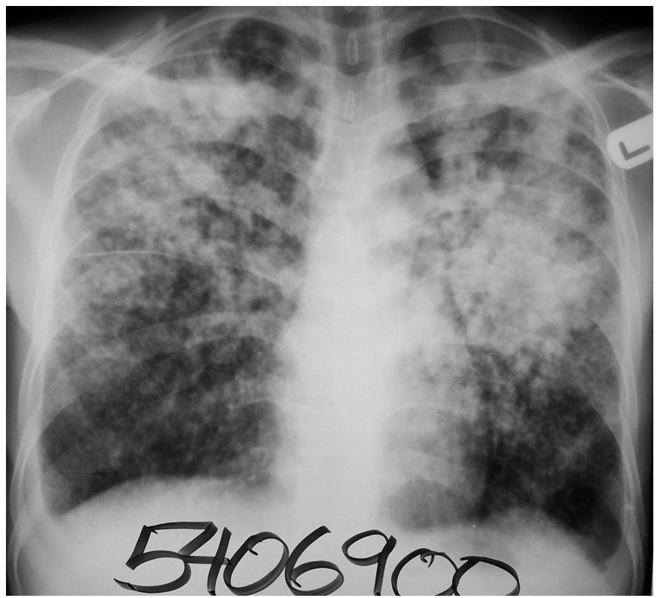
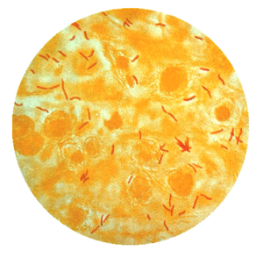
True or False: Bronchoscopy with BAL is superior to sputum induction to rule out Tuberculosis
bronchoscopy.org

Slide 19
FALSE
Induced sputum is equivalent to bronchoscopy with BAL for routine evaluation of suspected Tuberculosis.
Anderson et al
Patients unable to expectorate or sputum negative. 3% saline followed by bronchoscopy. 26 had TB, 20 cases positive on sputum, 19 cases positive on bronchoscopy. Sensitivity: 73% bronchoscopy, 77% sputum.
Conde et al
143 patients with confirmed TB. Diagnosis based on Single sputum induction in 66%, BAL 72%. This was Regardless of HIV status.
Saglam et al
HIV negative patients with suspected TB. Initially smear negative. Sputum induction smear positive 47%, culture positive 63%. Bronchoscopy smear positive in 53% and culture positive in 67%.
McWilliams et al
Prospective study. Patients initially smear negative, 3 sputum inductions, if negative then bronchoscopy with BAL. 42 cases of TB. 27 TB patients went through all phases. 96% were positive on induced sputum. 52% positive on bronchoscopy with BAL. Only 1 positive using bronchoscopy alone. 13 positive with sputum induction alone and 13 were positive using both modalities.
bronchoscopy.org

Slide 20
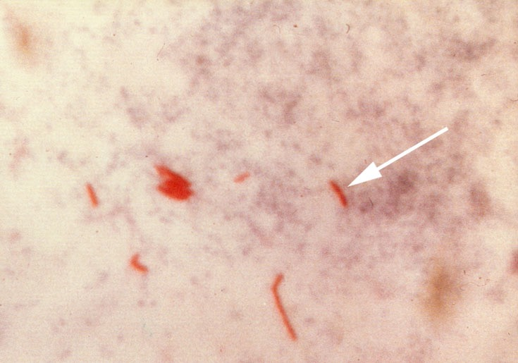
Induced sputum versus BAL for detection of Acid Fast Bacilli Smear
AFB (shown in red) are tubercle bacilli
bronchoscopy.org

Slide 21
Induced Sputum vs BAL
*Induced sputum vs BAL
sensitivity 34% vs 38%
specificity 100% vs 100%
positive predictive value 100% vs 100%
negative predictive value 53% vs 55%
These patients were able to participate in sputum induction.
Multiple (up to 3) induced sputum samples should be obtained
*Conde MB; Soares SL; Mello FC. Comparison of sputum induction with fiberoptic bronchoscopy in the diagnosis of tuberculosis: experience at an acquired immune deficiency syndrome reference center in Rio de Janeiro, Brazil; Am J Respir Crit Care Med 2000 Dec;162(6):2238-40.
bronchoscopy.org

Slide 22
Induced Sputum vs BAL
Bronchoscopy should only be done after induced sputum x 3 are negative, or in patients unable to provide inducible sputum because:
There are risks to pt/staff.
There is limited availability of bronchoscopy in many countries.
M Brown, H Varia, P Bassett, et al. Prospective study of sputum induction, gastric washing, and bronchoalveolar lavage for the diagnosis of pulmonary tuberculosis in patients who are unable to expectorate. Clin Infect Dis. 2007 Jun 1;44(11):1415-20
bronchoscopy.org

Slide 23
BAL in Lung Cancer
BAL usually performed in setting of peripheral, endoscopically nonvisible lesions
Cytology positive in about 25% with peripheral lesions
Increases to 70% in patients with endoscopically visible lesions
Higher yield with infiltrates as opposed to nodules
Bronchoalveolar cell carcinoma: most readily identified primary lung cancer
Positive cytology approaching 90%
Can also detect metastatic malignancy
Melanoma, soft tissue sarcoma, and malignancies of breast, GI, and pancreas, as well as help diagnose lymphangitis carcinomatosis.
bronchoscopy.org

Slide 24
BAL in immuno-suppressed patients
Diagnostic Yield | HIV | Stem cell transplants Chemotherapy | Solid organ Transplants | Other s | Total
Bacteria | 202 (48%) | 74 (20%) | 45 (26%) | 37 (37%) | 358 (34%)
Mycobacteria | 63 (15%) | 0 | 0 (0%) | 1 (1%) | 64 (6%)
Aspergillus | 1 (0.2%) | 10 (3%) | 6 (4%) | 3 (3%) | 20 (2%)
CMV | 119 (28%) | 45 (12%) | 46 (27%) | 23 (23%) | 233 (22%)
Other viruses | 37 (9%) | 16 (4%) | 23 (13%) | 7 (7%) | 83 (8%)
PCP | 110 (26%) | 13 (4%) | 25 (15%) | 8 (8%) | 156 (15%)
Total BAL | 420 | 374 | 173 | 99 | 1066
Joos L et al. Pulmonary infections diagnosed by BAL: A 12-year experience in 1066 immunocompromised patients. Respir Med. 2006
bronchoscopy.org

Slide 25
BAL – related complications and adverse events
Hypoxemia
Fever in 25-50 %
Usually resolves in a few hours and after administration of antipyretics.
Increased density on chest radiograph or CT
Crackles and alveolar infiltrates may last up to 24 hours
Decrease in spirometry
Pneumothorax
Increases mean airway pressures (in ventilated patients)
bronchoscopy.org

Slide 26
Other complications of BAL
BAL specific bleeding 0.7%¹
Complication rates similar to those of inspection flexible bronchoscopy
Mortality 0.01 -0.04%
Major complications < 1%
Fever, bleeding, infection, arrhythmia, respiratory depression, vagal reactions, pneumothorax, bronchospasm, bacteremia
Decrease in pa02 is common and worse when larger BAL volumes are used.
Small series of critically ill pneumonia patients experienced high fever with decreased MAP and pa02*
1CHEST 1981;80:268-271 BAL in ILD *Intensive Care Med 1992;18:6
bronchoscopy.org

Slide 27
Safety of BAL
Studies show that BAL is usually safe in patients with asthma, AIDS, ARDS, mechanical ventilation, and thrombocytopenia when appropriate technique and patient safety precautions are use.
bronchoscopy.org

Slide 28
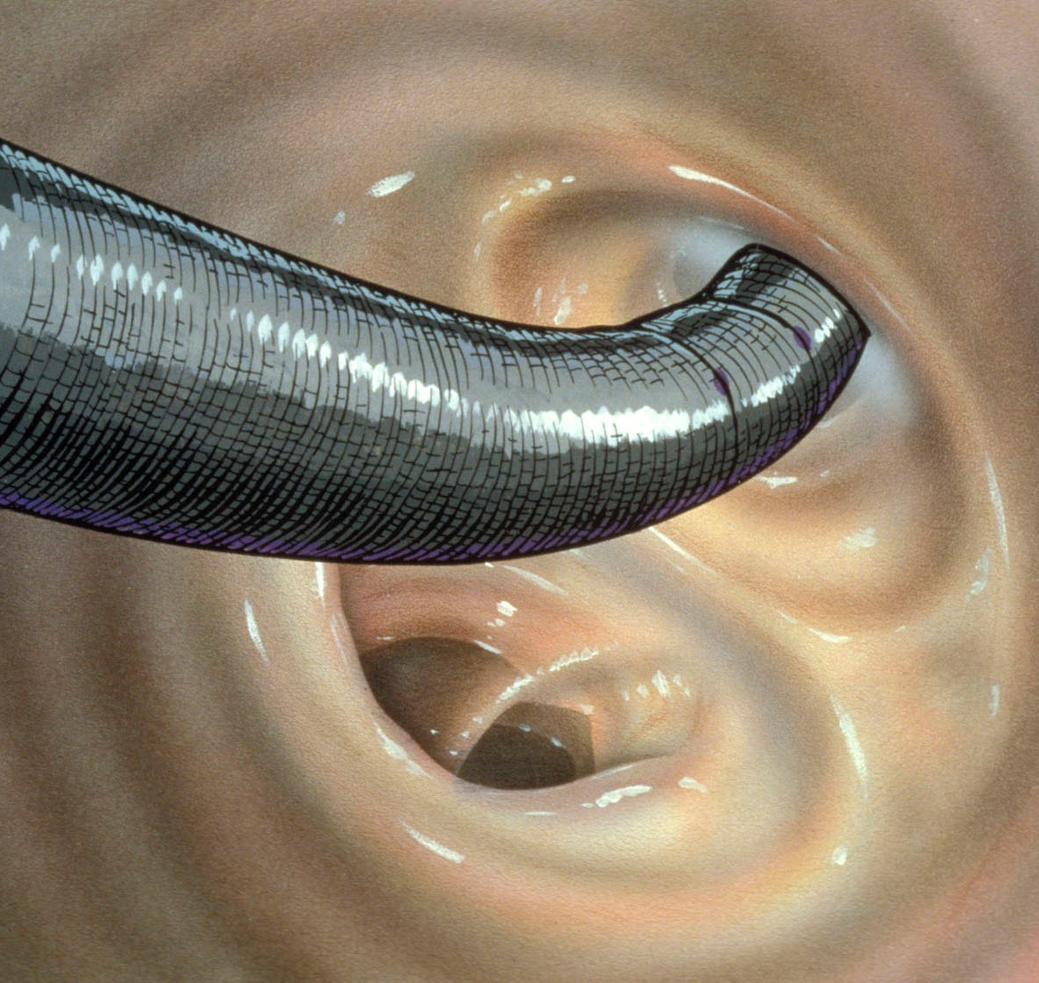
Helpful reminders for BAL
Avoid rapid “trumpet playing”
Instead, suction gently and slowly
Keep scope in the midline
Avoid cough
Decreased recovery in
COPD (correlates with worsening FEV1/FVC)
Advanced age, smokers versus nonsmokers
Mechanical ventilation
When scope is over-wedged
Acknowledge an inadequate sample
Less than 10% of instilled volume
Greater than 2% columnar epithelial cells
Good wedge where airway remains visible
Am Rev Respir Dis 1985;132:254-260
bronchoscopy.org

Slide 29
Additional reminders for BAL
Ask patients to inhale or to hold their breath during fluid instillation.
Use conscious sedation to improve patient comfort.
Review the airway-computed tomography image correlations during procedural planning.
Inform bronchoscopy assistants of the plan.
Use instructions such as “traps on” and “traps off” to retrieve samples and to communicate with assistants.
Inform cytologist and microbiologists of indications for the procedure.
bronchoscopy.org

Slide 30
www.Bronchoscopy.org
Prepared with help from Udaya Prakash M.D. (USA), Atul Mehta M.D. (USA), and Wes Shepherd M.D. (USA)

