Slide 1
Fundamentals of Flexible Bronchoscopy Transbronchial lung biopsy: Indications, Equipment, and Techniques
www.Bronchoscopy.org

Slide 2
Training is essential in order to learn
Techniques and indications
To obtain adequate tissue for diagnosis
To avoid patient suffering (cough, anxiety, agitation, shortness of breath, prolonged procedures, excess sedation).
How to protect equipment and patients
How to avoid procedure-related complications.
bronchoscopy.org

Slide 3
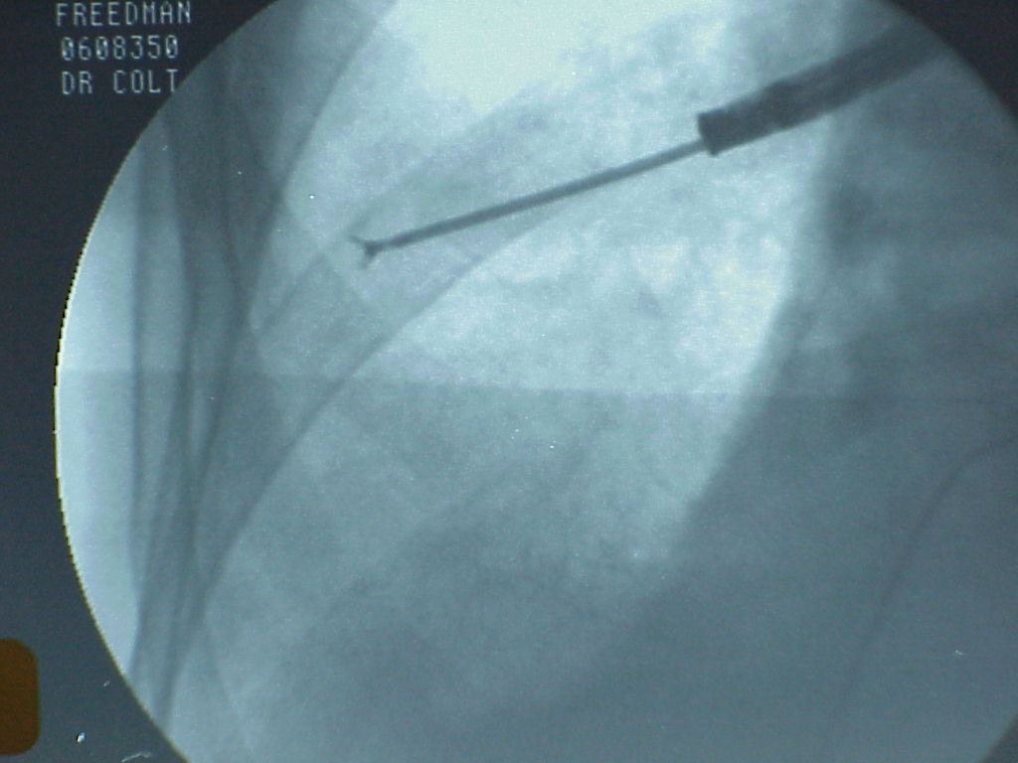
Equipment
Indications
Techniques
Summary of expected yield
Summary of complications
bronchoscopy.org

Slide 4
History
TBLB began to replace open lung biopsy in 1970’s in selected patients.
TBLB was originally considered very high risk
TBLB was originally performed in the operating theater .
TBLB performed by pulmonologists faced substantial opposition by surgeons.
TBLB was performed after endotracheal intubation.
Early history of TBLB was marked by frequent of bleeding, pneumothorax or respiratory failure.
bronchoscopy.org

Slide 5
TBLB today
Performed as outpatient procedureS in a bronchoscopy suite.
Performed using conscious sedation and topical anesthetic.
Fluoroscopy eliminates need for post-procedure chest radiograph and may increase patient safety.
Because most TBLB-related pneumothoraces occur during or immediately after TBLB, patients should probably be kept under observation for at least 1-2 hours after TBLB. A chest radiograph should be obtained if symptoms are present.
bronchoscopy.org

Slide 6
Indications: When to perform TBLB
Usually, only after results from other bronchoscopic procedures such as BAL are negative, nondiagnostic, or considered not helpful depending on differential diagnosis.
Usually, only when results from TBLB will have an impact on disease management.
Usually, only when risks of the procedure are satisfactorily understood by patients or family.
bronchoscopy.org

Slide 7
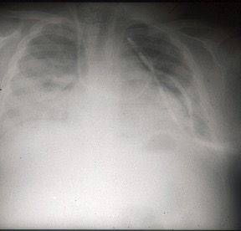
Specific indications for TBLB
Diffuse and localized lung infiltrates suggestive of
Infectious lung disease (with negative or non helpful BAL)
Interstitial lung disease
Carcinoma or lymphoma
Pulmonary nodules and masses
bronchoscopy.org

Slide 8
Contraindications to TBLB
Inadequate equipment
Insufficient training to assure efficacy and patient comfort and safety
Coagulopathy, patient on anticoagulation
Thrombocytopenia
Uremia (increases risks of bleeding)
Pulmonary hypertension (may increase bleeding risk)
Undue risk for respiratory failure or death in case of TBLB-related pneumothorax or bleeding
Examples: History of pneumonectomy, impending respiratory failure, poor lung function.
bronchoscopy.org

Slide 9
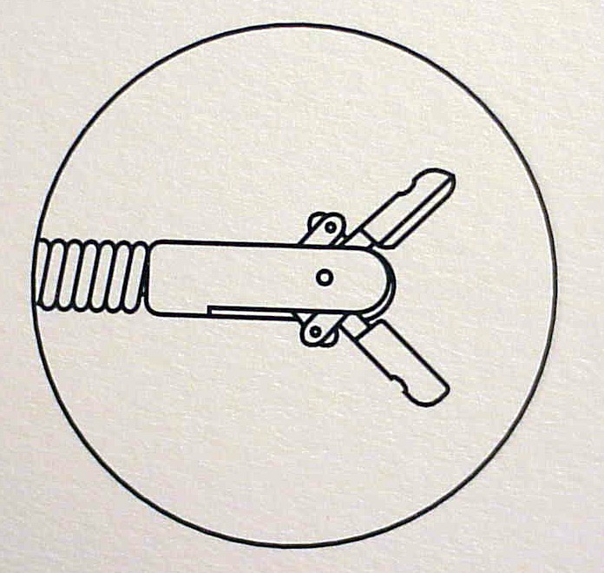
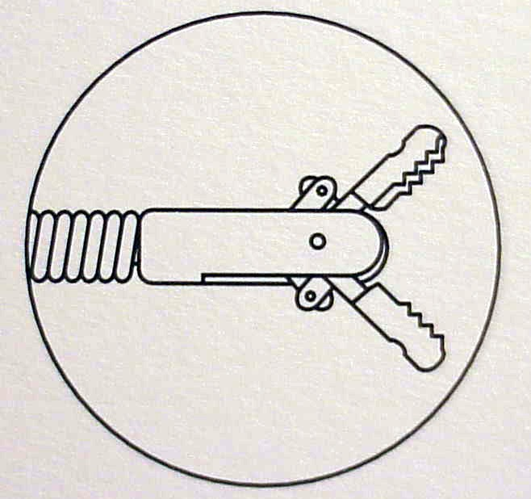
Equipment: Types of Forceps
Cup
Toothed
BI

Slide 10
Fluoroscopy is often used for TBLB
Frequency of pneumothorax possibly increased if fluoroscopy is not used.
Avoids causing pleuritic chest pain with forceps.
Avoids need for post bronchoscopy radiograph because fluoroscopic examination at end of procedure determines presence or absence of TBLB-related pneumothorax.
Improves physician ease, comfort, and security
Used routinely by 75% of doctors in the USA.
BI

Slide 11
Other advantages of fluoroscopy
Prevention of pneumothorax
Position of forceps in relation to pleura is visualized
Ability to obtain biopsies from localized infiltrate
Possibility to accelerate procedure
Avoid looking through the bronchoscope
Guidance possible using fluoroscopy image only, therefore scope can be wedged and forceps can be viewed using fluoroscopy only.
BI

Slide 12
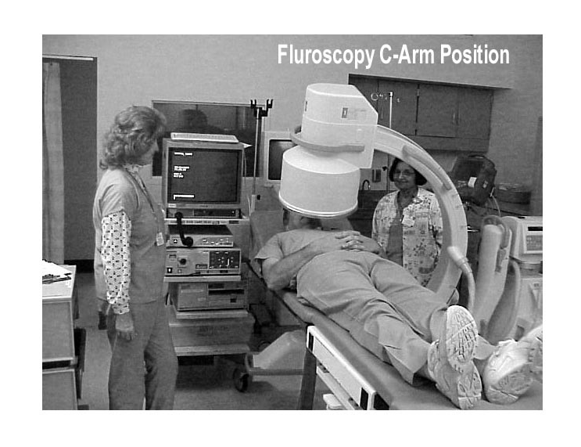
Fluoroscopy-assisted TBLB
Position C-Arm first
Test before starting bronchoscopy
Be sure abnormalities can be seen on fluoroscopy
Bronchoscopist should operate machine to avoid excess radiation
Be certain that there is enough room in procedure area to assure patient safety in case of complications.
Remove machine after biopsies
Avoids need for post procedure radiograph
BI

Slide 13
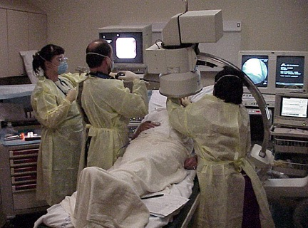
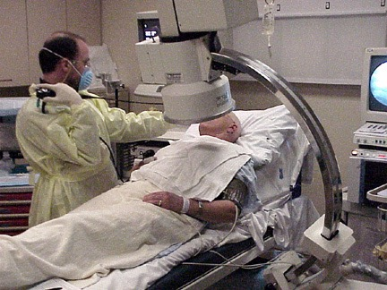
With fluoroscopy
Patients can be done supine or partially sitting
Forceps are easily inserted by the assistant into the bronchoscope if the scope is held “over the shoulder”
BI

Slide 14
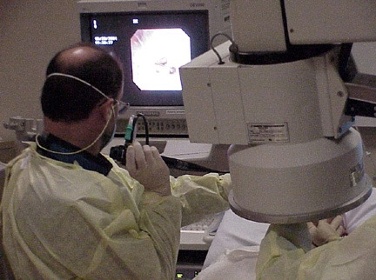
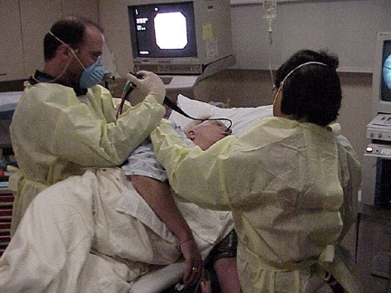
Fluoroscopy-assisted TBLB
Once the scope is wedged, the Bronchoscopist watches the forceps using fluoroscopy only, and does not need to look through the bronchoscope until after all specimens are obtained
In case of bleeding, the scope is kept wedged, suction is applied, and the patient is turned into the lateral safety position, bleeding side down.
BI

Slide 15
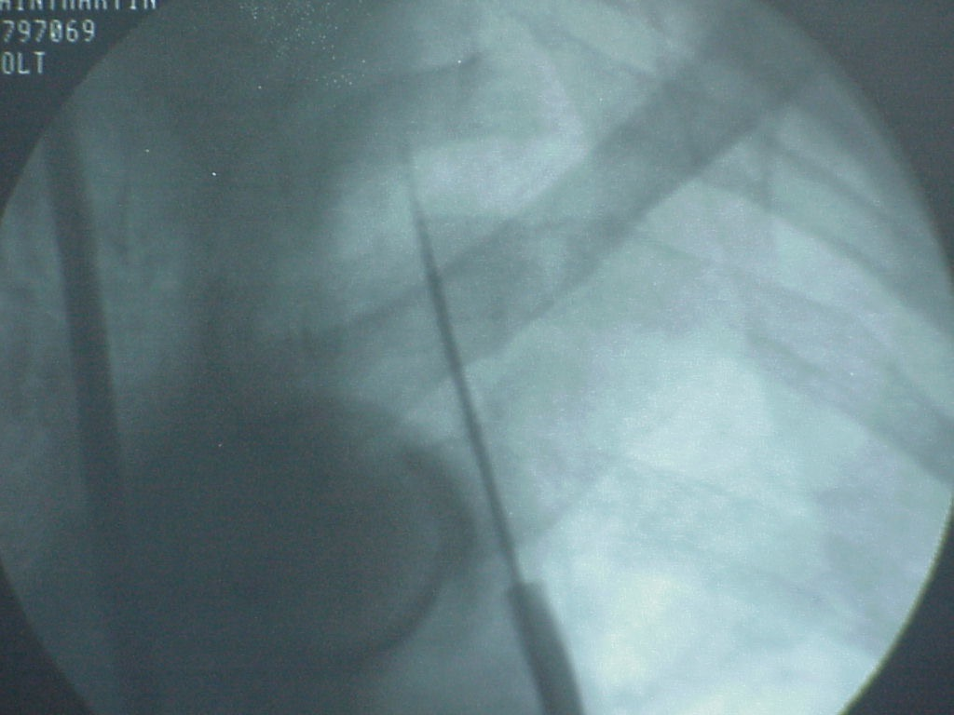
Techniques of TBLB
TBLB of the Right Lower lobe infiltrate, forceps open via lateral basal segment.
TBLB of apical-posterior segment Left Upper Lobe, forceps still closed
BI

Slide 16
Manipulating the Bronchoscope during TBLB
Wedge technique
Keeps scope in optimal position
Allows suction and tamponade in case of bleeding
Full view technique
Keeps segmental airways in view
Ability to better visualize bleeding if it occurs and to control patency of contra lateral lung
Ability to guide forceps into multiple specific segments
BI

Slide 17
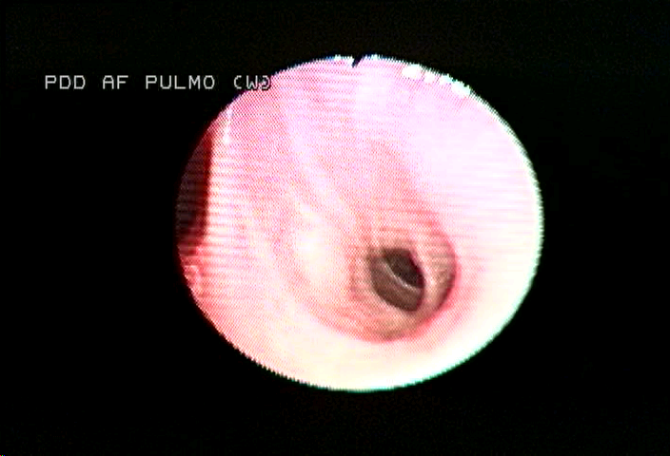
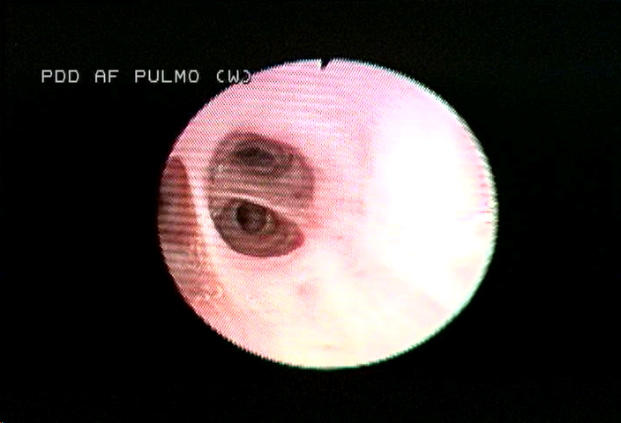
Full view and wedge techniques of TBLB
Full view technique
The scope is kept in a more proximal segmental bronchus
Wedge technique
The scope is wedged distally into the target subsegmental bronchus
BI

Slide 18
Wedge and nonwedge techniques of TBLB
Click here to view video presentation nonwedge technique
Click here to view video presentation Wedge technique
Click to continue
BI

Slide 19
Touch and feel technique
Move forceps through working channel of scope.
As forceps becomes visible, begin fluoroscopy (intermittent rather than continuous decreases radiation exposure)
When forceps is at target position, open forceps and shake gently
Insert forceps a bit further until some resistance is felt
Ask the patient to raise a hand if pain is felt
This signals that the forceps is near the periphery of the lung and “touching” the pleura
Often used when fluoroscopy is NOT available
Increases the length of the procedure
Difficult if patients are well sedated
Close forceps, stop fluoroscopy, and withdraw forceps gently into working channel of bronchoscope.
BI

Slide 20
Performing TBLB
When entering the apical segments of the upper lobes, keep the scope in the central airway and using only fluoroscopy to guide the forceps into the appropriate segment.
Seeing the target infiltrate in the retro cardiac and “sub diaphragmatic” regions.
Shaking the forceps if they don’t open immediately
If the scope is “over wedged”, pull forceps back slightly and bring the working channel into the midline and off the bronchial wall to make room for the forceps as it exits the working channel.
Change the angle of the forceps if they do not advance further into the periphery (forceps are probably caught on a spur)
BI

Slide 21
Helpful hints for performing TBLB
Inform the patient that “there are no nerve endings in the airway, so the biopsy itself will not hurt”.
Use conscious sedation to improve patient comfort.
Forewarn the patient to “raise hand” if pain is felt at any time during the procedure.
Prefer biopsies from the lung periphery (as close to the pleura as possible) because bronchial vessels are smaller in the distal airways and forceps are most likely to “pinch” through bronchial mucosa to obtain representative tissue (contains alveoli and bronchioles) from lung parenchyma.
Avoid the lingula and right middle lobe because of proximity to fissures and risk of pneumothorax.
BI

Slide 22
More Helpful hints for performing TBLB
When infiltrates are diffuse and involving the lower lobe, prefer biopsies from the lateral segment because fluoroscopically, the position of the forceps is true in relation to the chest wall.
Patient inhalation as the forceps is opened often allows the operator to advance the forceps further towards the periphery.
Keep the forceps open and advanced into the periphery for as short a time as possible, also keeping fluoroscopy time to a minimum (Usually < 30 seconds per biopsy).
Patient exhalation is followed by closure of the forceps. A quick and short tug is often followed by a patient inhalation.
By advancing the bronchoscope as the forceps is withdrawn, the scope is maintained in the wedge position. There is NO need to pull the forceps quickly up into the bronchoscope.
BI

Slide 23
Summary of complications of TBLB
Pneumothorax
Risk 1-4 %
Bleeding
1.2 – 40% varies with studies and patient population.
Bleeding > 50 ml approximately 1-2%
Increased in uremia and immunocompromised patients
Death
Risk estimated at 0.04 -0.12 %
bronchoscopy.org

Slide 24
How does that compare to flexible bronchoscopy without TBLB ?
Bleeding in only 0.5 - 26 %.
Other adverse events include vaso-vagal reactions, reactions to anesthetics, bronchospasm, cardiac arrhythmias, and pneumothorax.
Mortality 0.01 - 0.05 %.
bronchoscopy.org

Slide 25
Risk of bleeding after Transbronchial lung biopsy
Perhaps a 45 % incidence in uremia (older studies).
< 15% incidence if PLT < 50,000.
Other concerns
Preprocedure laboratory studies often preferred
Importance of individualizing decisions based on H&P, Past medical History, Family History, and risk-benefit analysis.
One may consider stopping aspirin, other antiplatelet agents, and nonsteroidal anti-inflammatory drugs. One should definitely stop Plavix and anticoagulants (except subcutaneous Heparin used for prophylaxis).
bronchoscopy.org

Slide 26
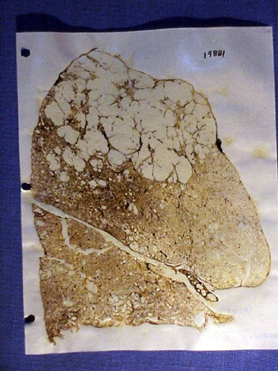
Presumed dangers of TBLB
Biopsies of emphysematous lungs
Biopsies around bullae and blebs
Biopsies of stiff lungs of ILD
Biopsies in vasculitis
Biopsies of the middle lobe or lingula are adjacent to fissures
Biopsies of superior segment of lower lobes are adjacent to fissures
Avoid Non gravity dependent areas (anterior segment upper lobes) because bleeding may be difficult to control in these areas.
Gough section: Upper lobe Emphysema
bronchoscopy.org

Slide 27
Results of TBLB: Diagnostic yield depends on
Bronchoscopist’s experience
Pathologist's experience
Predetermined criteria
if broad: yield > 72%
if narrow < 38%
bronchoscopy.org

Slide 28
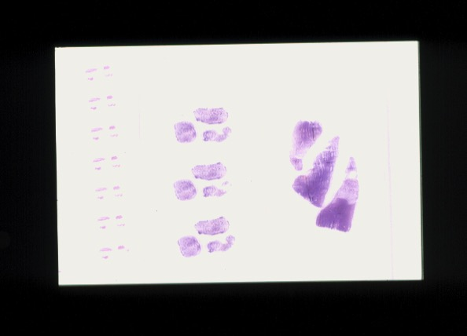
predetermined criteria
Determine when results are accepted and acceptable.
Pathology interpretations may be difficult because of small specimens
TBLB
Forceps
VATS
BI

Slide 29
Number of specimens needed
PCP : at least 2 specimens if chest x-ray is Abnormal, and at least 4 specimens if chest x-ray is Normal (97% yield).
Sarcoid: Stage III, sensitivity increases with number (73-80% yield with at least 4 specimens, and increases further if endobronchial biopsies are done also. For Stage I Sarcoid, up to 10 specimens might be needed.
Transplant and lung rejection: Multiple specimens from multiple lobes are warranted. Yield > 60% for infection of rejection, but only 15 % for BO. Multiple specimens (> 6) are necessary.
BI

Slide 30
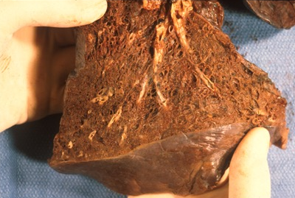
Type of specimen : the Float sign
Float sign definition: Aerated lung floats, but nonaerated lung does not.
BUT, the float sign is not a reliable sign of representative alveolar and bronchiolar tissue.
Remember that increased number of biopsies increases diagnostic yield, but probably increases risk for complications with each biopsy.
Partially aerated lung in patient with severe emphysema and iatrogenic pneumothorax
BI

Slide 31
Size of specimens
Toothed (Alligator) forceps tear the lung more than cup forceps, and may cause more bleeding.
Large forceps obtain more tissue (more alveoli) than small forceps; frequency of bleeding is unchanged compared to smaller forceps.
Am Rev Respir Dis 1993;148:1411-1413
Chest 1992;102:748-752.
BI

Slide 32
Results: Diagnostic yield of TBLB
Nodules > 2 cm
60% for lung cancer, 50% for metastatic disease
Inferior diagnosis in benign disease
AIDS
PCP
Mycobacteria
Kaposi
Kidney transplant and other immunocompromised hosts (poor for aspergillus, CMV, Mucor, Nocardia), but does add up to 10% yield to BAL ?)
Sarcoidosis: Usually > 80%
Interstitial lung disease: A diagnosis of fibrosis is Nonspecific and should be called NONDIAGNOSTIC
bronchoscopy.org

Slide 33
Yield in tumors
Primary tumor: yield > 60%
Metastases yield > 50%
Brushing increases yield
Lesions > 2.0 cm yield > 60 %
Lesions < 2.0 cm yield < 25%
Yields are lower in benign nodules
bronchoscopy.org

Slide 34
Yield in infiltrates
yield is usually > 75 % for
Sarcoidosis
Alveolar proteinosis,
Lymphangitic carcinomatosis
Pneumoconiosis
PCP, CMV
Lung rejection
Bronchoalveolar cell carcinoma
Diffuse pulmonary lymphoma
Hypersensitivity pneumonitis
bronchoscopy.org

Slide 35
www.Bronchoscopy.org

