Slide 1
Fundamentals of Flexible Bronchoscopy Transbronchial lung biopsy: Fluoroscopy and wedge techniques
www.Bronchoscopy.org

Slide 2
Manipulating the bronchoscope during TBLB
Video of TBLB
www.bronchoscopy.org

Slide 3
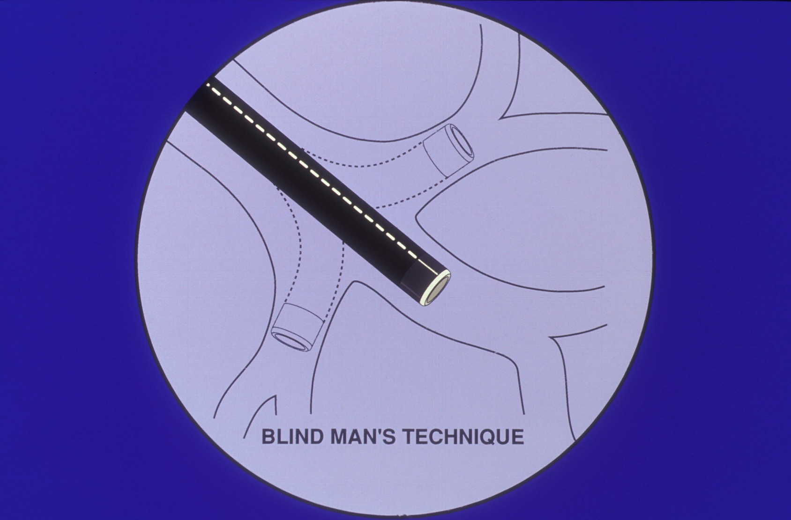
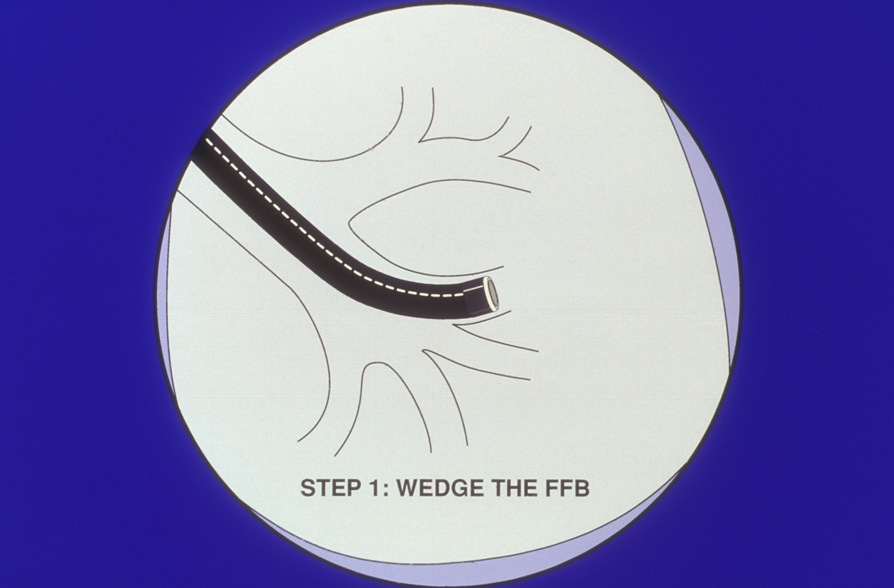
Techniques of TBLB without Fluoroscopy
www.bronchoscopy.org

Slide 4
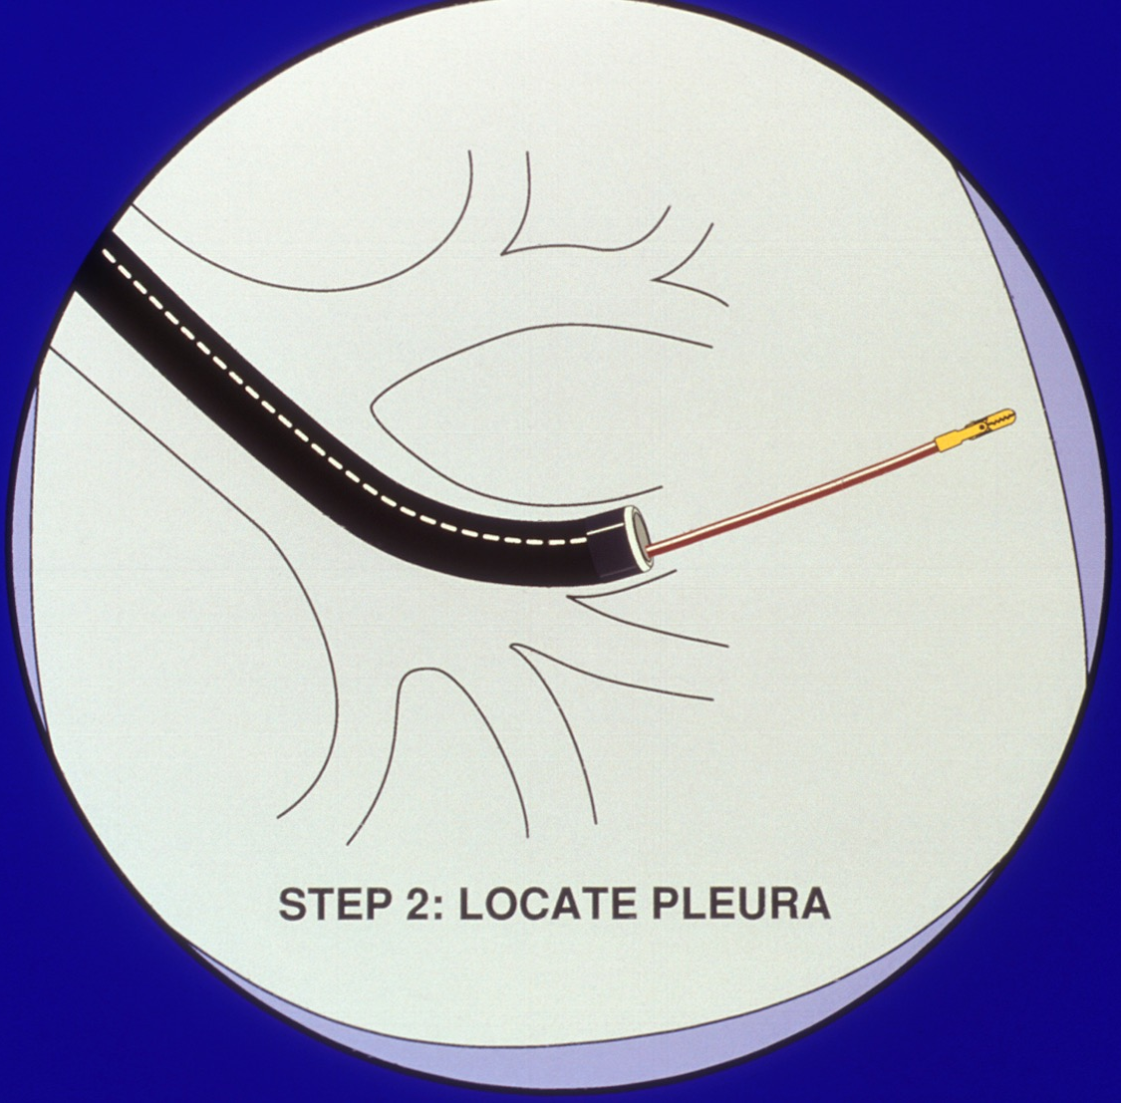
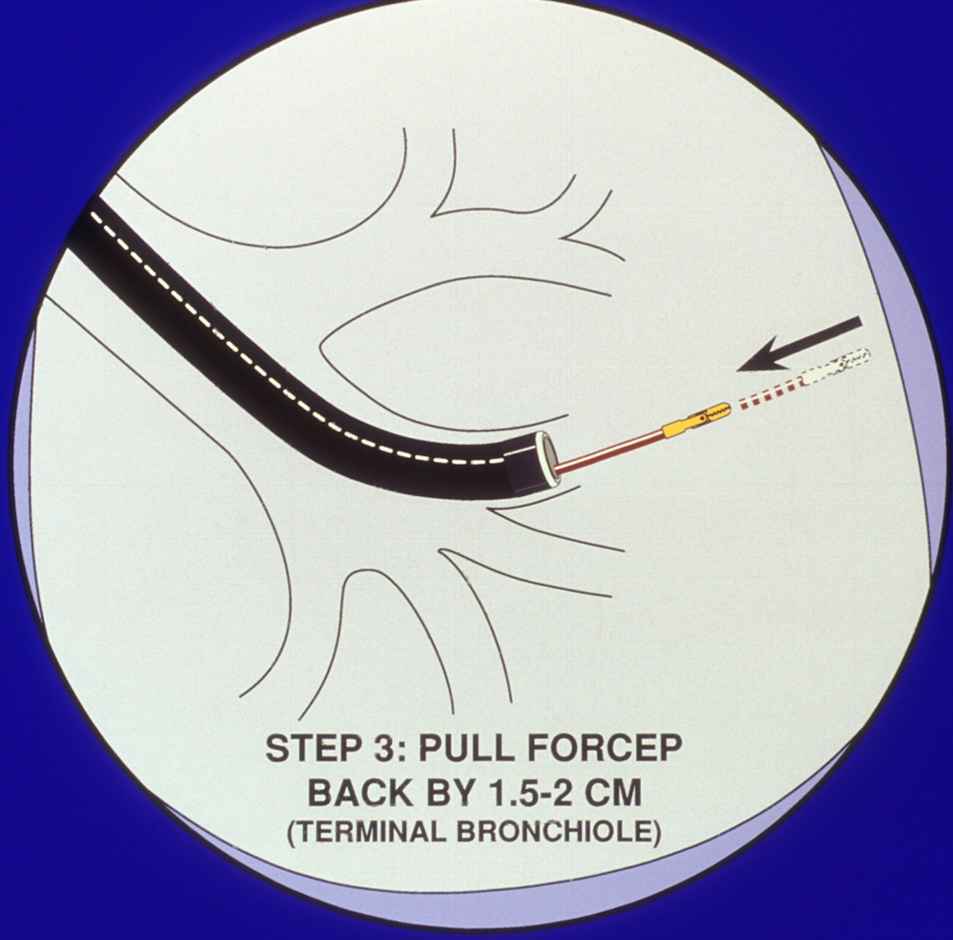
Advance the forceps until gentle resistance is met. Then pull back. Patient may have pain if forceps is out to far
www.bronchoscopy.org

Slide 5
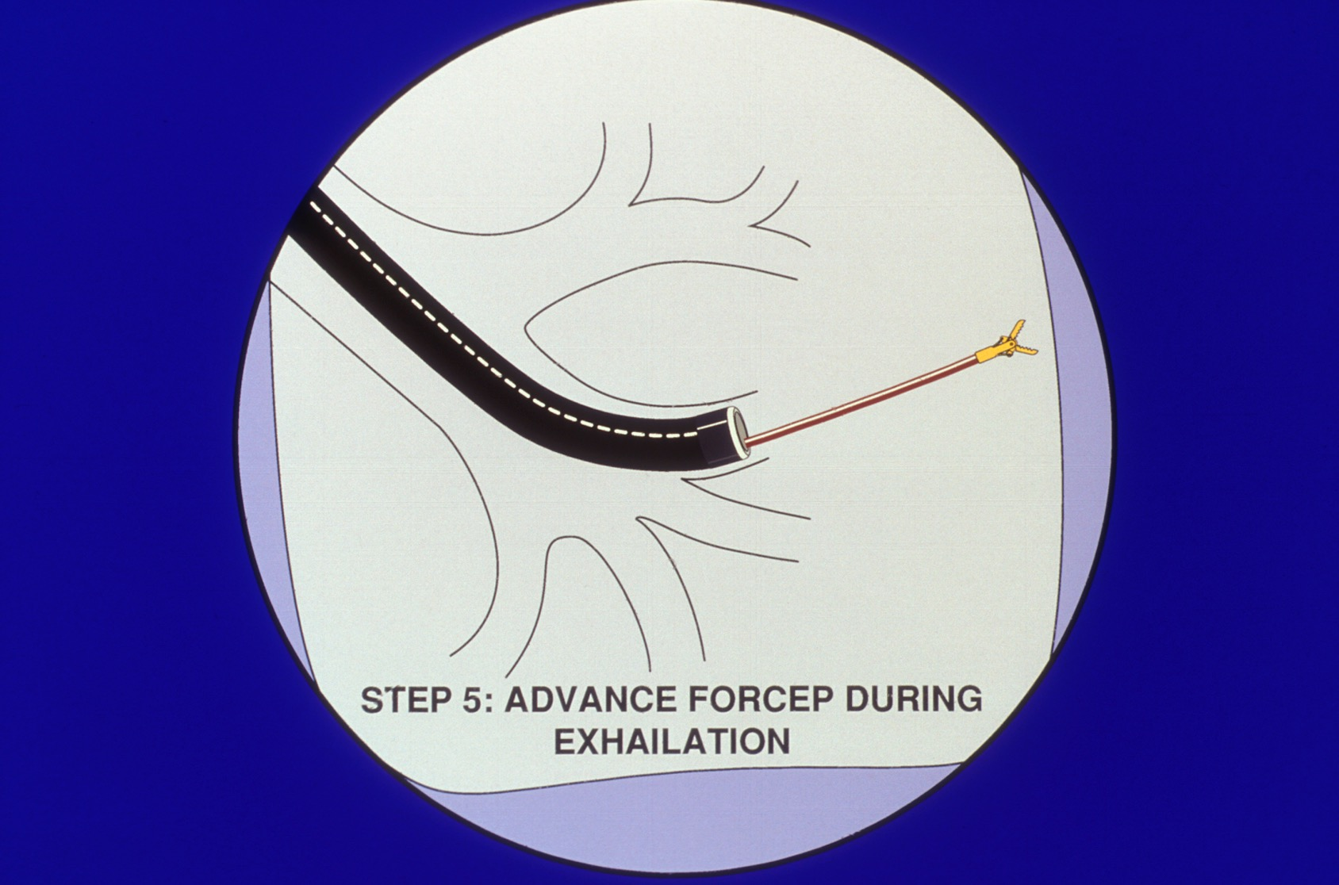
Advance the open forceps again until gentle resistance is met. After closing the forceps, pull back immediately without entering the bronchoscope. Keep the scope wedged.
Exhalation
www.bronchoscopy.org

Slide 6
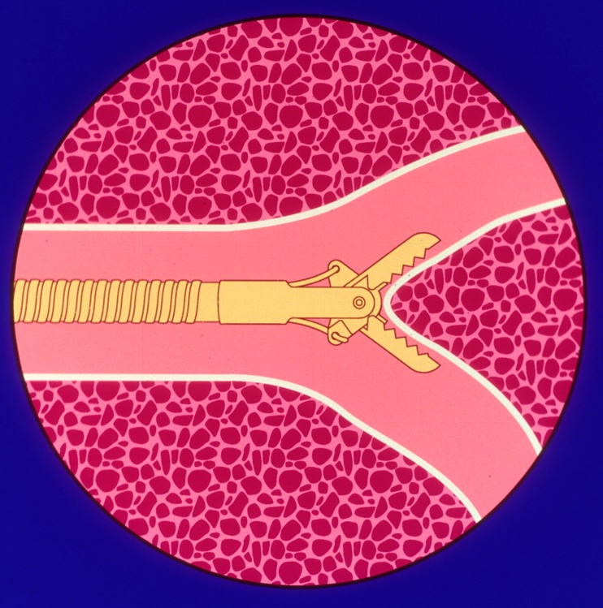
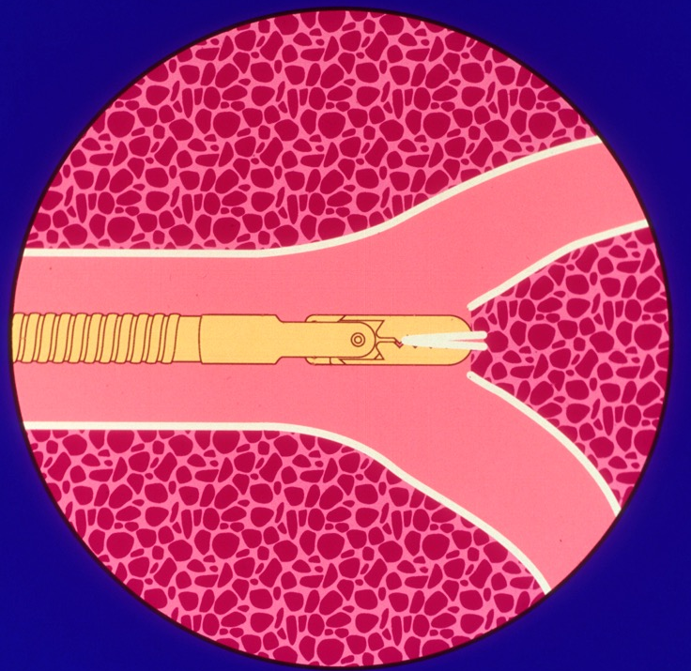
Anchor Forceps at Bifurcation of Respiratory Bronchioles
www.bronchoscopy.org

Slide 7
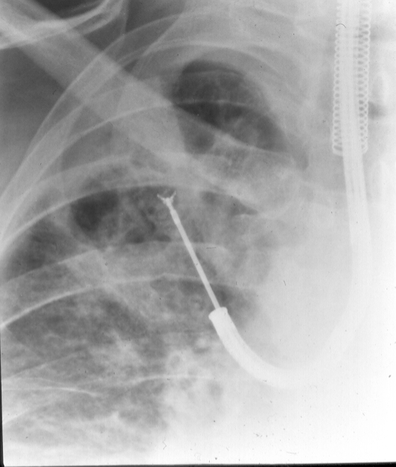
Similar technique is used under fluoroscopic guidance
Usually 4-5 specimens are obtained
Lung parenchyma is obtained by tearing the respiratory bronchioles
Forceps to distal may cause pneumothorax
Forceps too proximal may cause bleeding
www.bronchoscopy.org

Slide 8
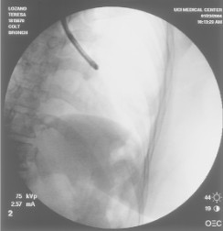
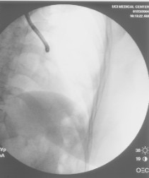
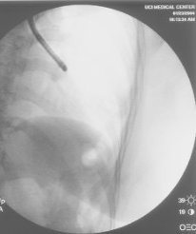
Left lower lobe fluoroscopic guidance
Anterobasal LB 8
Lateral basal LB 9
Posterior basal LB 10
Superior segment LB 6
www.bronchoscopy.org

Slide 9
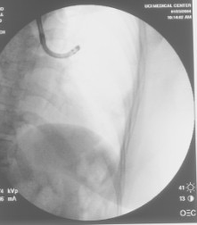
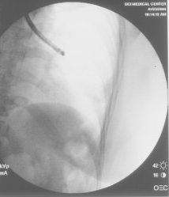
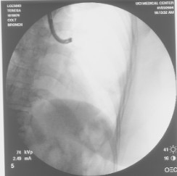
Left upper lobe fluoroscopic guidance
Apical posterior LB 1+2
Anterior segment LB 3
Lingula LB 4+5
www.bronchoscopy.org

Slide 10
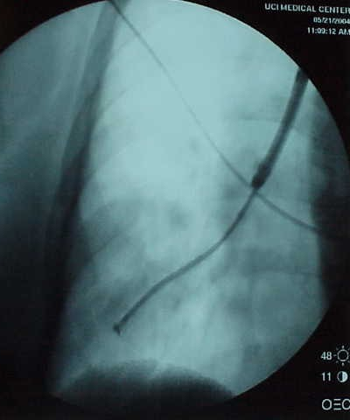
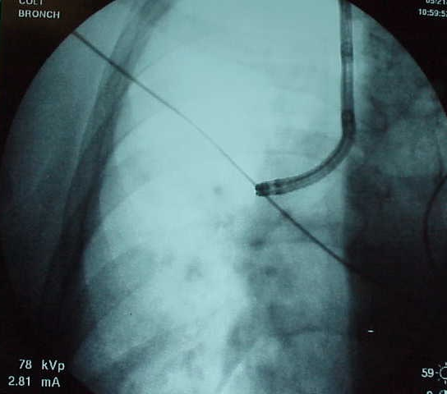
Right lower lobe fluoroscopic guidance
Anterior basal RB 8
Lateral basal RB 9
www.bronchoscopy.org

Slide 11
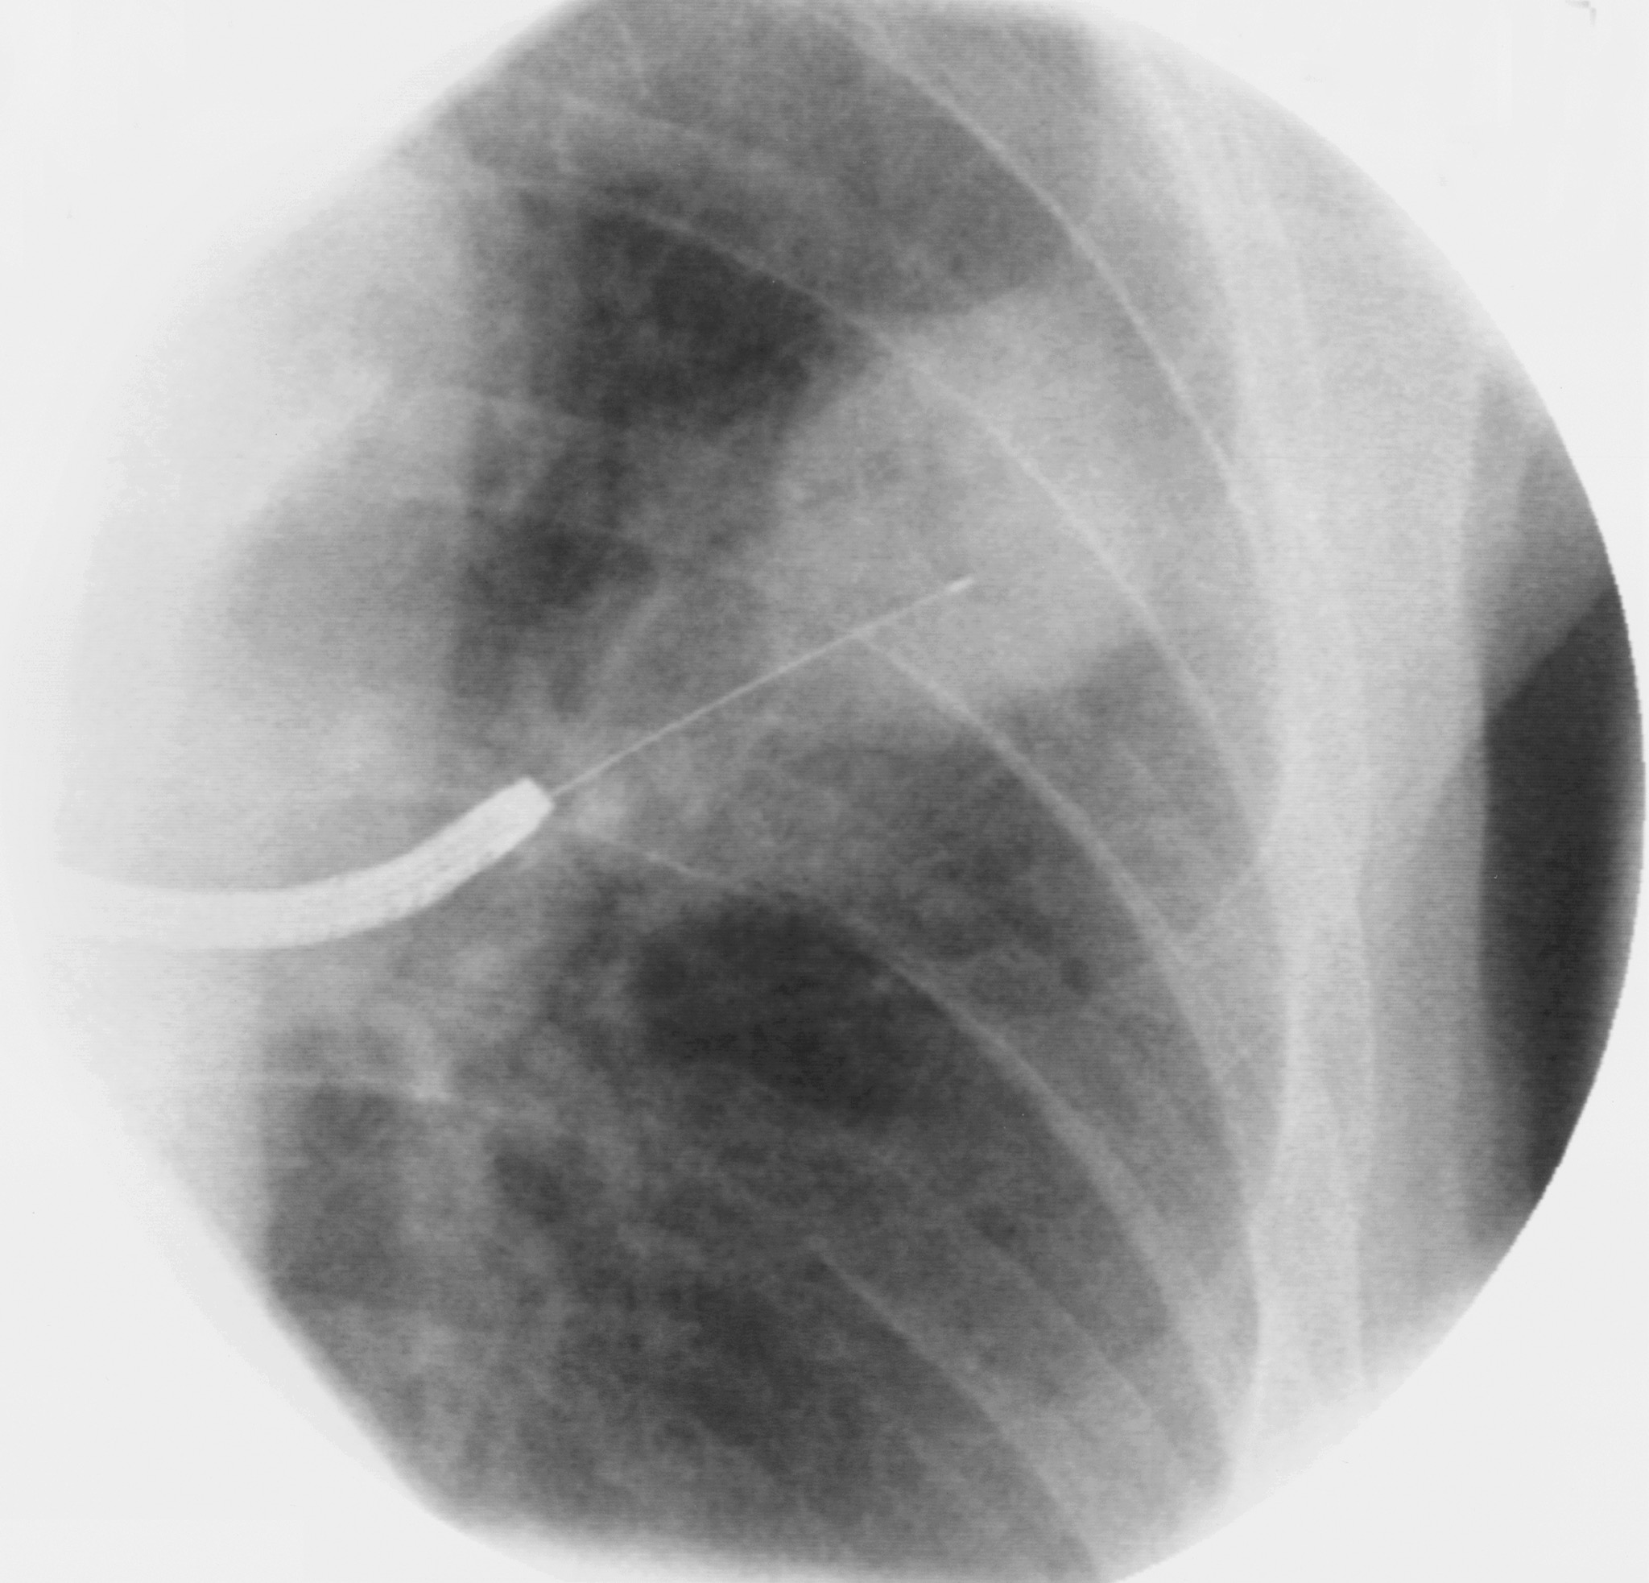
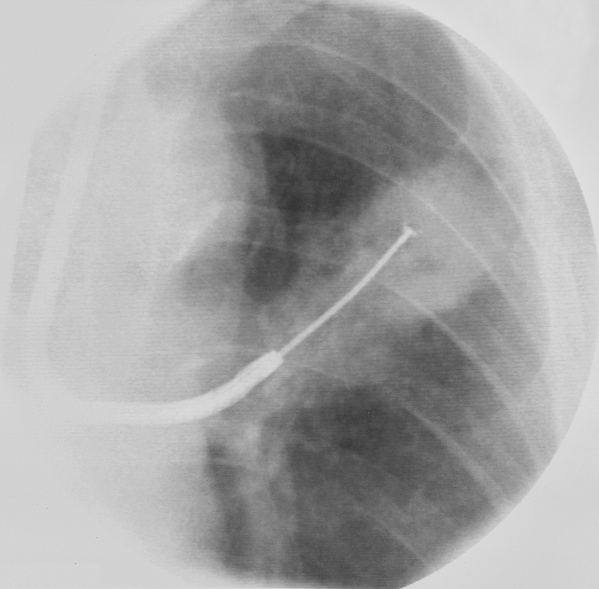
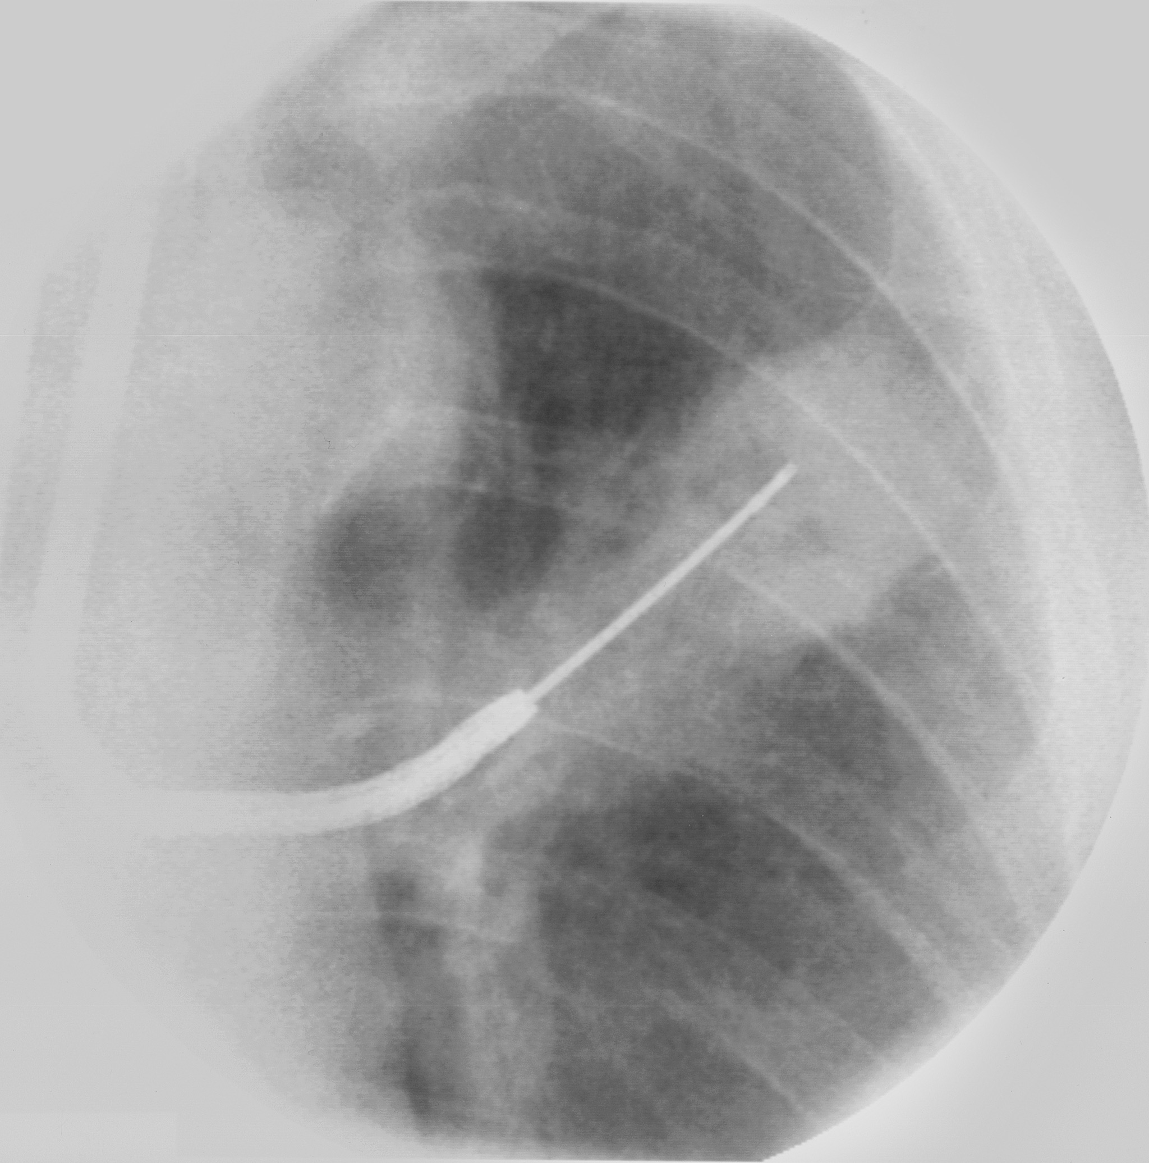
Fluoroscopy is especially useful in case of focal disease
www.bronchoscopy.org

Slide 12
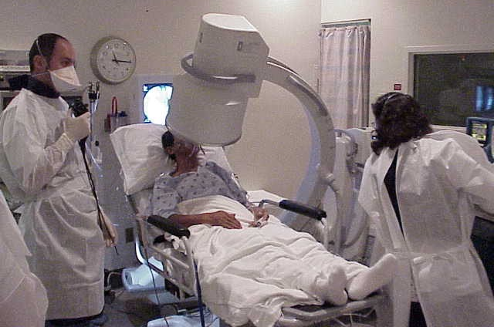
Fluoroscopy can be performed using C-arm with patient supine or sitting
www.bronchoscopy.org

Slide 13
Indications for fluoroscopy
To localize abnormalities
TO help prevent pneumothorax
TO extract foreign bodies
TO perform biopsy or brushing of solitary pulmonary nodules
To improve diagnostic yield
To detect pneumothorax
www.bronchoscopy.org

Slide 14
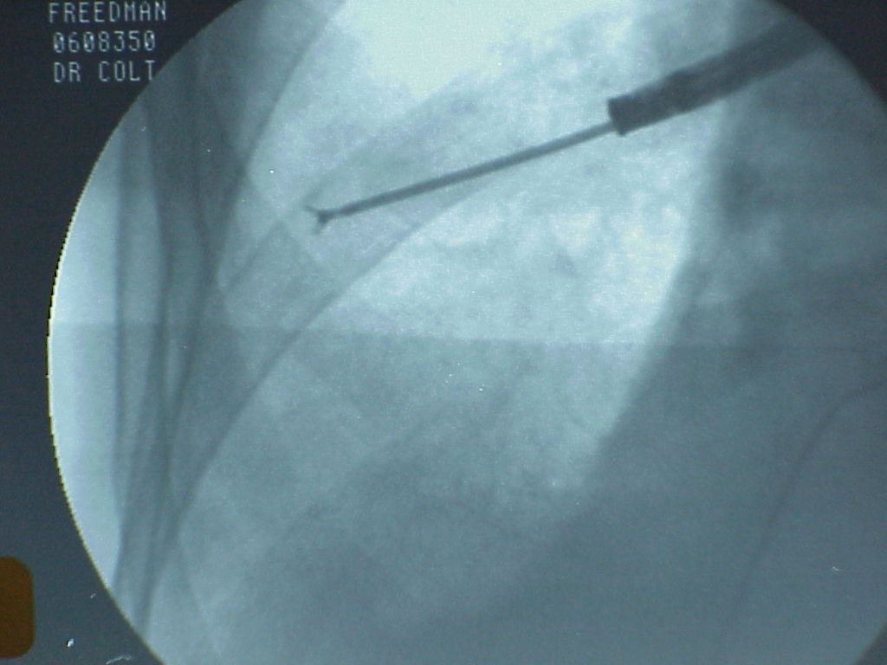
If necessary, forceps can be advanced into various segments. Position is verified using fluoroscopy before biopsies are obtained
Video of forceps probing basal segments
www.bronchoscopy.org

Slide 15
However, TBLB is “safe” without fluoroscopy
Andres G et al, Chest 1988;94:557
TBLB: 122 with & 135 without Fluoroscopy Diagnostic yield higher for focal diseases with Fluoro (pre-CT era), complication rate same
Mulligan S et al, ARRD 1988; 137:486
N=168, Retrospective, AIDS & PCP, yield and complications same
Puar HS, Chest 1985: 87:303
N=68, Sarcoidosis, Yield 76%, 1 Pneumo
Computed tomography scans can help avoids need for double image fluoroscopy
www.bronchoscopy.org

Slide 16
Complications after TBLB
Review of 22 prospective studies of BLB (1974-1991)*
Fluoroscopy employed in 19 studies
BLB PTX Bleed Death
Total (n) 4,252 167 89 5
Percent 4.0 2.1 0.1
* Courtesy: Villeneuve and Kvale in: Textbook of Bronchoscopy
Editors: Feinsilver and Fein, Williams & Wilkins, 1995, page 64
www.bronchoscopy.org

Slide 17
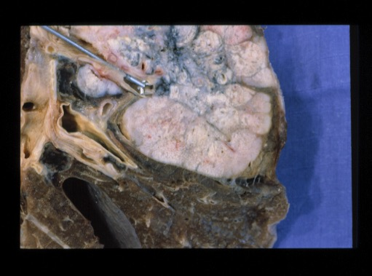
True or False: A chest radiograph should always be performed after TBLB
www.bronchoscopy.org

Slide 18
False. Chest radiographs are not always necessary after TBLB
Fluoroscopy can reveal lung collapse
Pneumothorax occurs in < 3 % of patients.
Chest 2006;129:1561-1564
Among 350 consecutive biopsies, chest radiograph within 2 hours after procedure revealed pneumothorax in 10 patients, 7 of whom were symptomatic
Chest radiographs are probably indicated only in symptomatic patients.
www.bronchoscopy.org

Slide 19
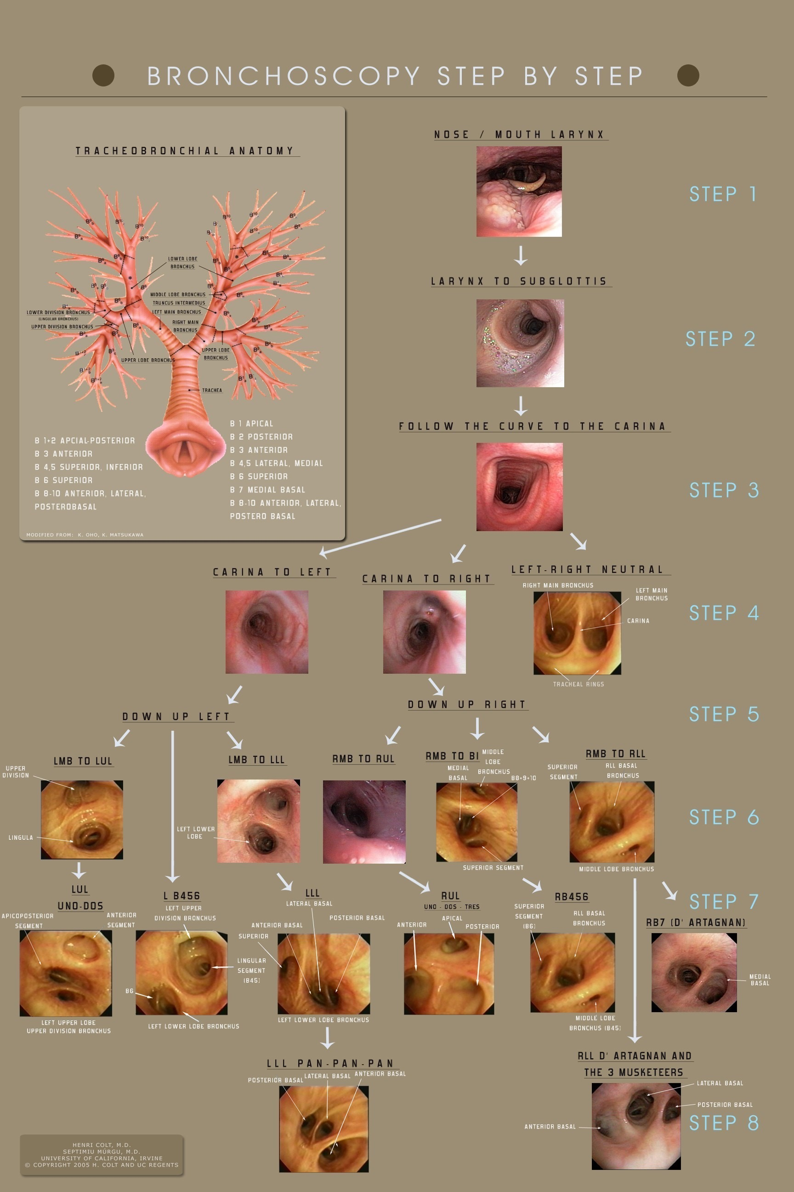
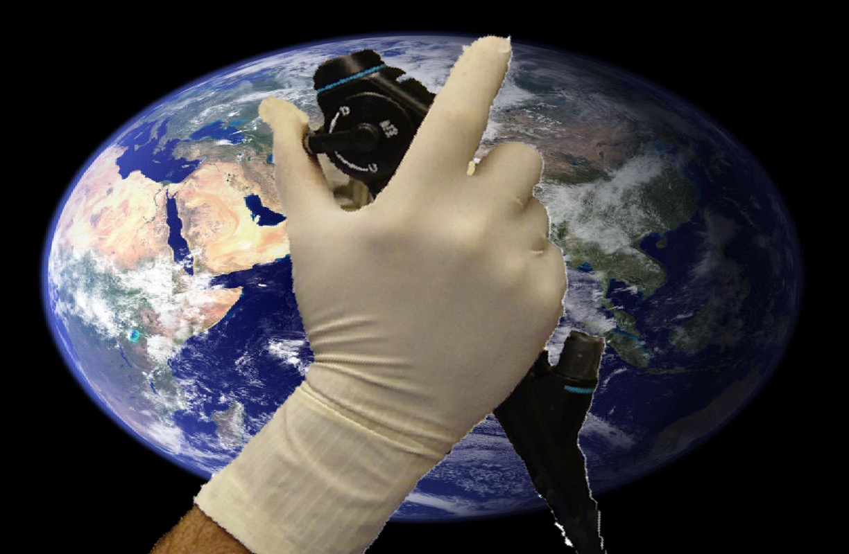
Step by Step©
Fundamentals of Bronchoscopy Multidimensional Curriculum
BRONCHATLAS©
www.bronchoscopy.org

Slide 20
www.Bronchoscopy.org
Prepared with help from Udaya Prakash M.D. (USA), Atul Mehta M.D. (USA), and Wes Shepherd M.D. (USA)

