Slide 1
Fundamentals of Flexible Bronchoscopy Transbronchial lung biopsy: Response to complications
www.Bronchoscopy.org

Slide 2
Generally reported frequency of complications after Transbronchial lung biopsy
Bleeding > 50 ml 1-2 %
Pneumothorax 1-4 %
Death 0.04 - 0.12 %
www.bronchoscopy.org

Slide 3
Bleeding after biopsy
Increased risk in case of
Coagulopathy
Platelet dysfunction
Platelets < 50,000
Uremia
Immunocompromised host
Anticoagulation medication including certain antiplatelet medications such as Plavix
Increased risk suspected but not documented in
Congestive heart failure
Pulmonary hypertension
www.bronchoscopy.org

Slide 4
Morbidity related to
Physiologic consequences of airway bleeding
Blood filling of dead-space
Airway obstruction and clot formation
Subsequent tachypnea and hypoxemia
Tachycardia, bradycardia, hypotension
Respiratory failure
Arrhythmia and cardiac arrest
Underlying disease state
History of pneumonectomy
Critically illness
Significant comorbidities
www.bronchoscopy.org

Slide 5
Bronchial arterial anatomy
Bronchial arterial blood (systemic arterial pressures)
Comes from the aorta (T 3-T 8)
Feeds the trachea and main bronchi
Drains into the bronchial veins and right heart
Feeds intrapulmonary tissues and airways
Drains through bronchopulmonary anastomoses into pulmonary veins and left heart
Collateral circulation and increased bronchial and pulmonary anastomoses are found in inflammatory diseases, cystic fibrosis, bronchiectasis, and TB.
www.bronchoscopy.org

Slide 6
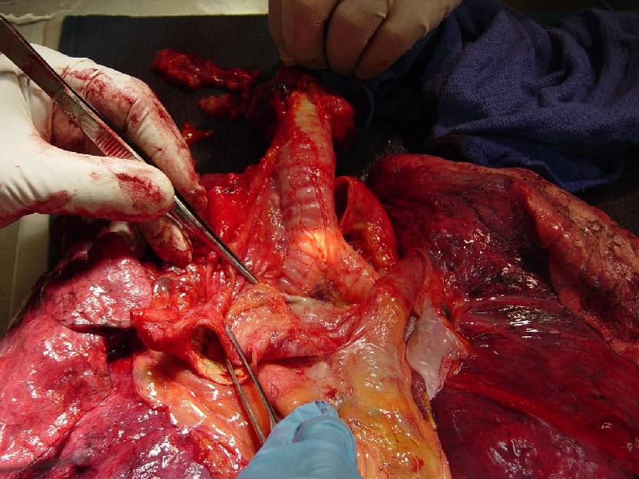
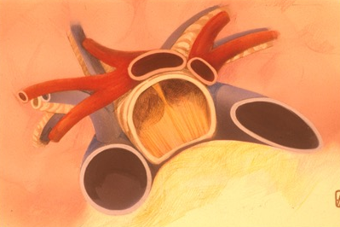
Vascular and airway anatomy
Carina
Left Pulmonary artery
Main pulmonary artery
Left upper lobe pulmonary veins
Left upper lobe pulmonary artery
www.bronchoscopy.org

Slide 7
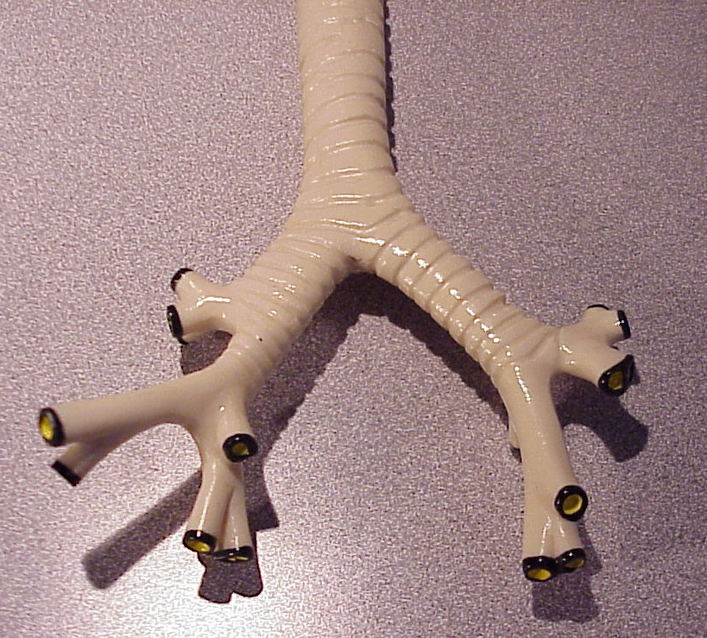
Ventilatory dead space
A patient’s left main bronchus, right main bronchus, and trachea can completely fill with only 150 ml of blood or saline, causing hypoxemia, and respiratory arrest.
www.bronchoscopy.org

Slide 8
Prevention
Screening before airway procedures
History, examination, laboratory tests, explanation of risks to patient and or family members
Careful procedure technique
Recognize hypervascularization, aberrant vessels, and submucosal arterioles
Procedural planning
Supplemental oxygen, cardiac monitoring
Be sure sufficient space in procedure room to move around.
Availability of medication and hemodynamic resuscitation, including crash cart.
Airway resuscitation including endotracheal tubes, large bore suction catheter/Yankauer, oral airway and bite block.
www.bronchoscopy.org

Slide 9
Accepted precautions to prevent bleeding
Platelet counts > 50,000/mm3
Avoid uremia (serum creatinine < 2, BUN < 25 mg/dl)
Avoid liver failure (alk phos < 110, SGOT < 25, Bilirubin < 1.5 ml/dl
Avoid anticoagulated patients
Check PT, aPTT in patients with history of bleeding or coagulopathy.
Stop antiplatelet agents such as Plavix
www.bronchoscopy.org

Slide 10
Clopidogrel should be discontinued at least 5 days before TBLB
N=604 patients,
Clopidogrel = 18
Clopidogrel + aspirin = 12
Control = 574
Bleeding frequency:
Clopidogrel = 16/18 (89%)
Clopidogrel + aspirin = 12/12 (100%)
Control group = 20/574 (3.4%)
Aspirin itself need not be stopped before TBLB
Ernst A, et al. Chest 2006
www.bronchoscopy.org

Slide 11
Other antiplatelet agents and Anticoagulants
Aspirin ⁽¹⁾ , Ticlopidine need not be discontinued
Warfarin (Coumadin) should be discontinued until INR <1.5 (or INR corrected using Fresh Frozen Plasma or Vitamin K)
I.V. Heparin should be stopped 2-6 hrs prior to biopsy. Check PTT.
Low molecular weight heparin should be held 12 hrs (hold previous dose).
S.Q. Heparin is safe and can be continued.
Follow recommendations for all other newer anti-coagulants and other agents.
(1) Herth F, Chest 2002;122;1461
www.bronchoscopy.org

Slide 12
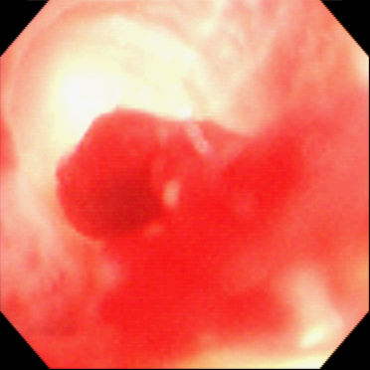
Preventing bleeds during and after TBLB
Avoid biopsy in bleeding diatheses.
Maintain wedge position after biopsy.
Avoid excessive suction after biopsy. Instead, use gentle brief suction to assess degree of bleeding.
If bleeding is excessive: gently instill 5-10 ml iced-saline through FFB, wait for 30 sec, then suction gently.
Epinephrine, 1:10,000 (1-3 ml) via FFB is usually not useful if bleeding is distal
Iced saline via scope wedged into segmental bronchus
www.bronchoscopy.org

Slide 13
TBLB in Pulmonary arterial hypertension
TBLB is not a primary diagnostic test for PAH.
Bleeding following TBBX is from bronchial artery circulation which carry systemic pressures.
In patients with supra-systemic PAH, bronchoscopy itself is high risk because of severe hypoxemia.
As of 2007, a single animal study has shown safety of TBLB when MPA pressure were high (33 mm Hg).
Morris M, JOB 1996;3:11-16
www.bronchoscopy.org

Slide 14
TBLB in Renal Failure
Check INR & platelet count
Bleeding time can be misleading
Dialysis within 24 hrs prior to procedure with TBLB
Correct INR and platelet count if necessary (<1.5, >50,000)
Desmopressin (DDAVP) 3µg/kg, IV 30 min prior to the procedure costs $ 1000, potential use of DDAVP analogues, estrogen, Cryoprecipitate)
Risk of bleeding is about 8%
Mehta N, JOB, 2005; 12(2): 81-83
Mannucci, NEJM 1983;308:3
www.bronchoscopy.org

Slide 15
Treating the bleeding airway
Establish and maintain an open airway
Stop the bleeding
Prevent or treat respiratory, cardiac, and hemodynamic complications
www.bronchoscopy.org

Slide 16
(1) Maintaining an open airway
Bronchoscopic suction and large bore suction of the oral pharynx
Lateral safety position
Tilt the patient or the table 45 degrees towards the bleeding side
Note the bleeding site and remember how to get back to it!
Tamponade the bleeding bronchus using continuous bronchoscopic suction
Unilateral intubation
www.bronchoscopy.org

Slide 17
The safety position (lateral decubitus)
Bleeding side down
Allows face to face contact with patient if operator working from the front or side of the patient
Allows blood and secretions to flow from the larynx and out of the corner of the mouth
Avoids collapse of the larynx and laryngeal obstruction by tongue or edematous upper airway.
Oral pharynx easily suctioned
www.bronchoscopy.org

Slide 18
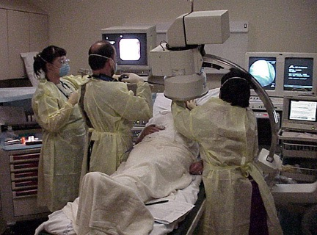
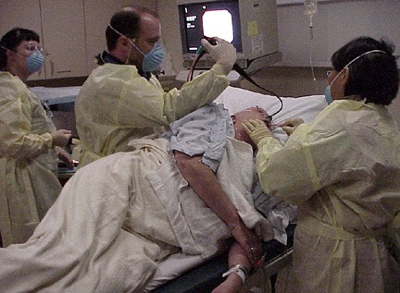
Safety position
Turning the patient onto the “safety position” (bleeding side down) also protects the contra lateral airway
www.bronchoscopy.org

Slide 19
(2) Stop the bleeding
Tamponade using
Bronchoscopic suction, Balloons, the rigid bronchoscope, cotton pledgets, tampons.
Vasoconstriction using
Epinephrine, cold saline washes
Intravenous vasopressin (0.2 - 0.4 units / min) causes bronchial arterial vasoconstriction: danger if patient has coronary artery disease and hypertension.
Enhance clot formation
Allow clot to form in the bleeding area
Lateral decubitus position
www.bronchoscopy.org

Slide 20
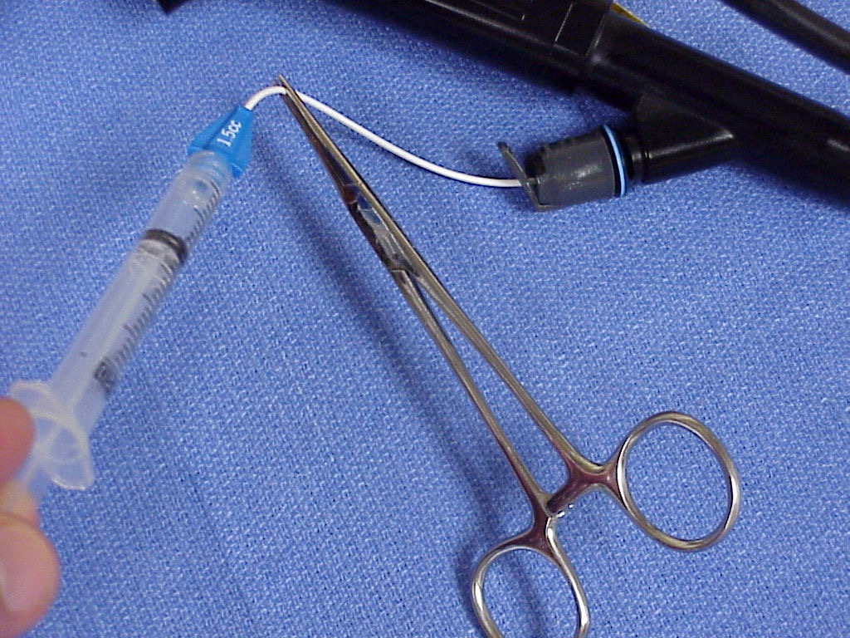
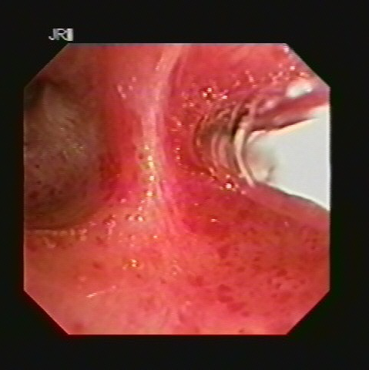
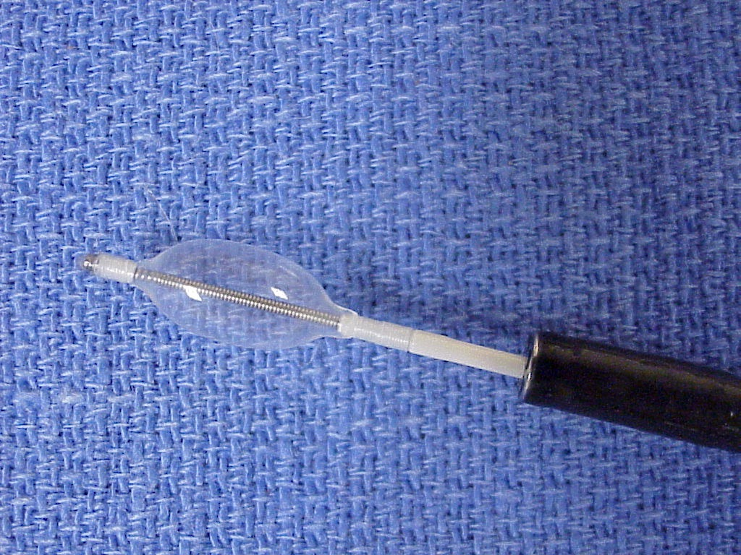
Tamponade balloons
If a tamponade balloon or Fogarty catheter is inserted into a bleeding segmental bronchus, its position should be verified by flexible bronchoscopy and chest radiograph. The balloon can remain in place for several days if necessary.
www.bronchoscopy.org

Slide 21
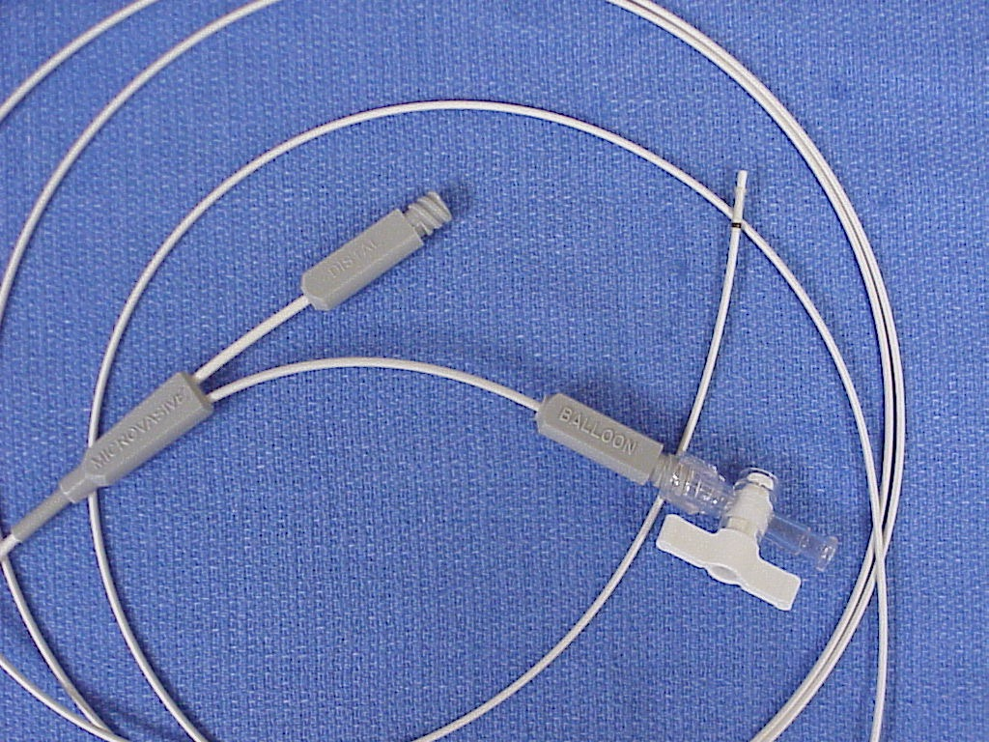
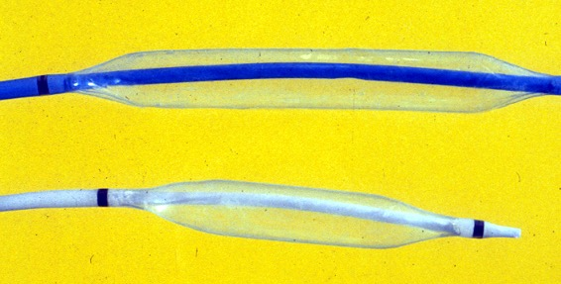
Dilating balloons
Tamponade balloons or, if necessary, dilating balloons are usually large enough to tamponade a bleeding segmental and subsegmental airway
www.bronchoscopy.org

Slide 22
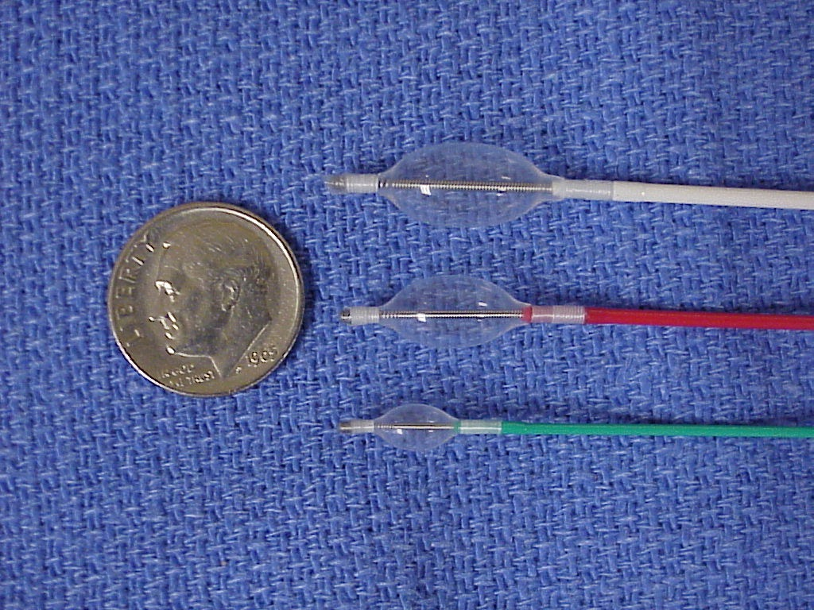
Fogarty catheters
A Fogarty balloon catheter can be used but operators and their assistants should first verify that balloon diameter is sufficient to fill segmental bronchial airway AND that balloon catheter fits through working channel of the bronchoscope.
www.bronchoscopy.org

Slide 23
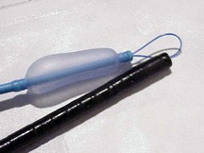
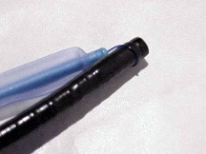
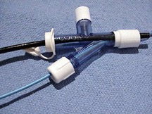
The Cook (Arndt) bronchial blocker, if necessary, should be inserted through a large endotracheal tube
www.bronchoscopy.org

Slide 24
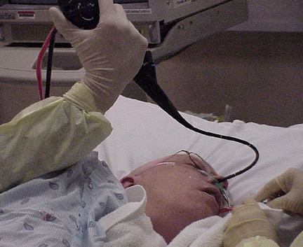
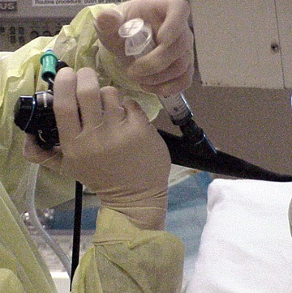
Saline lavage
Immediate administration of large aliquots of iced saline using a wedged or partially wedged bronchoscope and continuous or intermittent suction and gravity dependent clot formation stops most bleeding.
www.bronchoscopy.org

Slide 25
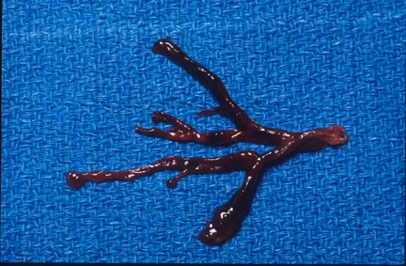
Do not remove freshly formed clot
Once a clot forms, it is important to NOT remove it once bleeding has stopped. Inspection bronchoscopy (with or without clot removal can be performed the following day
Large blood clot causing a cast of the distal airway
www.bronchoscopy.org

Slide 26
Avoid adverse effects on respiration , cardiac, and hemodynamic status: Beware the effects of anxiolytics and narcotics on respiration
In case of bleeding, additional intravenous sedation can result in adverse events:
These include respiratory failure, hypoxemia, and hypercapnia, hypotension and aspiration pneumonia.
Reversing agents should be available. Additional sedation or anxiolysis might warrant intubation even after bleeding is controlled.
www.bronchoscopy.org

Slide 27
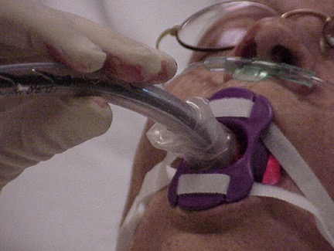
Avoid adverse effects on respiration , cardiac, and hemodynamic status: Consider intubation with a large endotracheal tube
If intubation is desired or warranted, a large single lumen endotracheal tube can usually be inserted over the bronchoscope. Selective unilateral bronchial intubation is only possible if the oral route is used. ALWAYS insert a bite block to prevent patients from biting down on the bronchoscope (regardless of level of sedation).
www.bronchoscopy.org

Slide 28
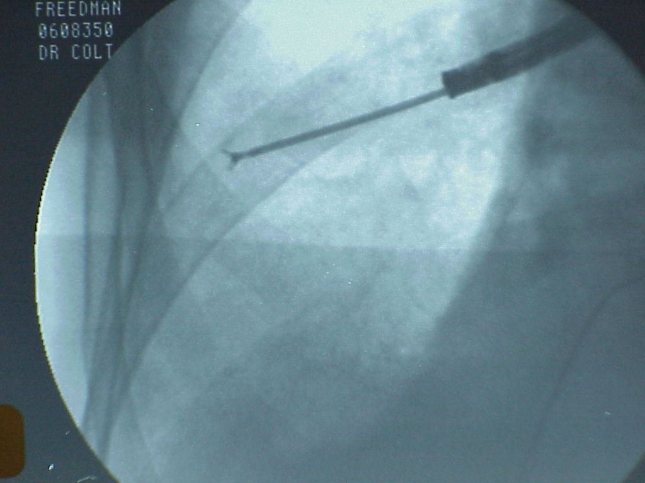
Pneumothorax after biopsy
May be immediate
Detected by symptoms such as dyspnea, pleuritic chest pain, hemoptysis, tachycardia, tachypnea, or hypotension.
Detected on fluoroscopy
May also be delayed
Justifies prolonged observation post-procedure
May be detected by symptoms, or chest radiograph (during exhalation)
May often be small and asymptomatic
www.bronchoscopy.org

Slide 29
Treatment alternatives
Observation and repeat chest radiograph if small and asymptomatic.
Observation and hospital admission.
Small bore chest tube insertion and discharge.
Small bore chest tube insertion and hospital admission.
Large bore chest tube insertion and hospital admission.
www.bronchoscopy.org

Slide 30
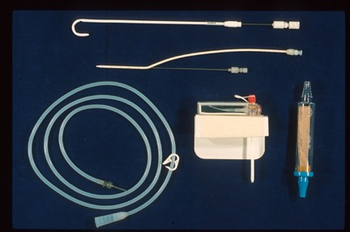
Chest tube insertion kits should be immediately available in the bronchoscopy suite or wherever TBLB is being performed
A
B
A Pigtail
B. Cook catheter
C. Tru-Close
D. One-way valve
C
D
www.bronchoscopy.org

Slide 31
www.Bronchoscopy.org

