Slide 1


Part 10A: Histopathology of squamous cell bronchogenic carcinoma
BRONCHATLAS©
Prepared By
www.Bronchoscopy.org

Slide 2
Classification of Lung Tumors
The most recent classification of the World Health Organization has gained wide acceptance. Several histological variant of each type of lung cancer are described. Major categories include :
Squamous cell carcinoma 25% to 40%
Adenocarcinoma 25% to 40%
Small cell carcinoma 20% to 25%
Large cell carcinoma 10% to 15%
The incidence of adenocarcinoma has increased significantly in the last two decade; it is now the most common form of lung cancer in women and, in many studies, men as well.

Slide 3
Squamous cell carcinoma
Most commonly found in men and closely correlated with a smoking history.
Histologically characterized by keratinization and/or intercellular bridges. Keratinization may take the form of squamous pearls or individual cells with eosinophilic dense cytoplasm.
Features are prominent in well-differentiated tumors. Easily seen but not extensive in moderately differentiated tumors, and focally seen in poorly differentiated tumors.
Mitotic activity is higher in poorly differentiated tumors.

Slide 4
Squamous cell carcinoma
Squamous metaplasia, epithelial dysplasia, and foci of frank carcinoma in situ may be seen in bronchial epithelium adjacent to the tumor mass.
In the past , most squamous cell carcinomas were seen to arise centrally from the segmental or subsegmental bronchi. However, the incidence of squamous cell carcinoma of the peripheral lung is increasing .
Surgpath images courtesy N. Narula, UCI Medical Center

Slide 5
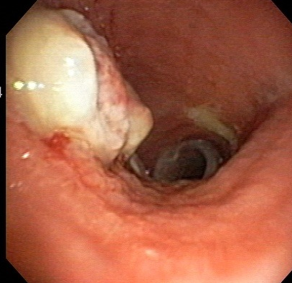
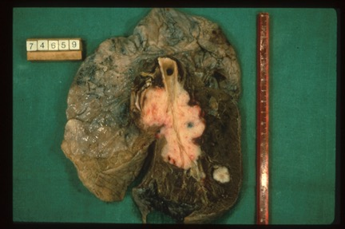
Squamous cell carcinoma often has gross necrosis on bronchoscopic examination
Photo, courtesy H. Colt
Photo, Hopital St. Marguerite, Marseille France

Slide 6
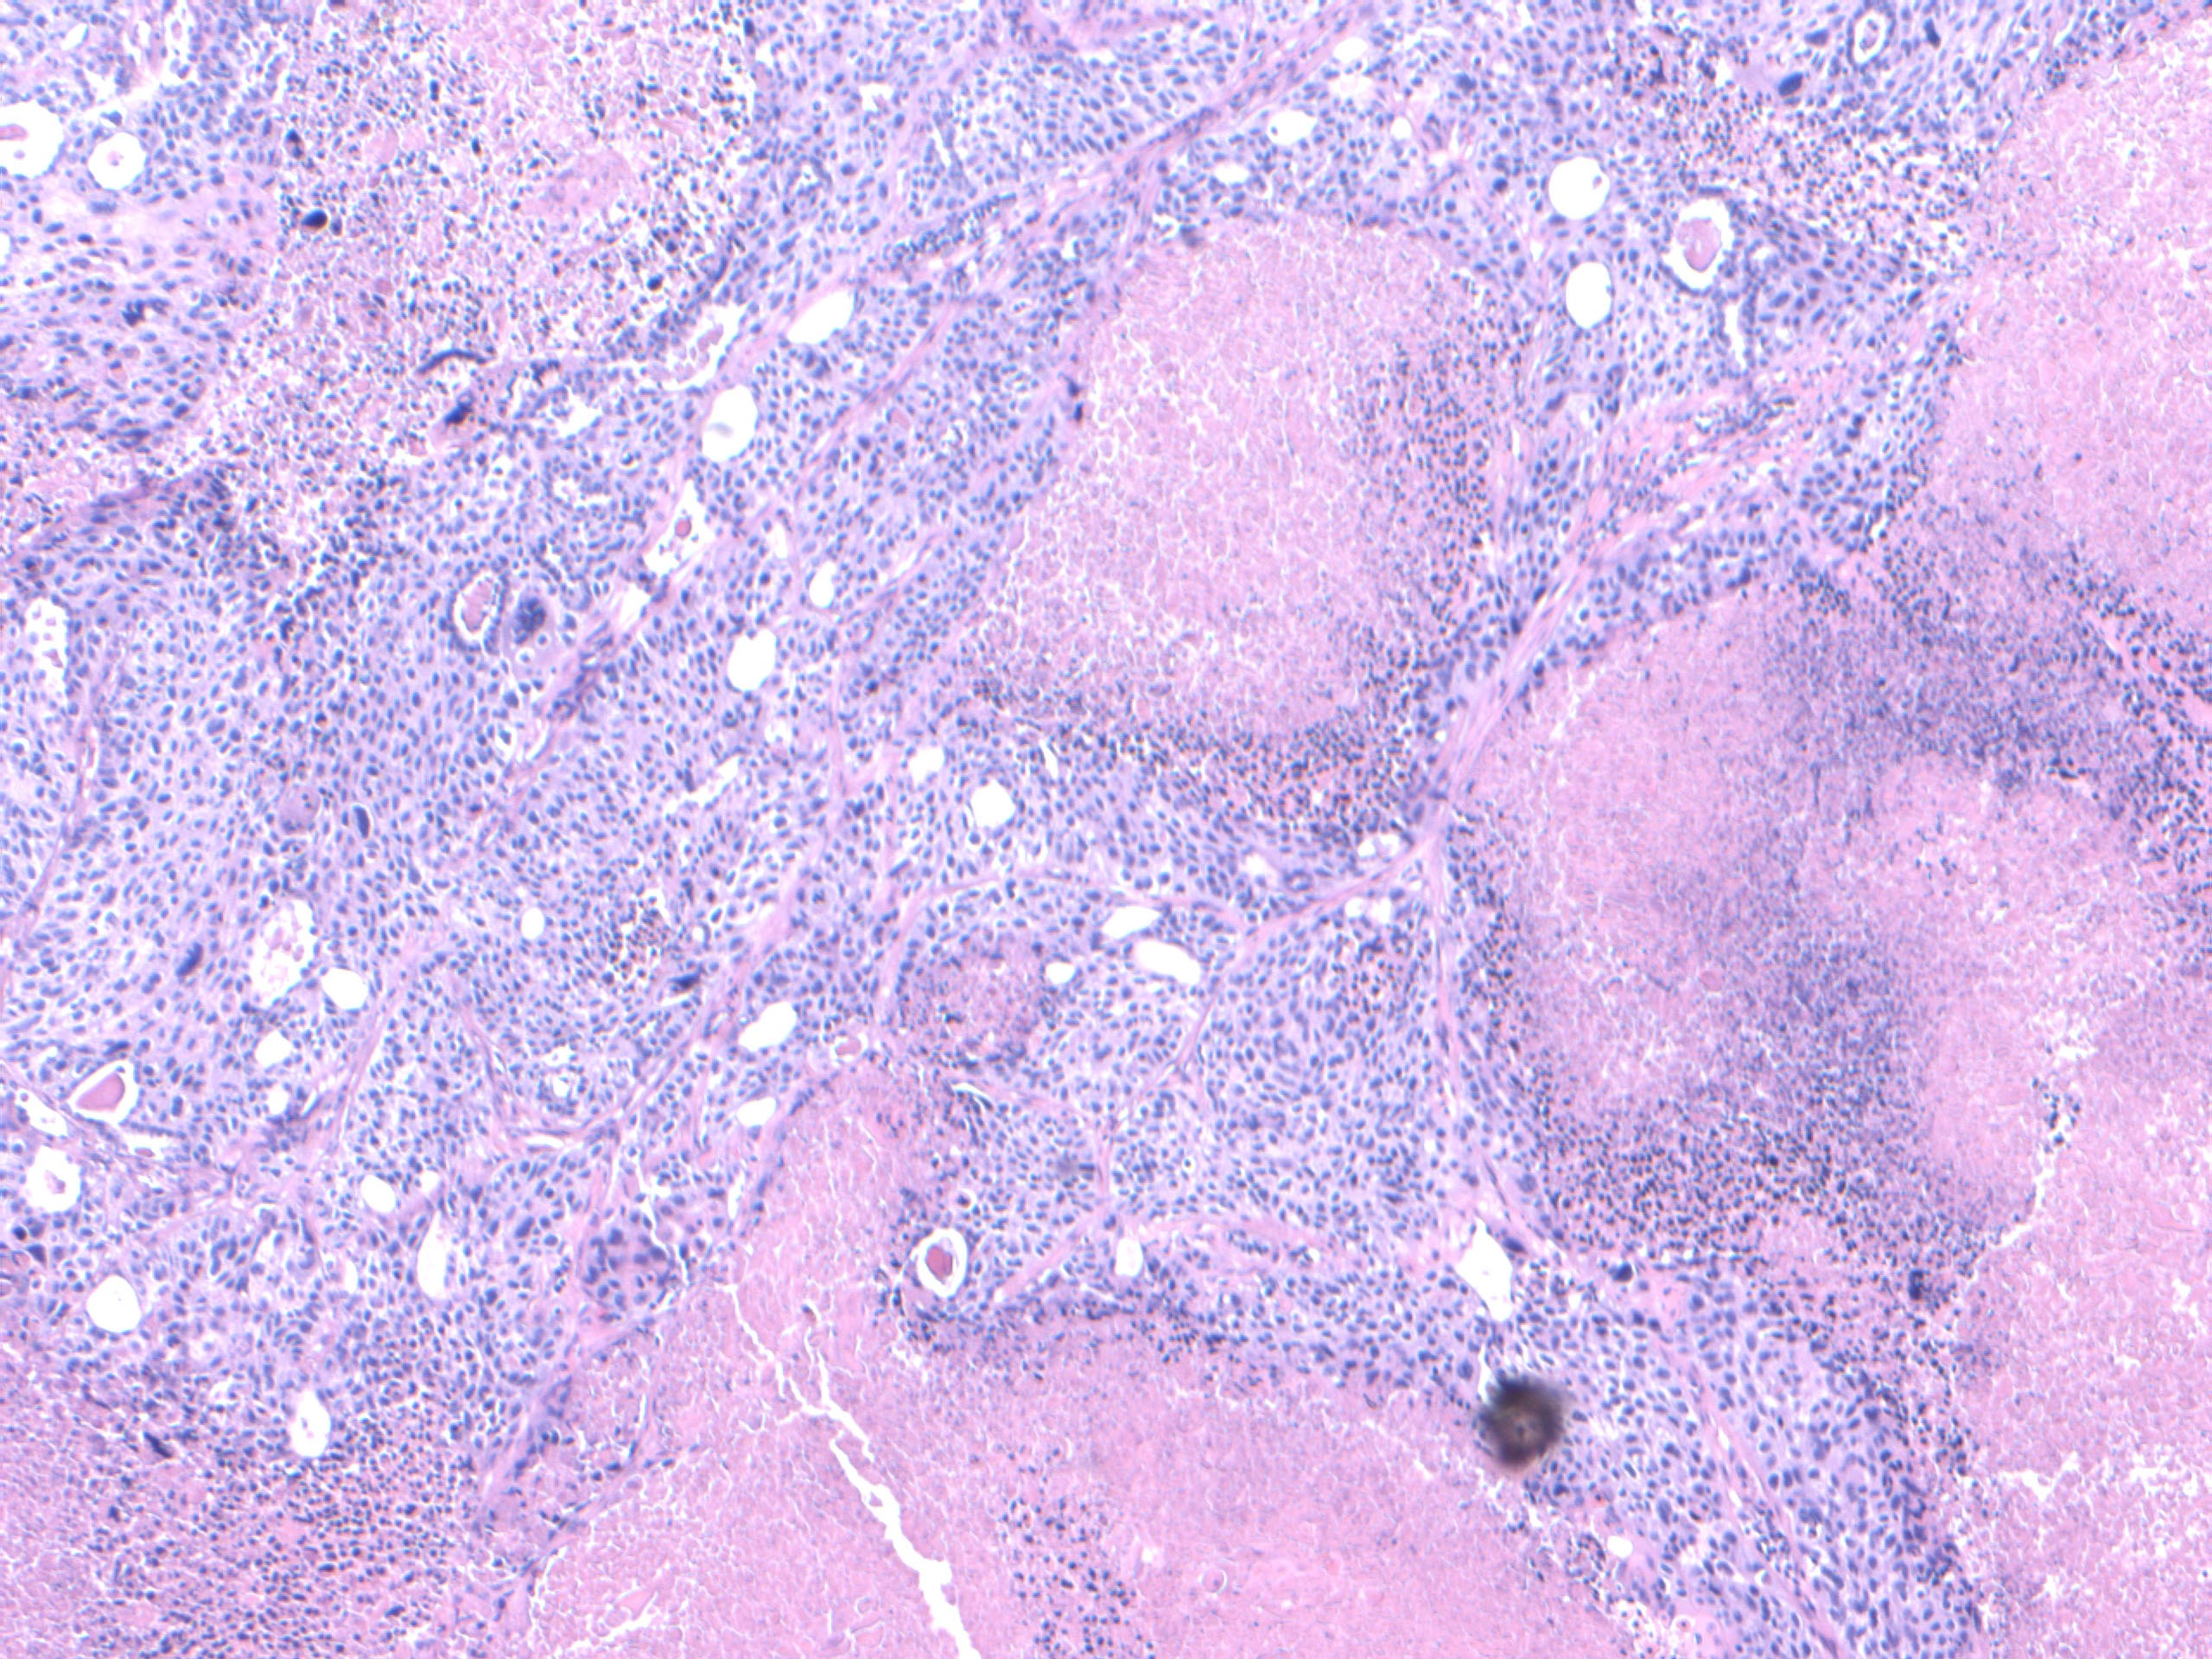
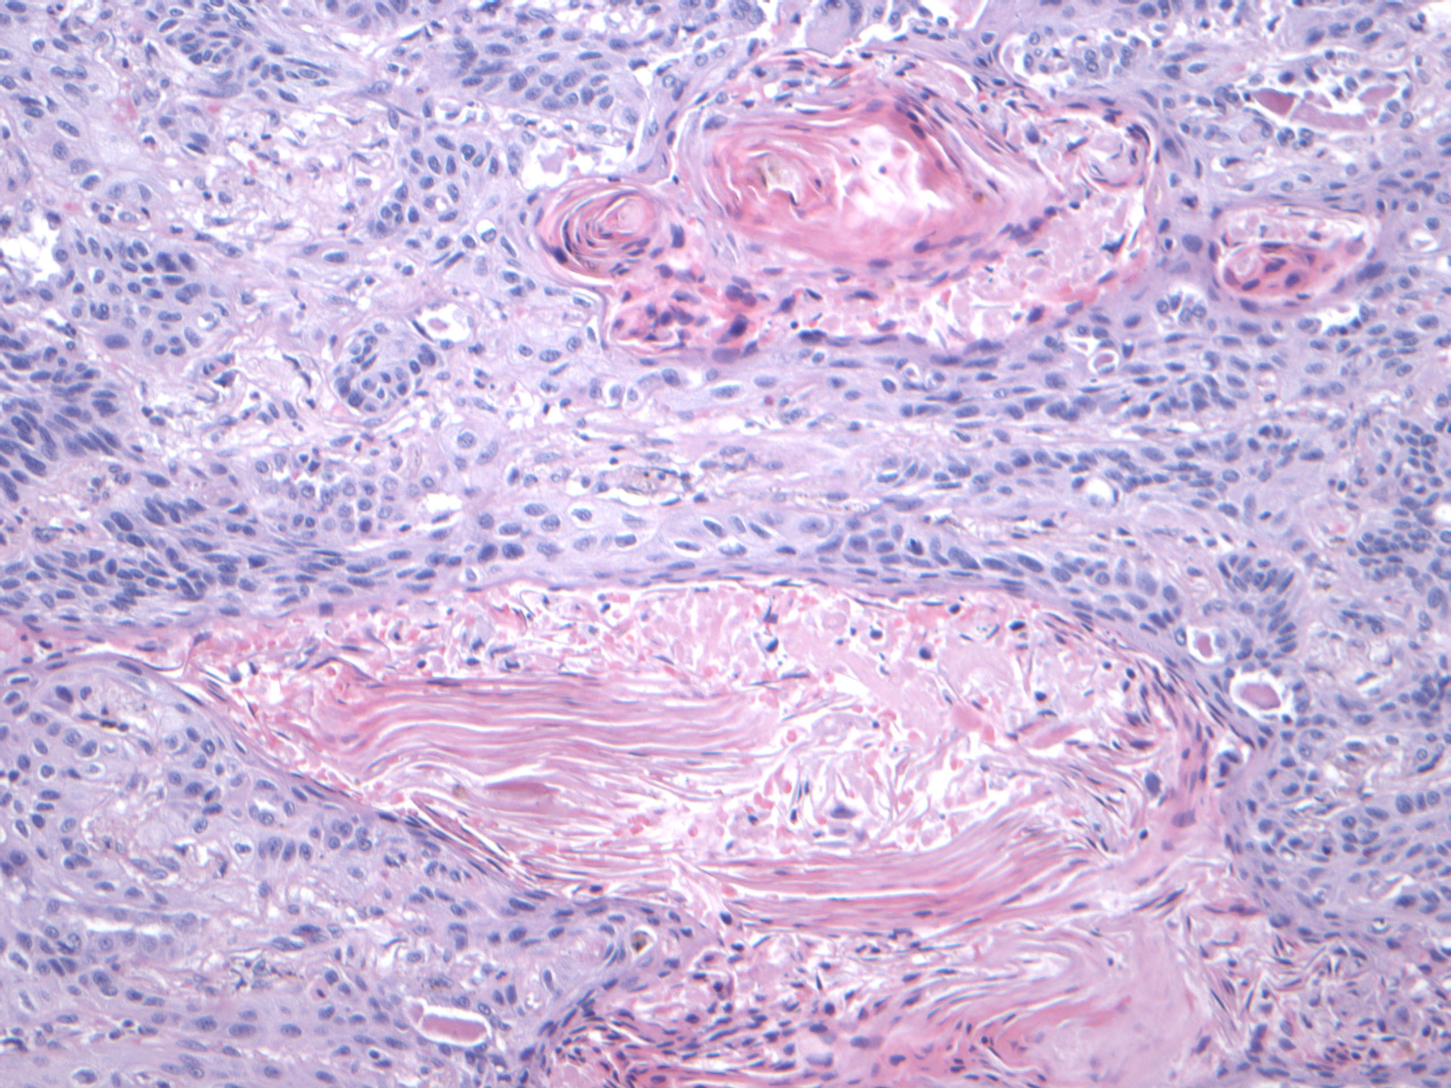
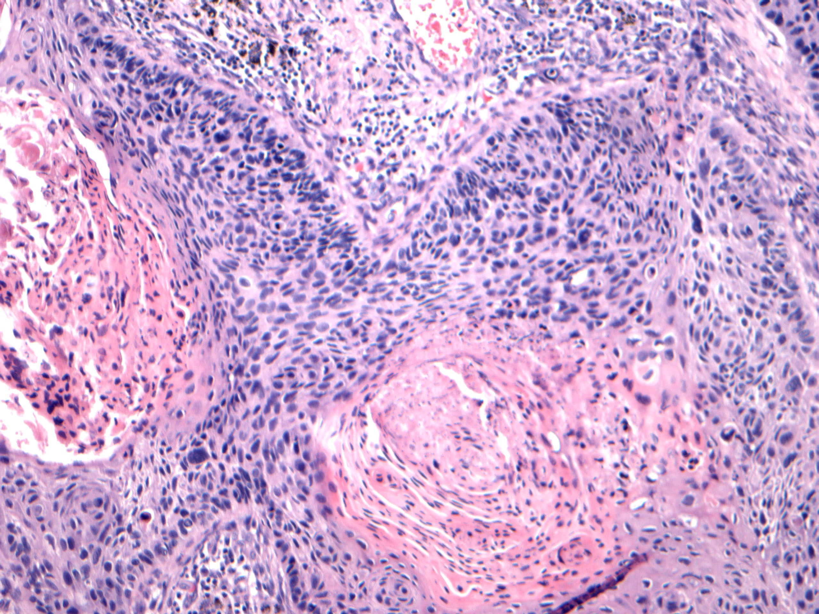
Squamous cell carcinoma Keratin pearls
Keratin pearls
Hemotoxylin-Eosin stain
Notes:
Keratin pearl

Slide 7
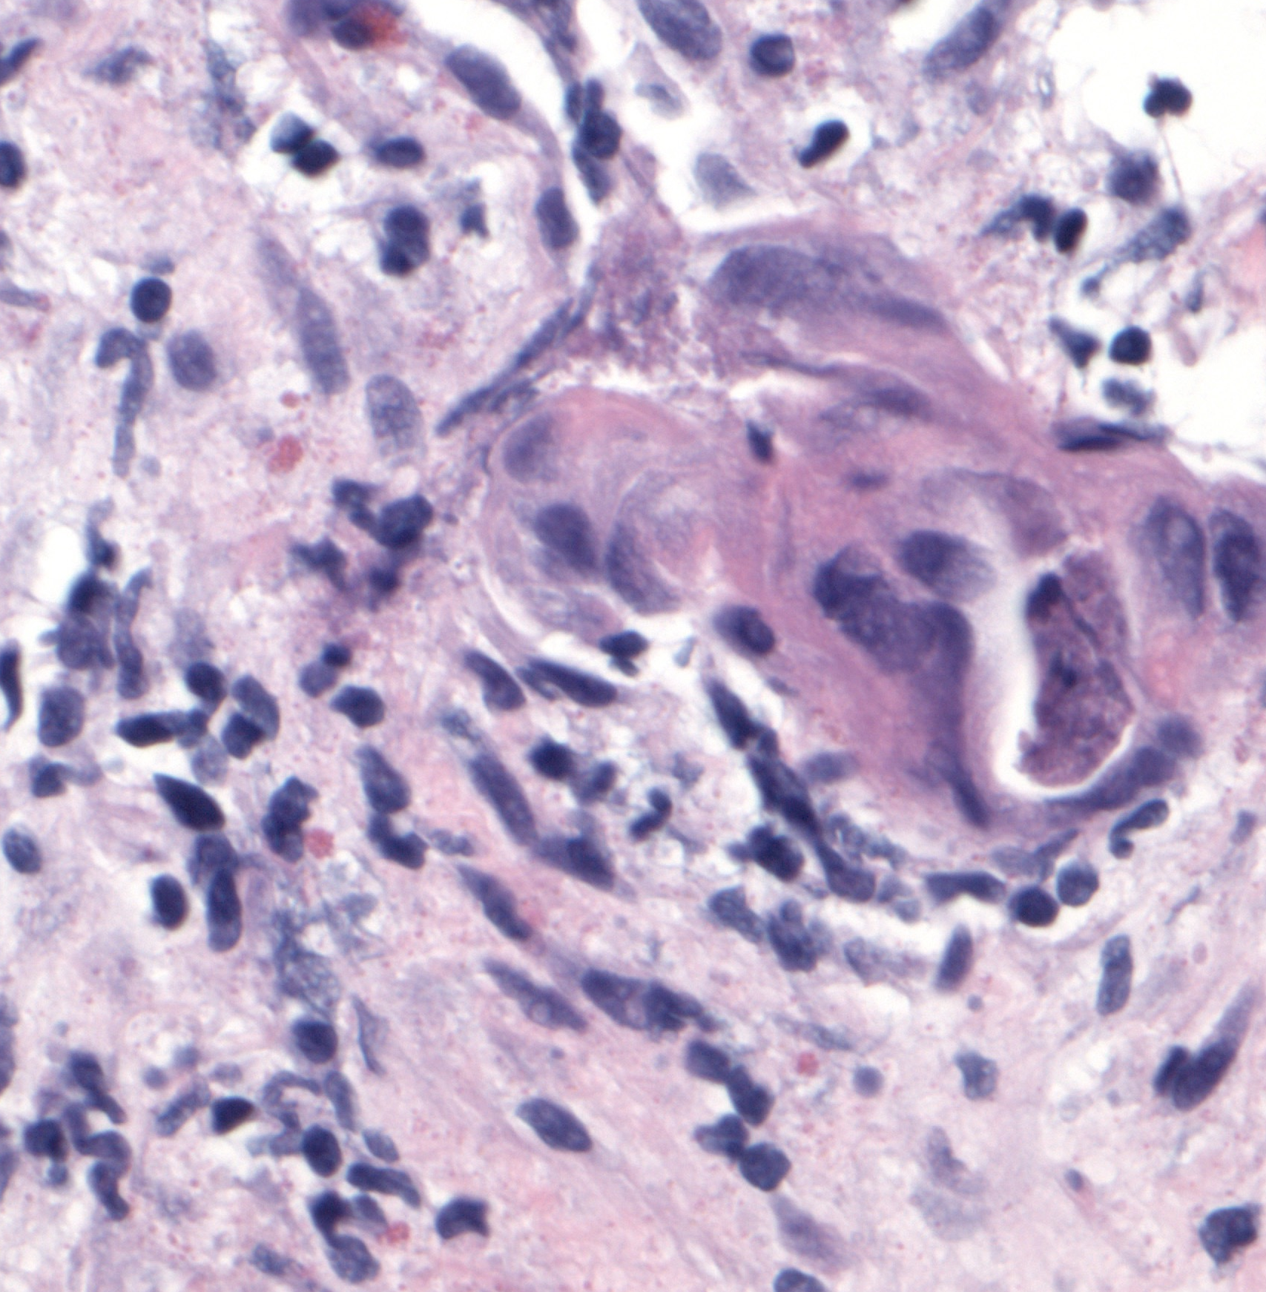
Squamous cell carcinoma keratinization
Keratinizing SCC
Hemotoxylin –Eosin stain
Surgpath images courtesy N. Narula, UCI Medical Center
Notes:
Keratin pearl

Slide 8
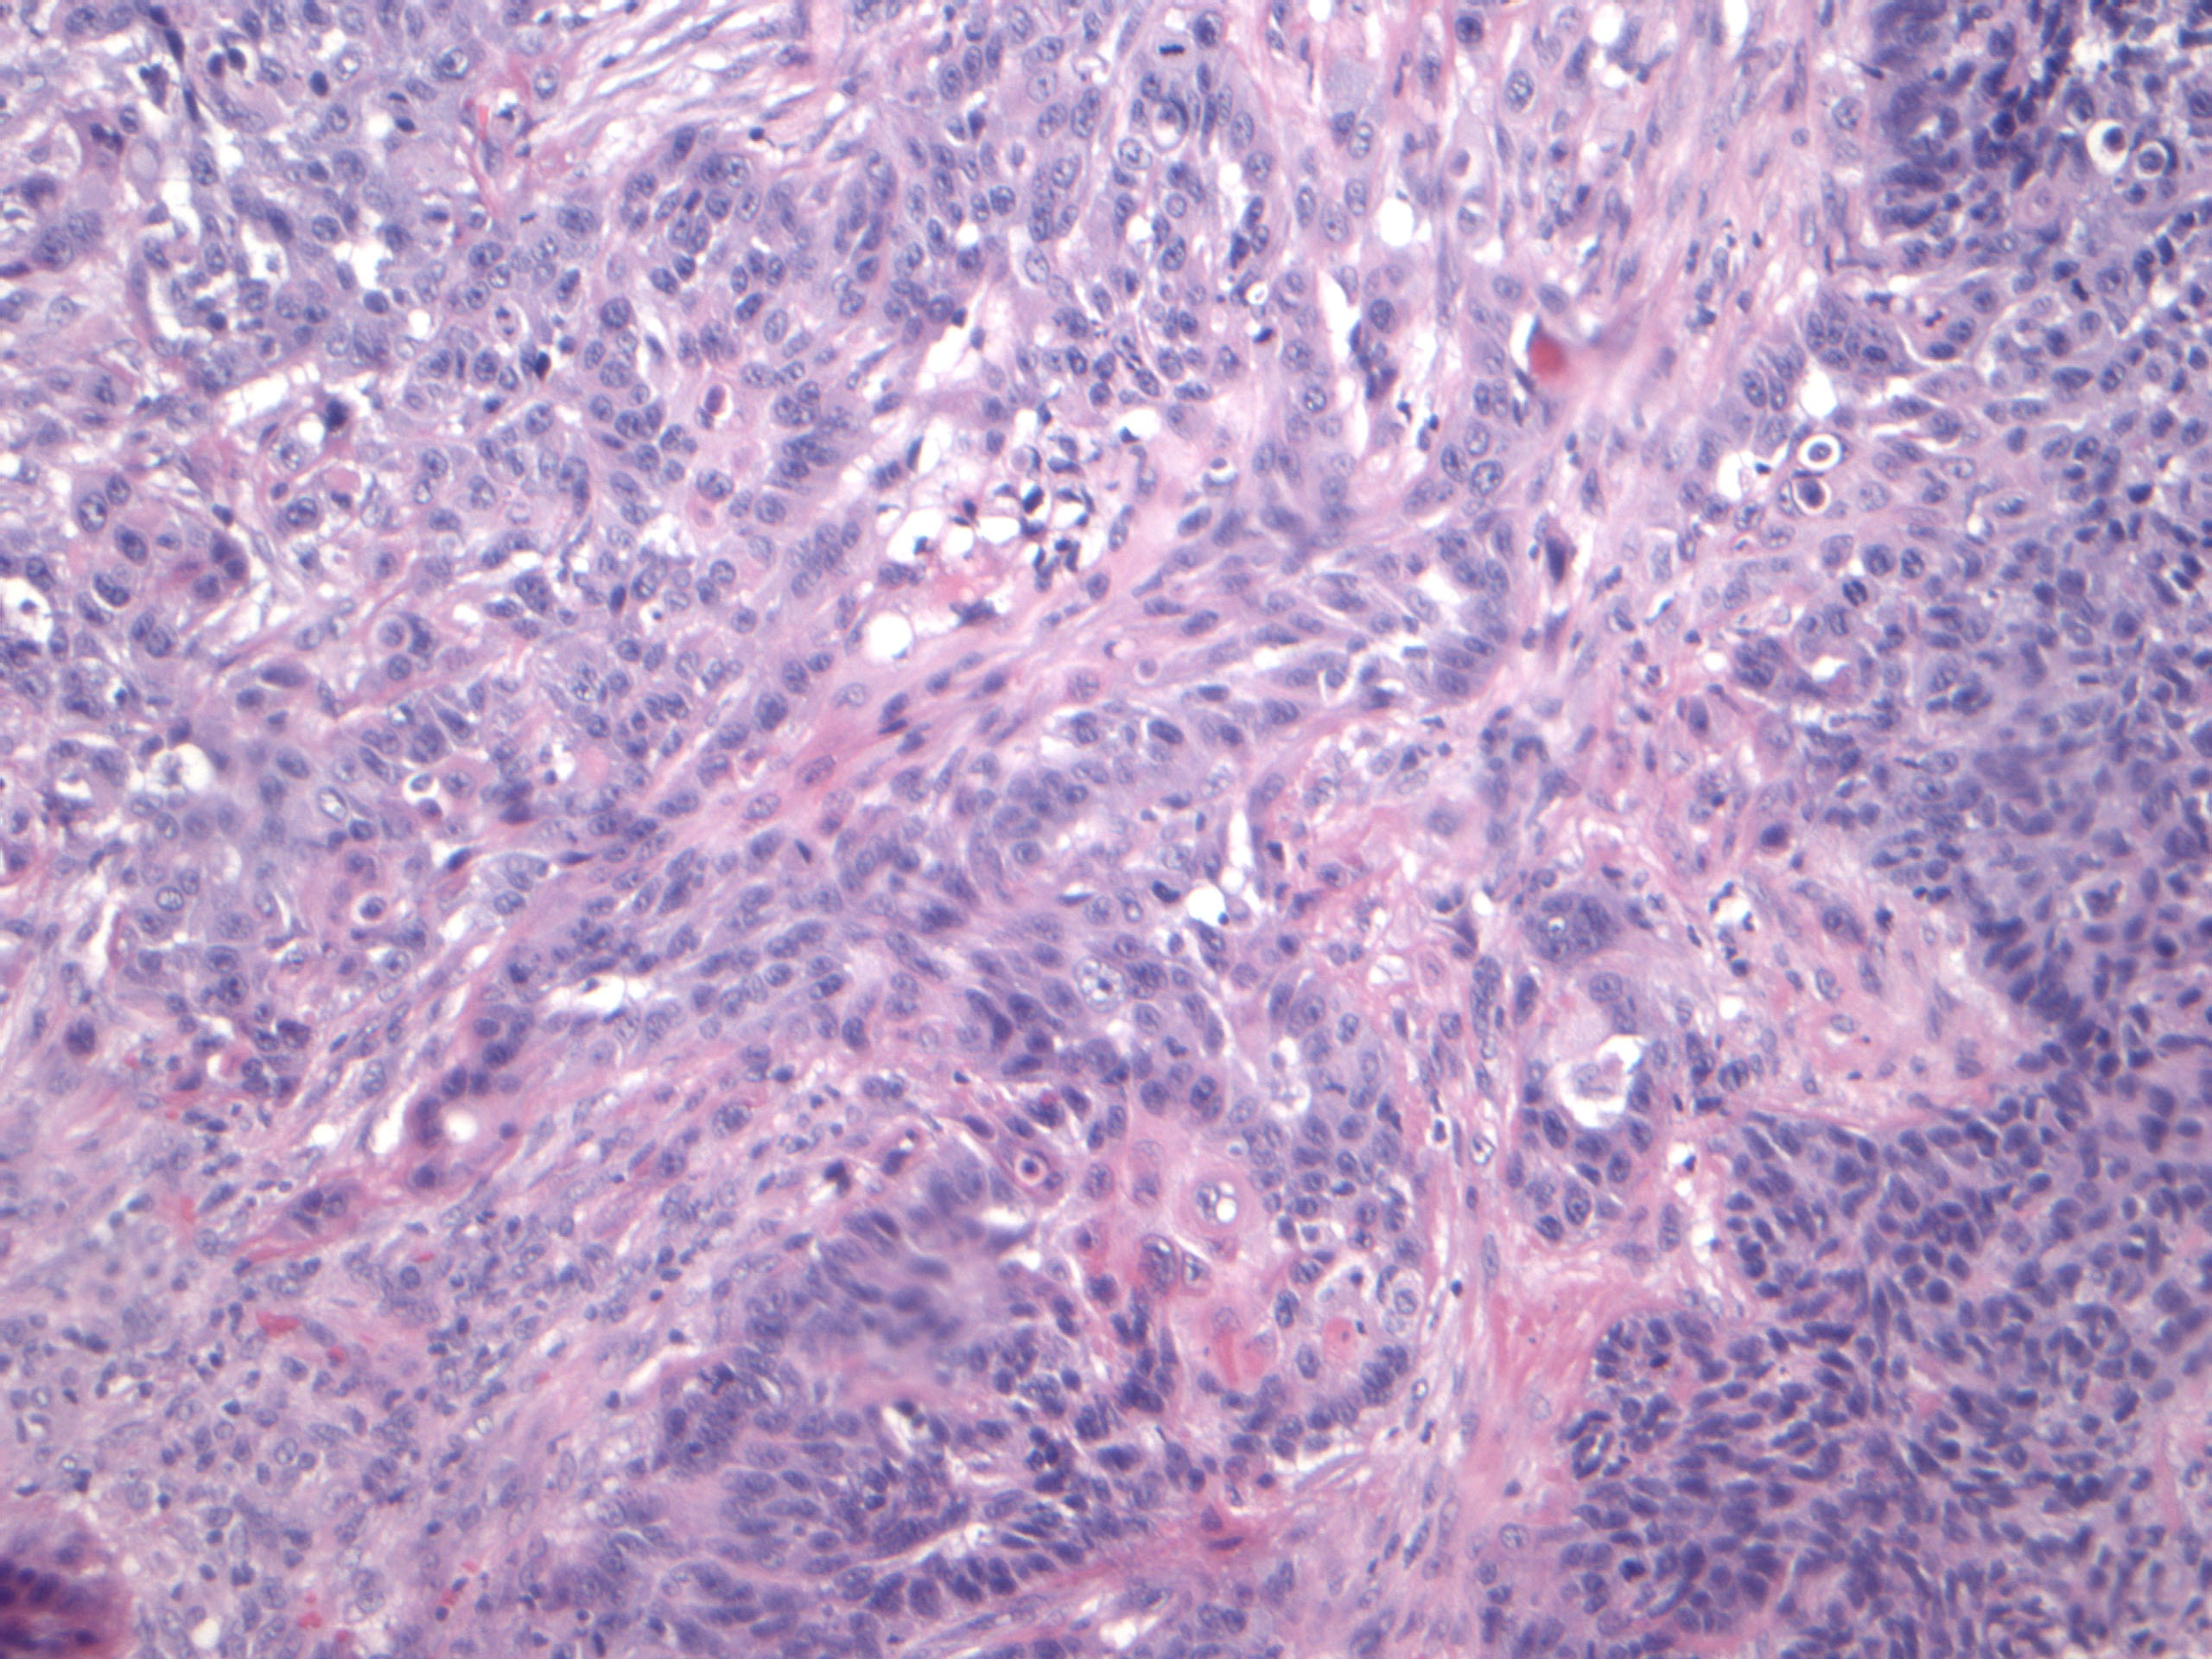
Squamous cell carcinoma polygonal cells
polygonal cells with pink cytoplasm
Hemotoxylin –Eosin stain
Surgpath images courtesy N. Narula, UCI Medical Center

Slide 9
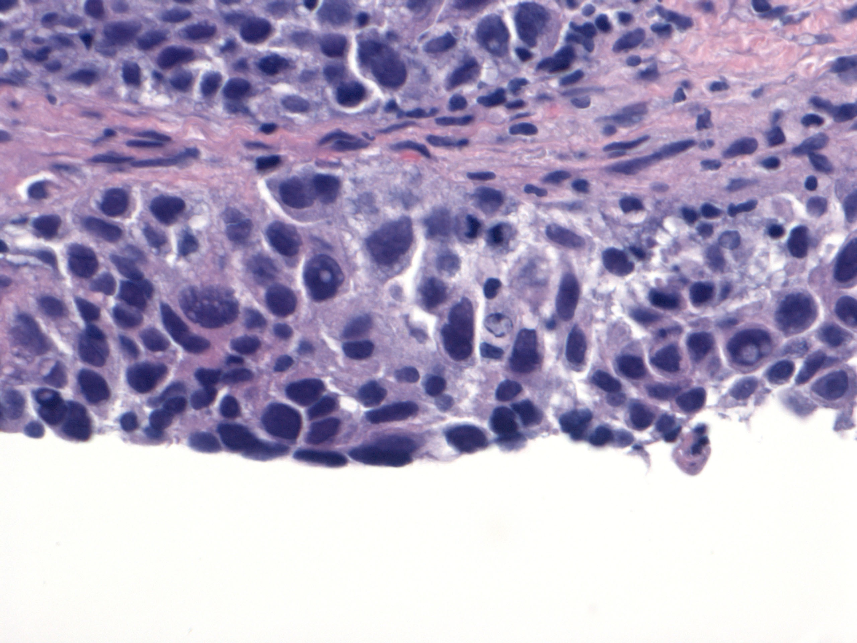
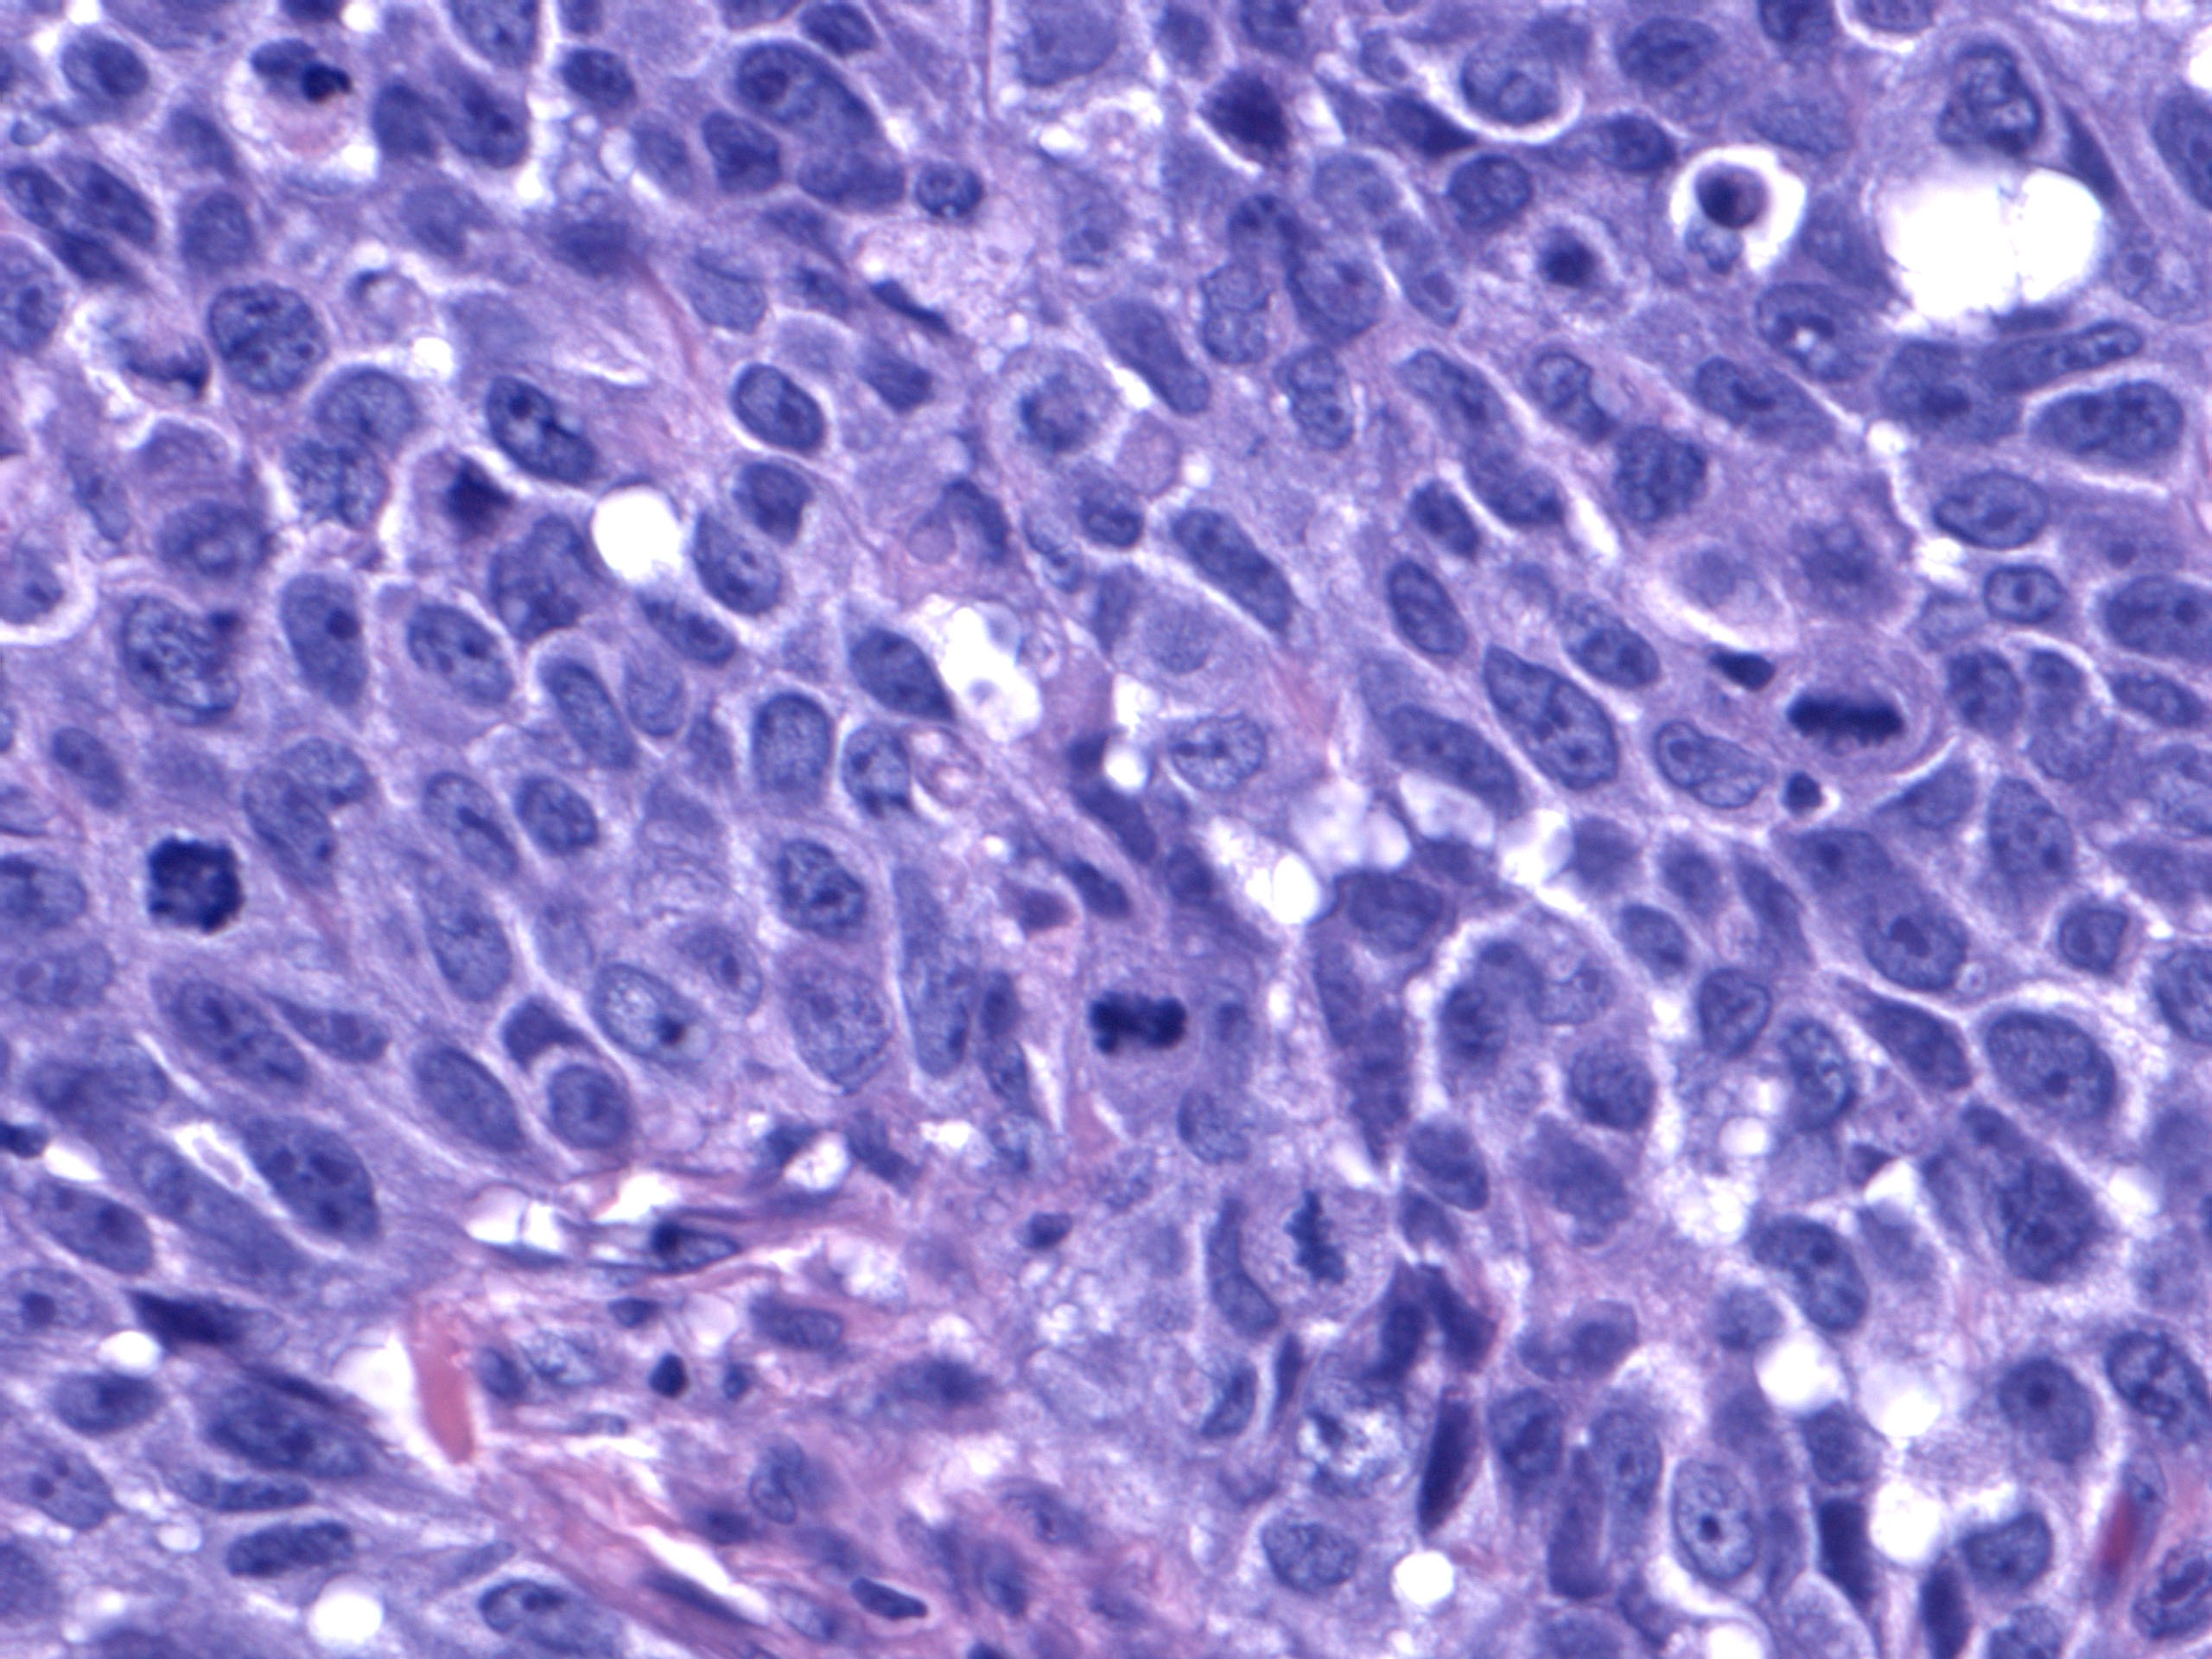
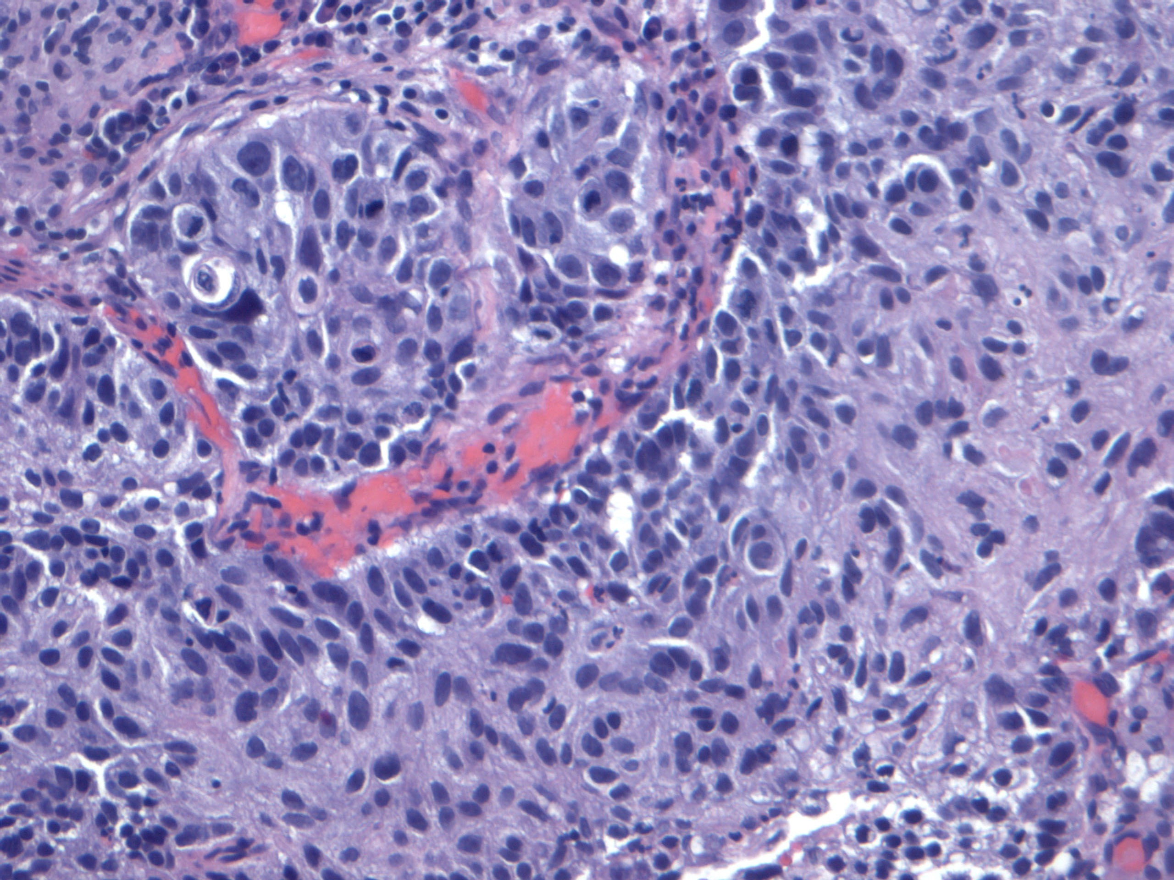
Squamous cell carcinoma hyperchromatic nuclei
Malignant cells with dense and hyperchromatic nuclei
and scanty cytoplasm in
Hematoxylin –Eosine stain

Slide 10
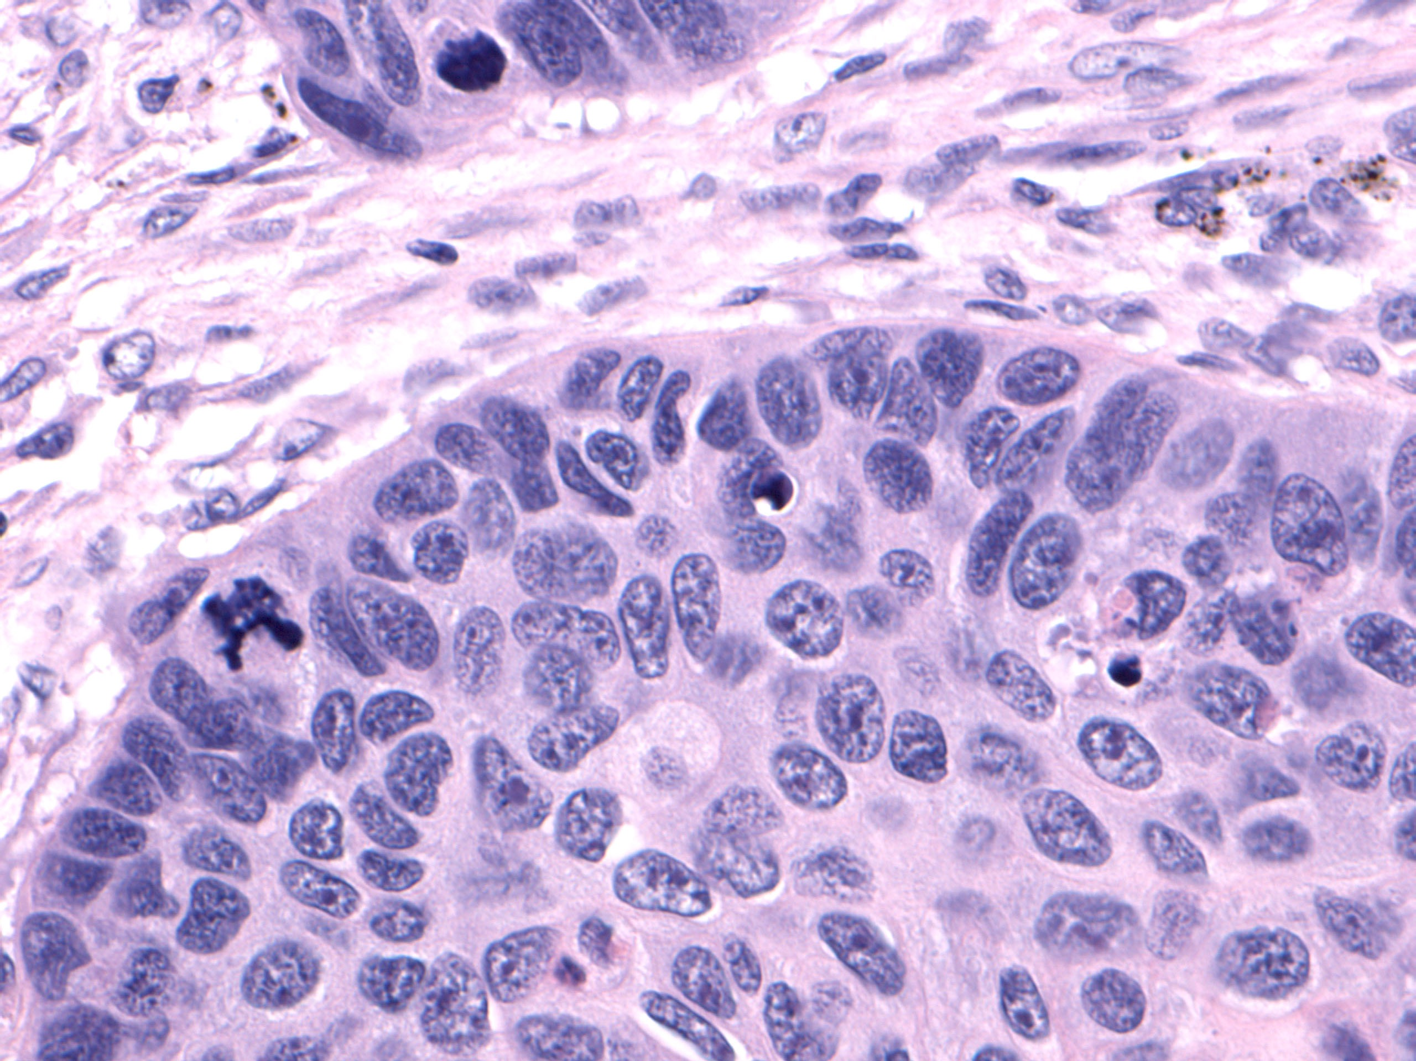
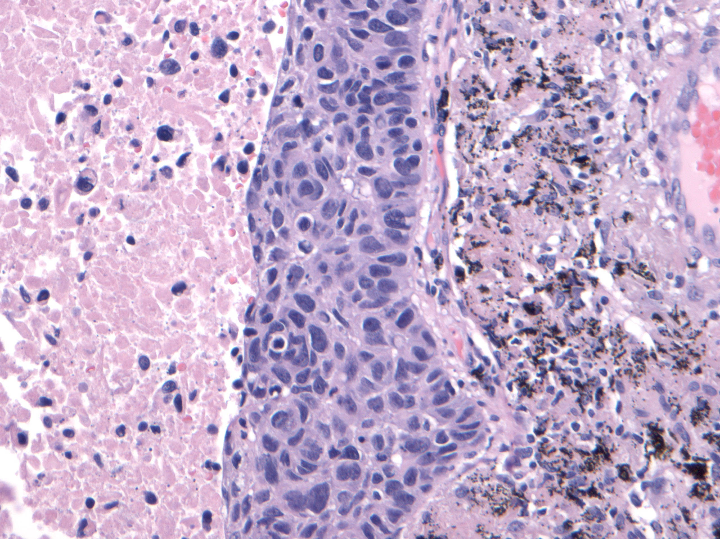
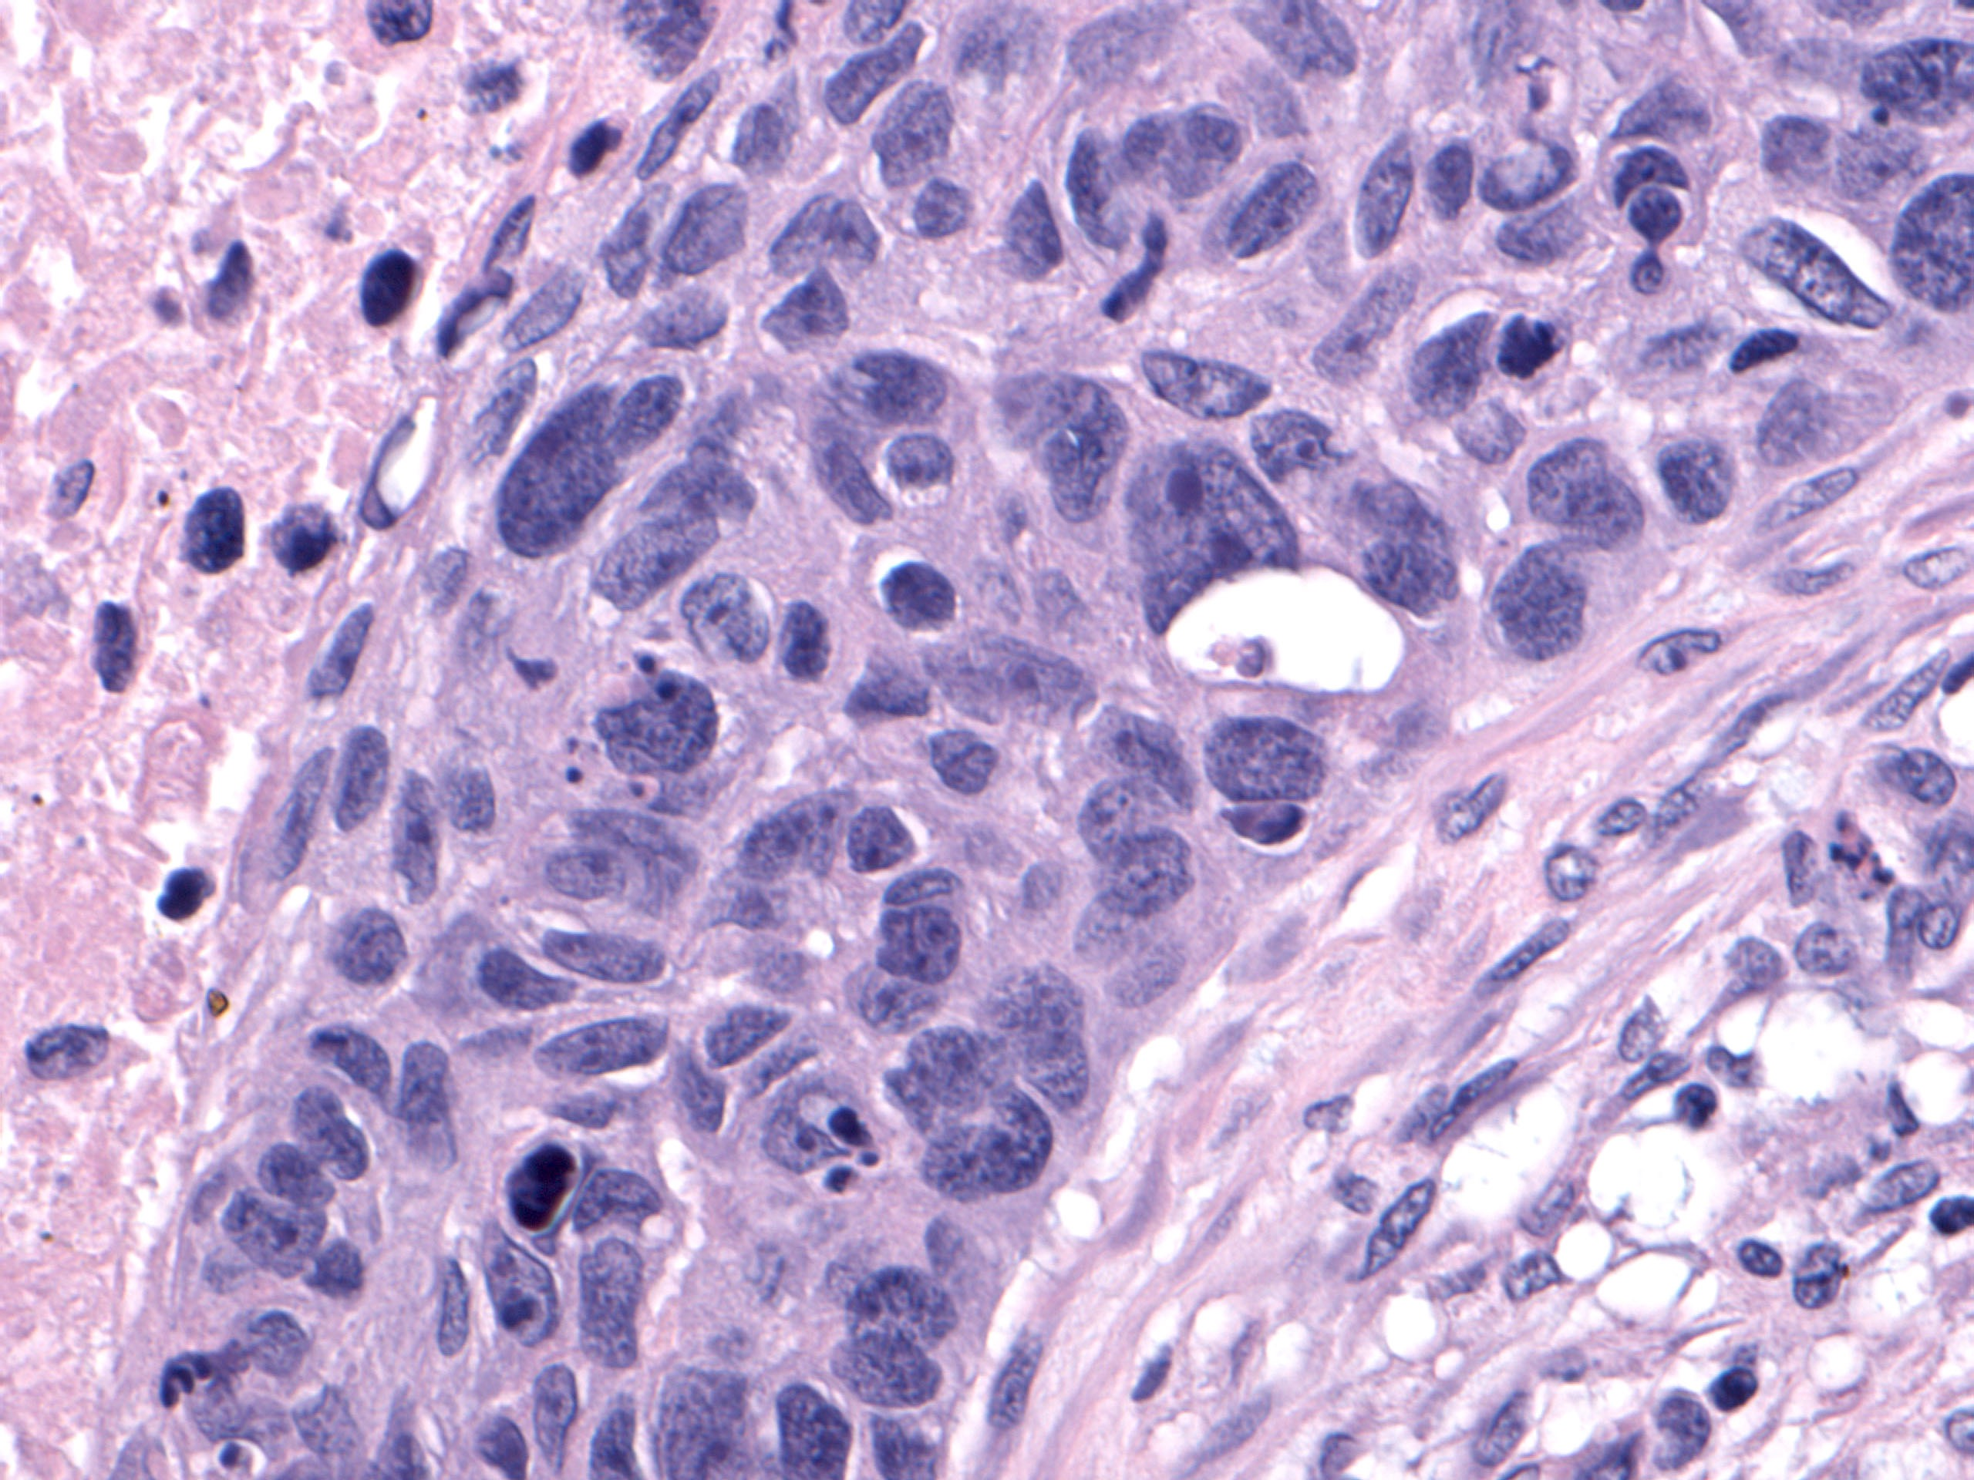
Squamous cell carcinoma polygonal cells, bridges, and hyperchromatic nuclei
SCC with :
Nest of polygonal cells , pink cytoplasm
and interacellular bridges .
The nuclei are hyperchromatic and angular
Hemotoxylin –Eosin stain
Surgpath images courtesy N. Narula, UCI Medical Center

Slide 11
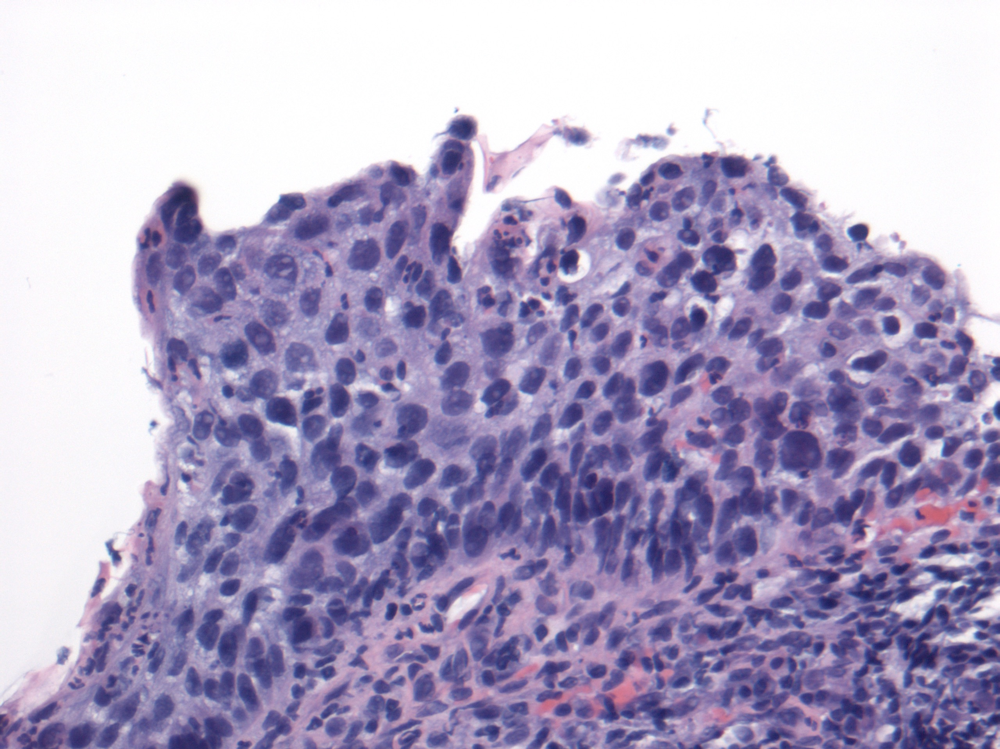
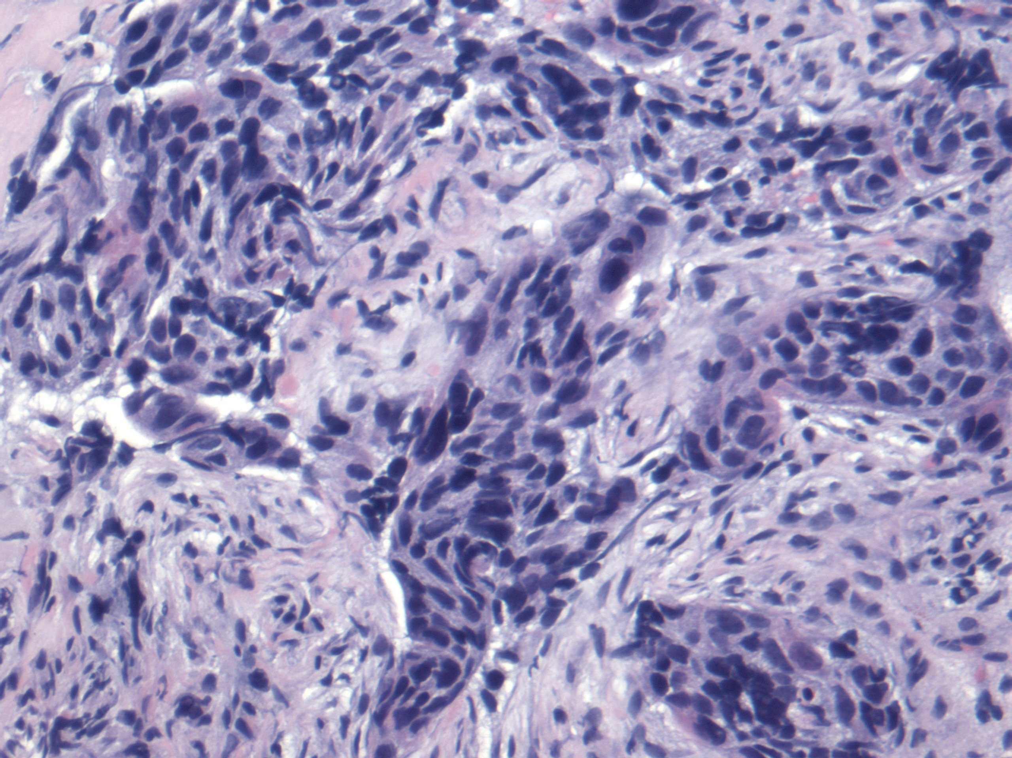
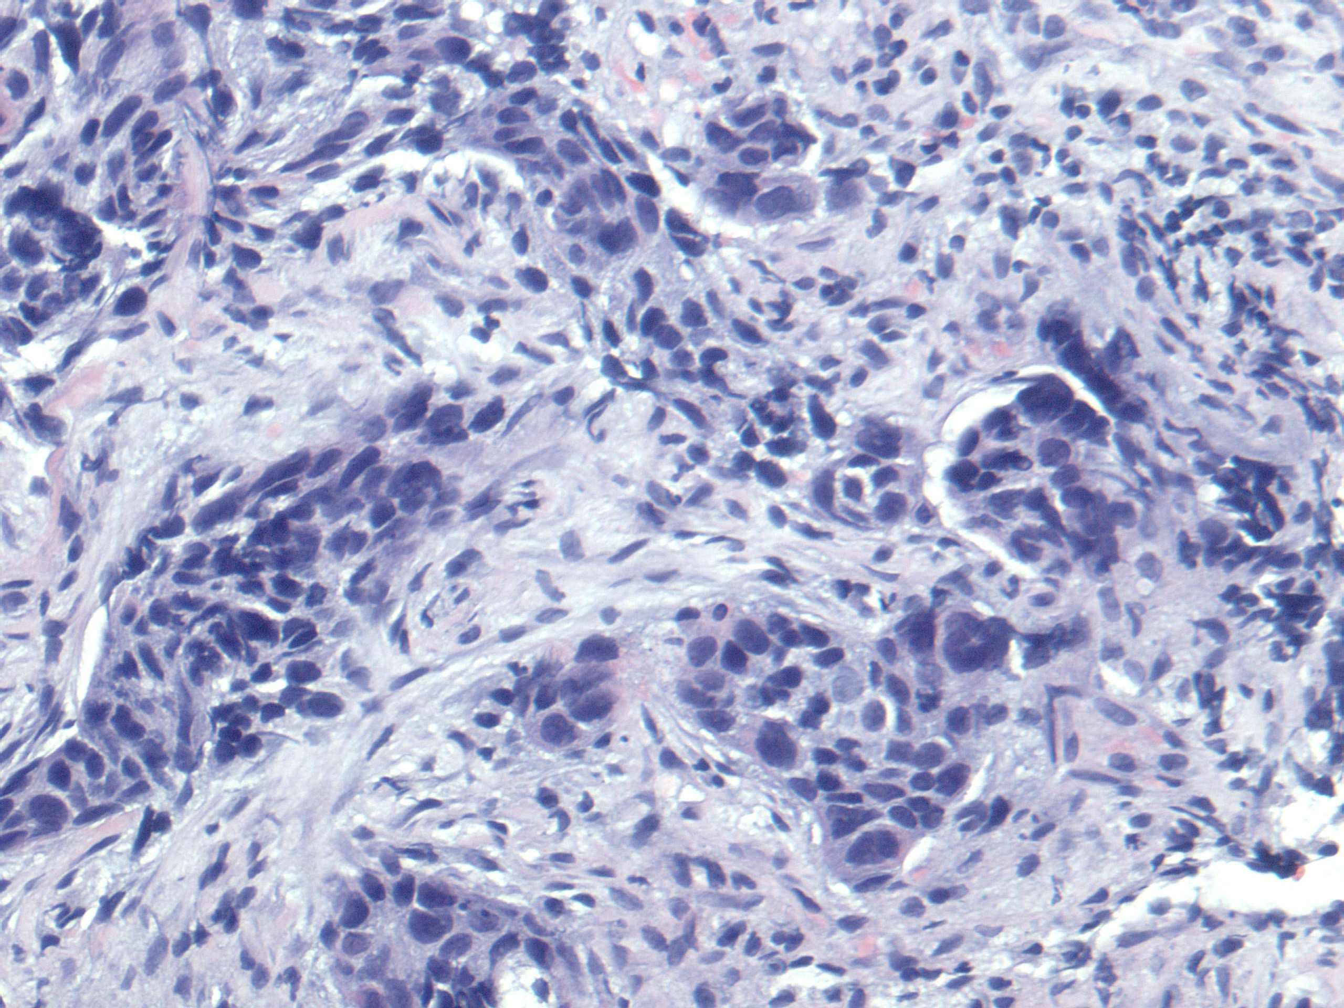
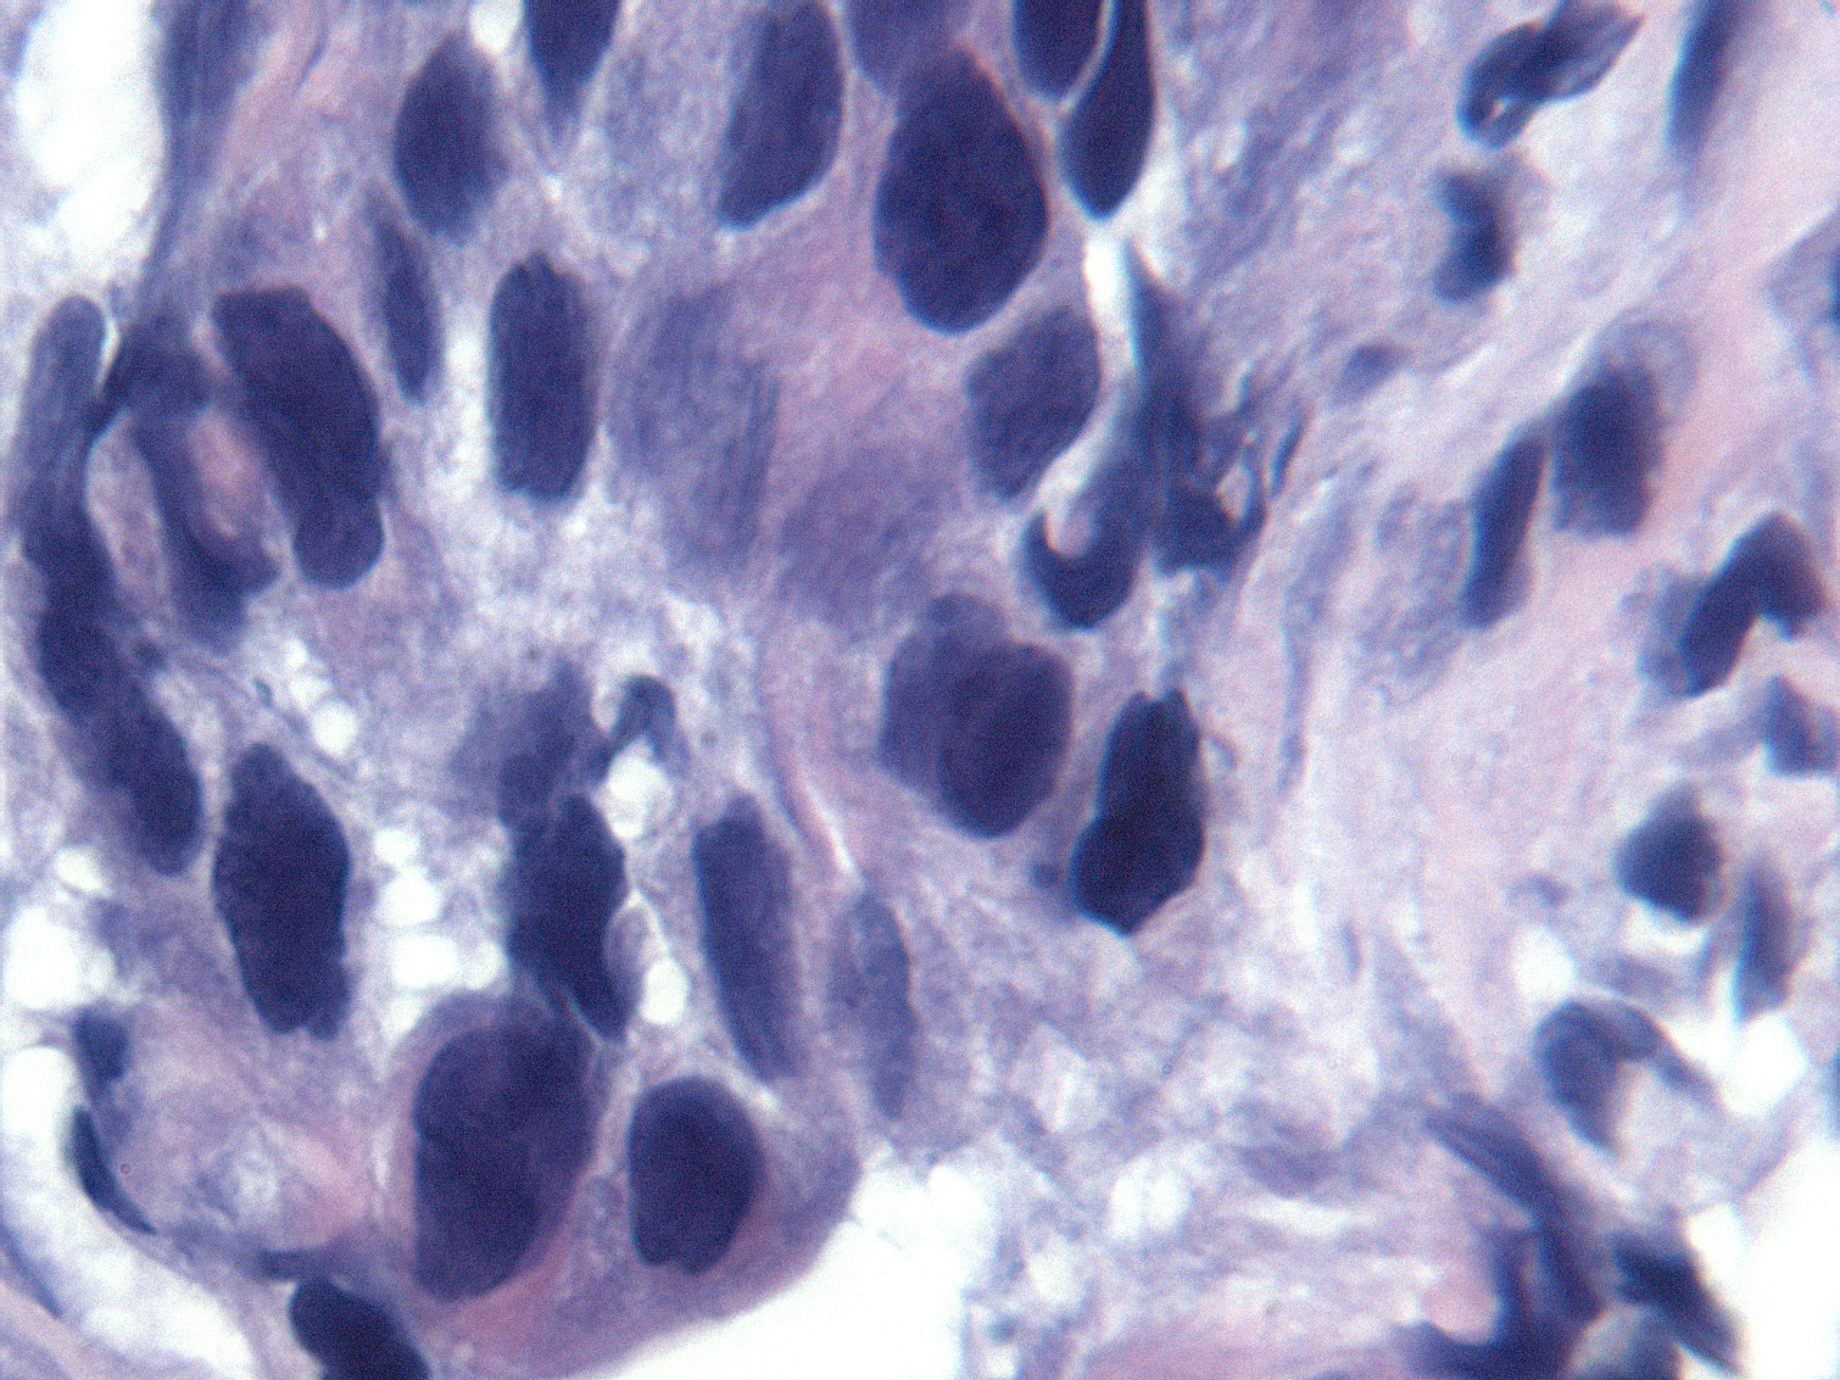
Squamous cell carcinoma mitoses
Mitosis in malignant cells
Hematoxylin –Eosine stain

Slide 12
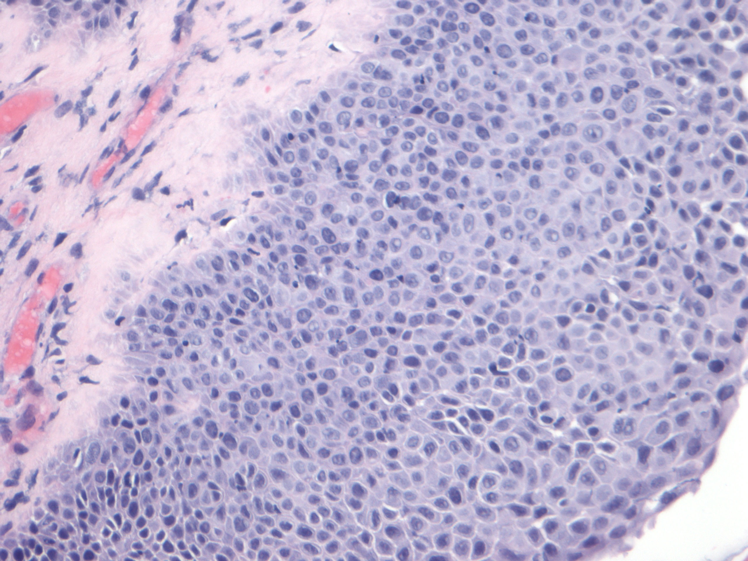
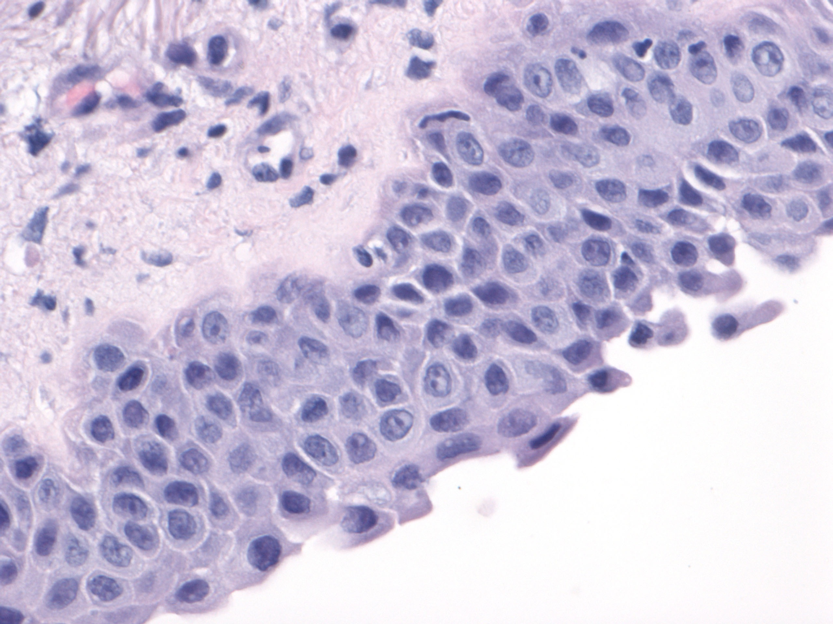
Squamous cell carcinoma with dysplasia
SCC dysplasia in metaplastic epithelium
Hematoxylin –Eosine stain
High power view

Slide 13
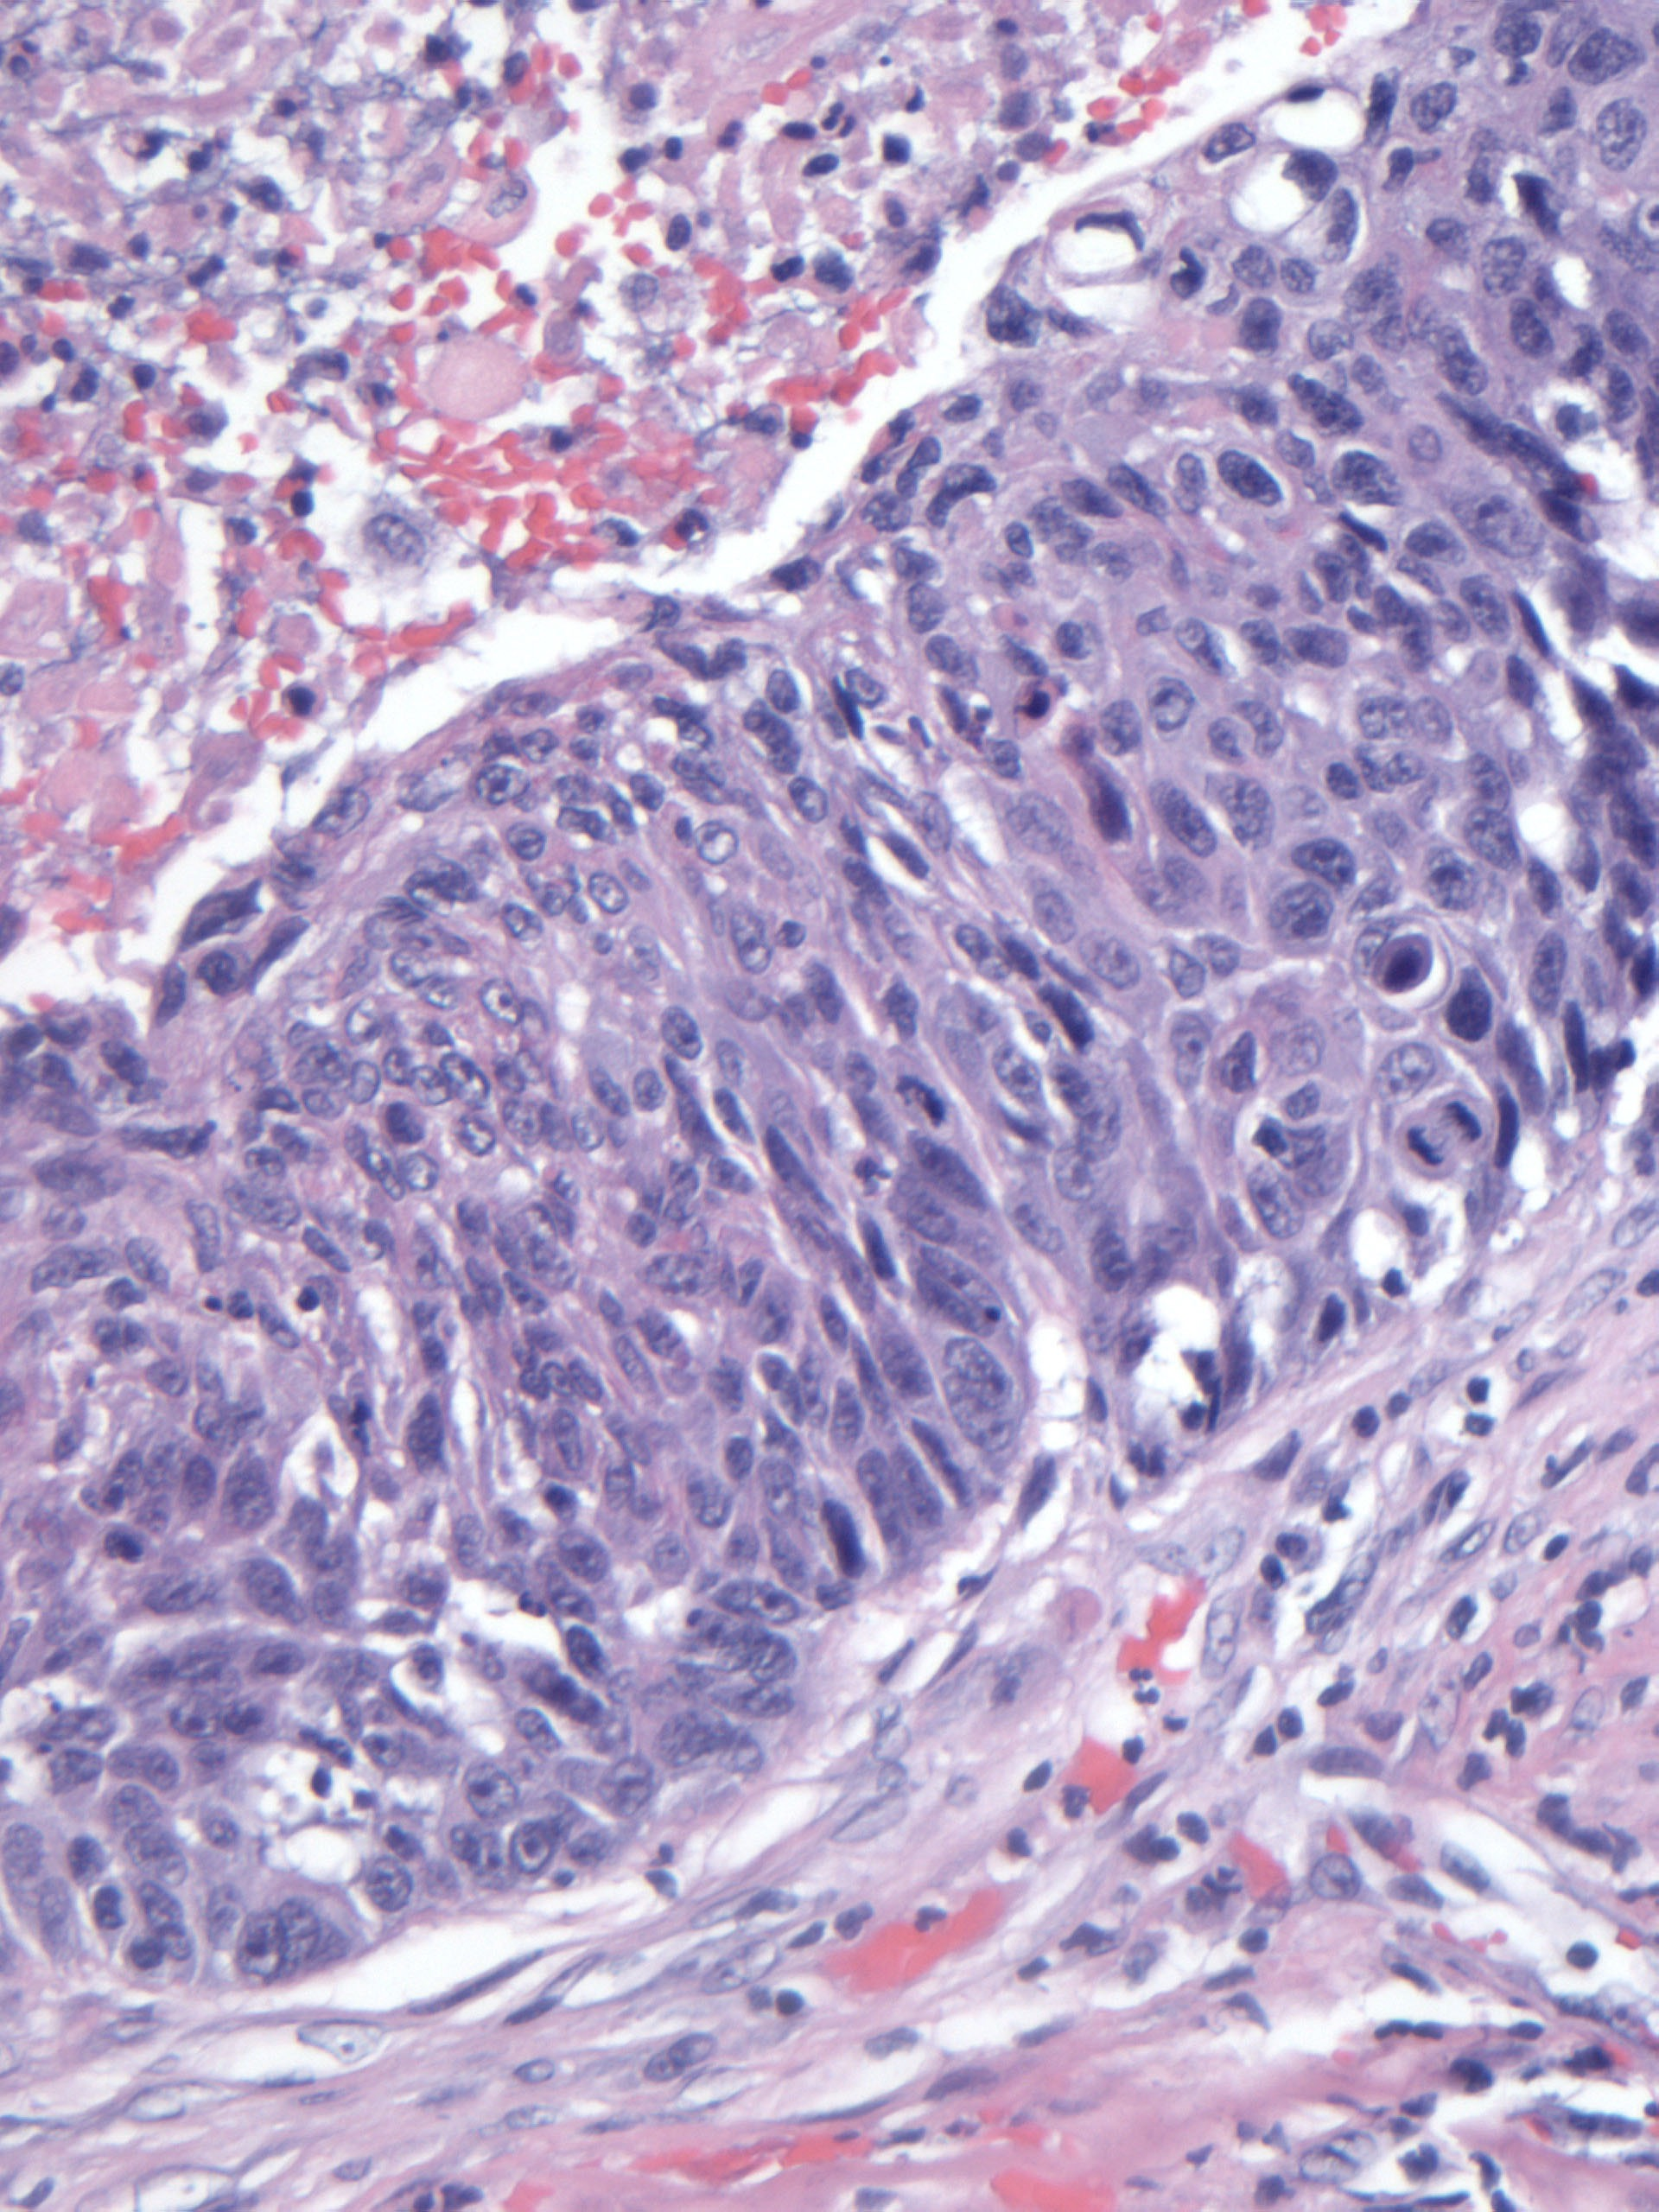
Squamous cell carcinoma metaplasia and displasia
Malignant cells in
Dysplastic Epithelium
Hemotoxylin-eosin stain
Surgpath images courtesy N. Narula, UCI Medical Center

Slide 14
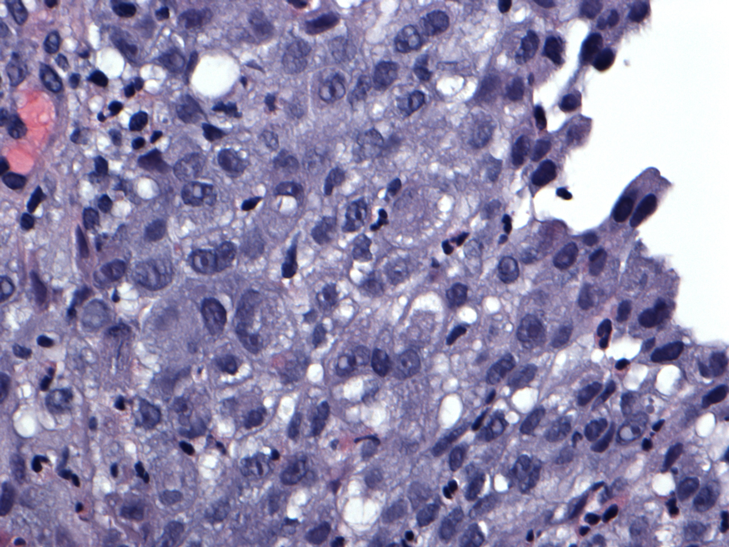
Squamous carcinoma in-situ
Malignant cells
High power
Hemotoxylin –Eosin stain
Surgpath images courtesy N. Narula, UCI Medical Center
Notes:
Malignant cell

Slide 15
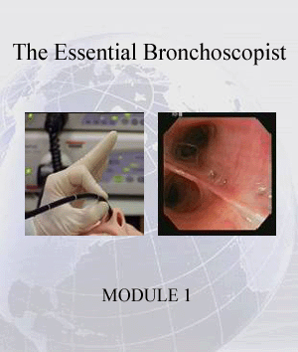

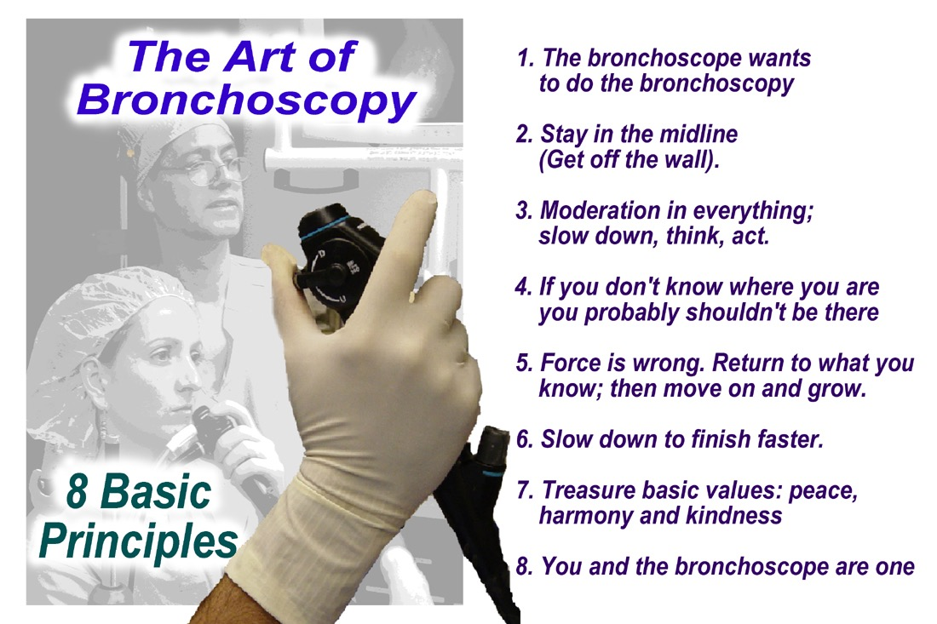
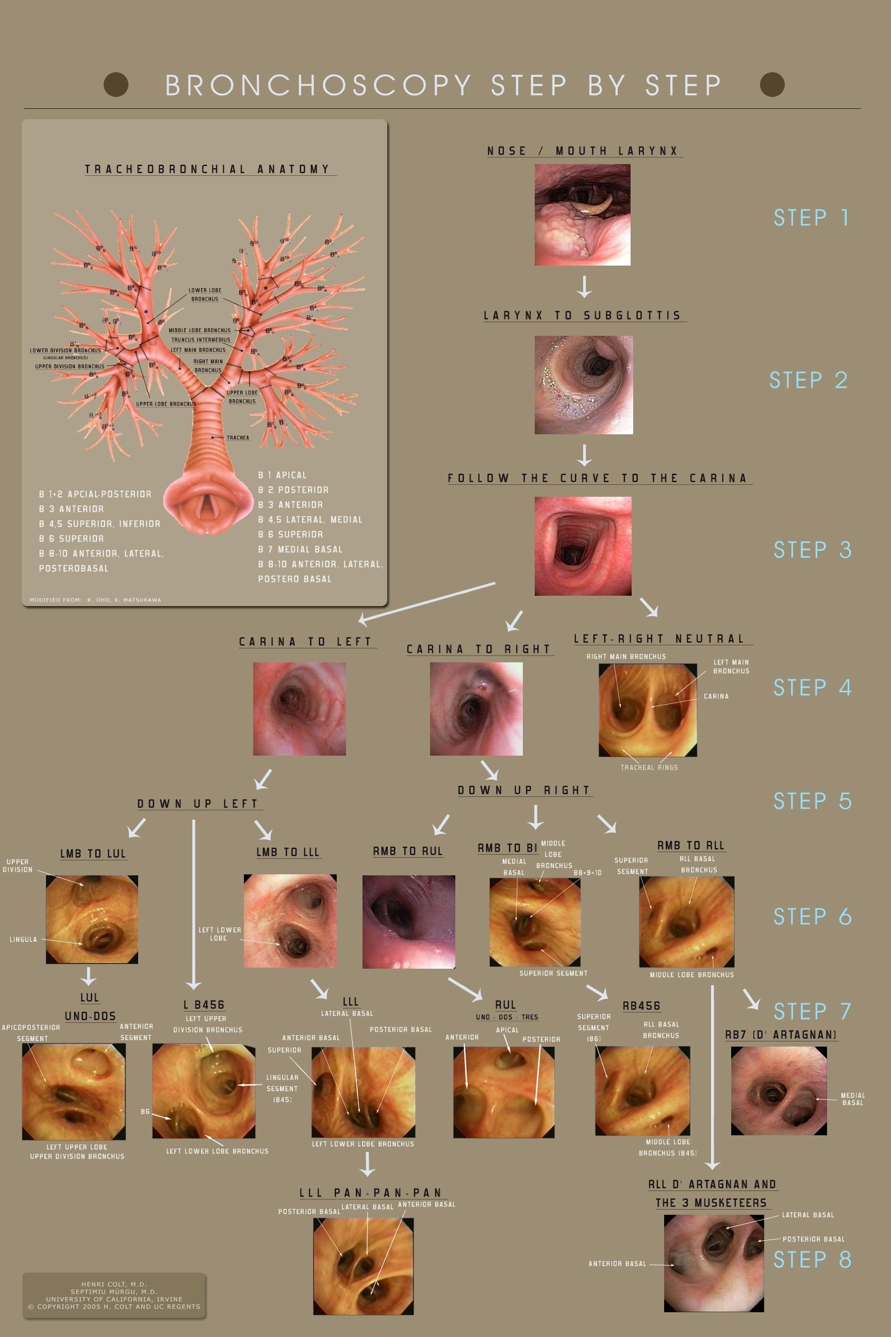
This presentation is part of a multidimensional competency-oriented curriculum for Flexible Bronchoscopy.
Our goal is to eliminate patient suffering caused by unequal physician expertise and on-the-job training.
Step by Step©
BRONCHATLAS©
& YouTube Instructional videos
5/26/17
All Rights Reserved, 2017

Slide 16
Thank you
All efforts are made by Bronchoscopy International to maintain currency of online information. Multimedia presentations and videos can be cited as:
Bronchoscopy International: BronchAtlas©, an Electronic On-Line Multimedia Slide Presentation. http://www.Bronchoscopy.org/Bronchatlas/htm. Published 2017 (Please add “Date Accessed”).
BRONCHATLAS©
5/26/17
All Rights Reserved, 2017

Slide 17
www.Bronchoscopy.org

