Slide 1
2C: Normal Anatomy of The Bronchial Tree
BRONCHATLAS©
Prepared By
www.Bronchoscopy.org
5/26/17
BI, All Rights Reserved, 2005

Slide 2
How to use this presentation
At anytime you may click anywhere with the left mouse button to advance to the next slide.
This presentation contains NO video or Audio
This presentation can be viewed FULL SCREEN by right clicking on the slide and selecting Full Screen on the menu bar.
To exit Full Screen, press the ESCAPE key.
5/26/17
All Rights Reserved, 2017

Slide 3
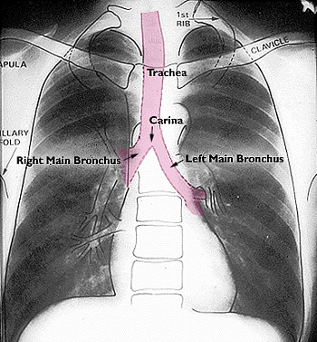
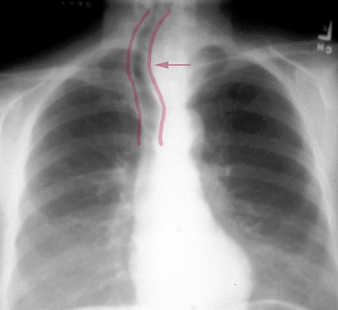
Tracheobronchial anatomy
From www.vh.org
Tracheal Displacement Due to Goiter
5/26/17
All Rights Reserved, 2017

Slide 4
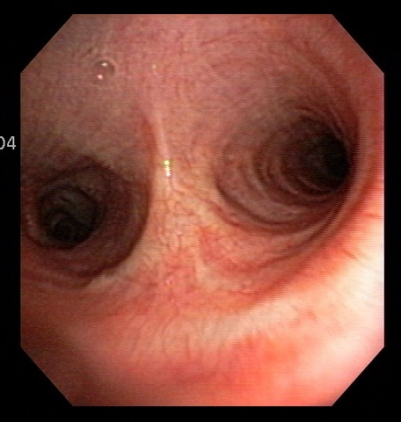
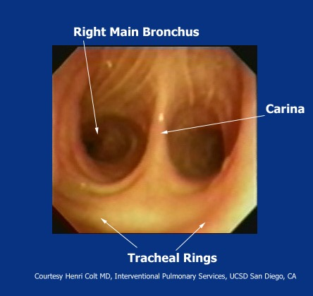
Main carina: Concepts of anterior and posterior
5/26/17
All Rights Reserved, 2017

Slide 5
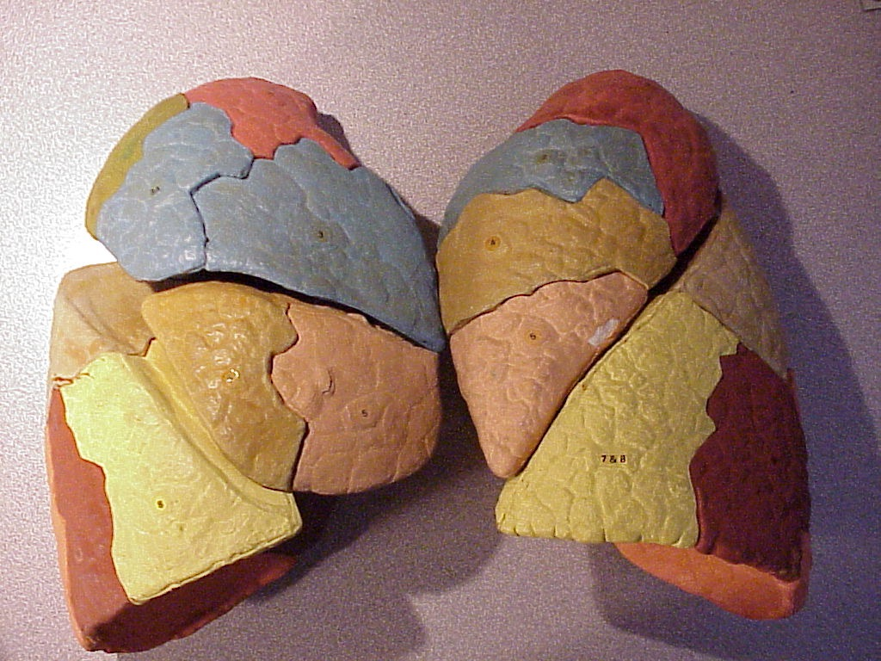
Lobar and segmental anatomy
R
L
RUL
RML
RLL
LUL-Lingula
LLL
5/26/17
All Rights Reserved, 2017

Slide 6
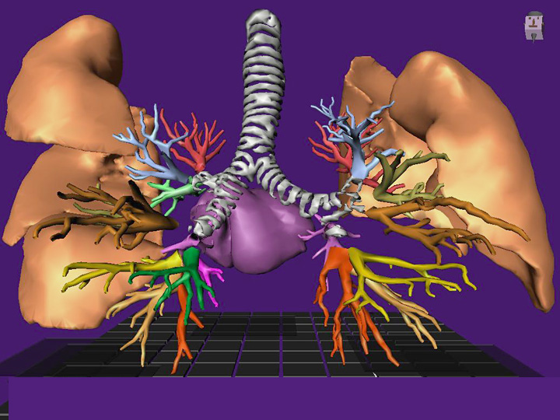
Lobar and segmental anatomy
3 Lobes
2 Lobes
R
L
5/26/17
All Rights Reserved, 2017

Slide 7
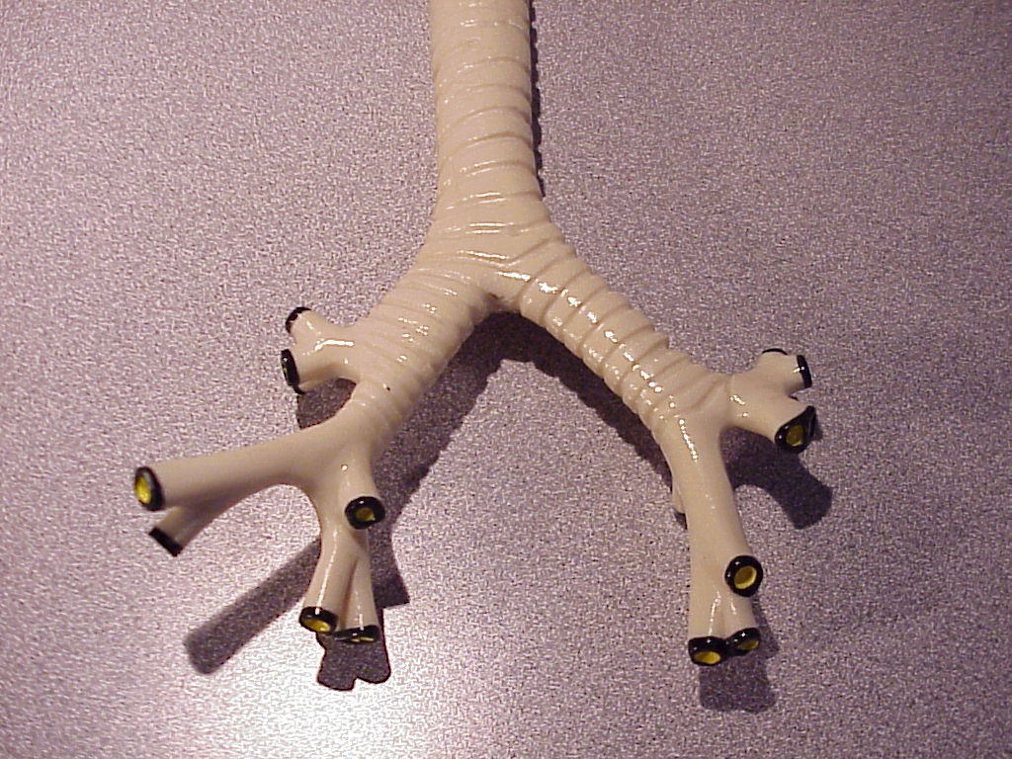
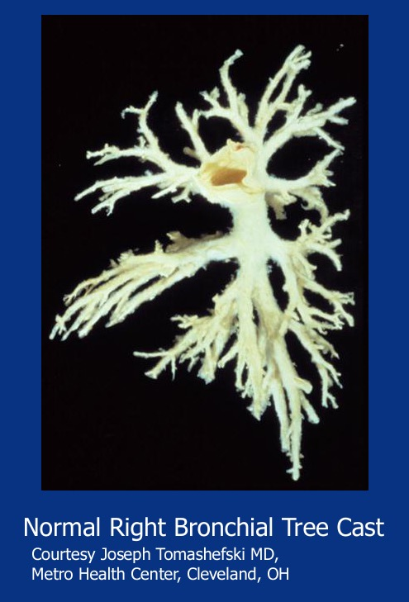
Lobar and segmental anatomy
2cm
5cm
R
L
5/26/17
BI, All Rights Reserved, 2017

Slide 8
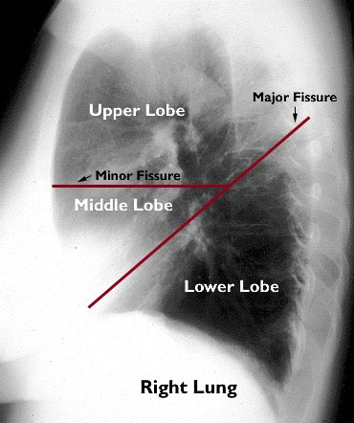
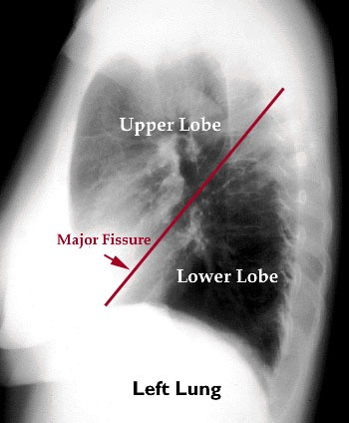
Lobar Anatomy : as seen on xray
Modified from : www.vh.org
Minor fissure: from R hilum to the 6th rib Major fissure: from T4-T5 to the diaphragm
5/26/17

Slide 9
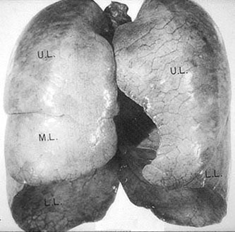
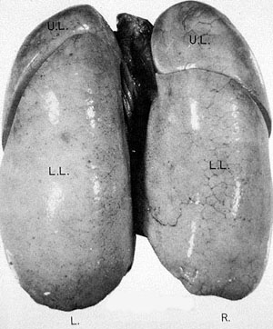
Lobar Anatomy
Modified from: www.vh.org
Anterior Projection of the Lungs
Posterior Projection of the Lungs
5/26/17
All Rights Reserved, 2017

Slide 10
Pathology correlates
Note Vertical RMB
Tumor RLL
5/26/17
BI, All Rights Reserved, 2005

Slide 11
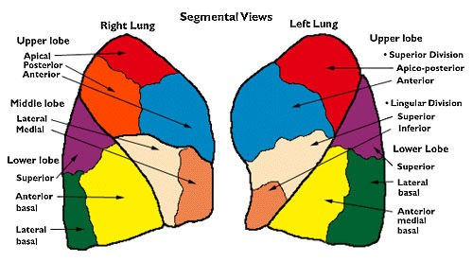
Segmental anatomy
Excerpted from www.vh.org
5/26/17
All Rights Reserved, 2017

Slide 12
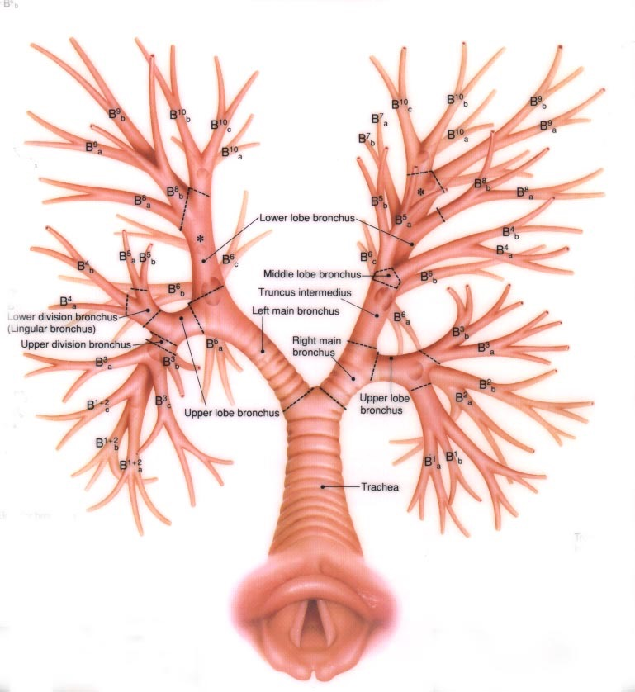
Lobar and segmental anatomy
From Oho and Matsukawa
Left
Right
5/26/17
BI, All Rights Reserved, 2005

Slide 13
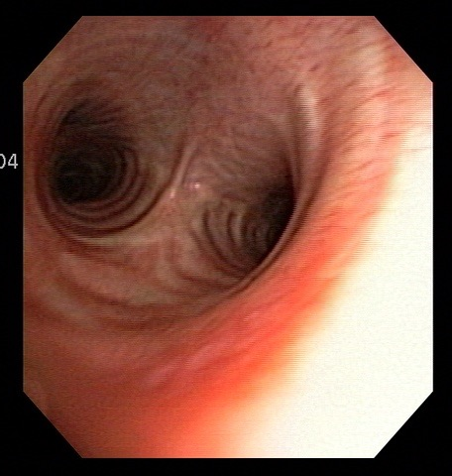
Horizontal and vertical main bronchi Focus on Right Main Bronchus
Seen from head of patient
Vertical Right main bronchus
Seen from in front of patient
5/26/17
All Rights Reserved, 2017

Slide 14
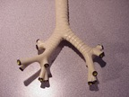
Right bronchial anatomy
The right main bronchus is 2 cm long on average and has an internal diameter of 10-16 mm. This is slightly larger than the diameter of the left main bronchus.
The bronchus intermedius of the right bronchial tree is actually quite short, extending for 1.0-2.5 cm until its anterior wall extends into and becomes the middle lobe bronchus. Its posterior wall extends into and becomes the right lower lobe bronchus.
Volume loss caused by pleural effusion, atelectasis, elevated right hemidiaphragm, as well as traction or torsion from a fibrotic or scarred upper lobe often cause shortening of this bronchus.
5/26/17
All Rights Reserved, 2017

Slide 15
The Right Bronchial Tree: Classification
JACKSON-HUBER NOMENCLATURE | BOYDEN SURGICAL ANATOMY | JAPANESE BRONCHOSCOPY SYSTEM
Right Upper lobe
Apical | B¹ | B¹
Anterior | B² | B₃
Posterior | B3 | B²
Right middle lobe
Lateral | B⁴ | B⁴
Medial | B⁵ | B⁵
Right lower lobe
Superior | B⁶ | B⁶
Medial basal | B⁷ | B⁷
Anterior basal | B⁸ | B⁸
Lateral basal | B⁹ | B⁹
Posterior basal | B¹⁰ | B¹⁰
5/26/17
BI, All Rights Reserved, 2005

Slide 16
Note: The Boyden surgical anatomical focus refers to the anterior and posterior segments of the upper lobe as B2 and B3 (Anatomical Focus 1983;206:103-114). This nomenclature IS NOT USED by bronchoscopists, who prefer the Japanese System using anterior as B3 and posterior as B2
5/26/17
All Rights Reserved, 2017

Slide 17
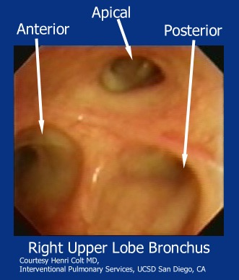
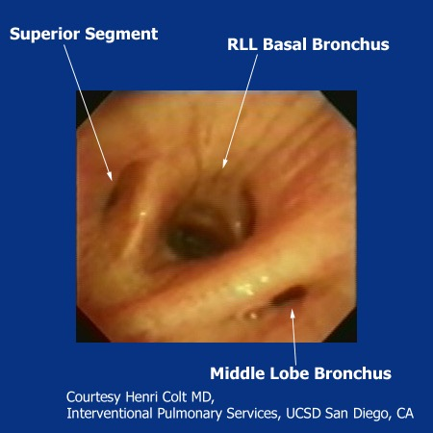
Right upper lobe bronchus and bronchus intermedius
RB 3, RB 1, RB 2
RB 6
RB 4 and 5
5/26/17
All Rights Reserved, 2017

Slide 18
The Right main bronchus
The right main bronchus is short and vertical, rapidly dividing into
The right upper lobe bronchus which in turn divides into
The apical bronchus
The anterior bronchus
The posterior bronchus
5/26/17
All Rights Reserved, 2017

Slide 19
The right middle lobe and lower lobe bronchus
Distally just beyond the bronchus intermedius, another division occurs into :
The Middle lobe bronchus with its anterior direction, dividing into a medial and lateral segmental bronchus.
The Right lower lobe bronchus
5/26/17
All Rights Reserved, 2017

Slide 20
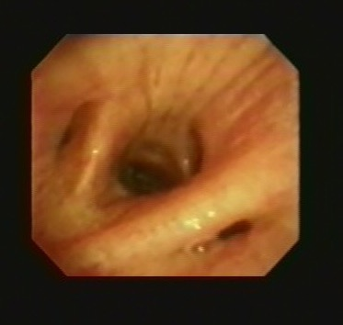
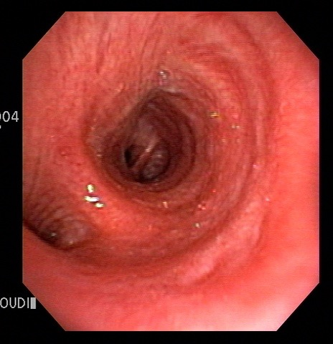
Anatomy: secondary carina: right side
On the right, the carina between the right middle lobe bronchus and the bronchus to the right lower lobe is named the right carina 2 or RC-2,
The carina dividing the right upper lobe from the bronchus intermedius is called the right carina 1 or RC-1.
5/26/17
All Rights Reserved, 2017

Slide 21
The right lower lobe bronchus
The right lower lobe bronchus divides immediately into a superior segmental bronchus (jsut across from the right middle lobe bronchus), and
A medial basal segmental bronchus a bit more distally and along its medial wall.
Finally dividing into three lower lobe bronchi (Three musketeers):
Antero-basal
Latero-basal
Postero-basal
5/26/17
All Rights Reserved, 2017

Slide 22
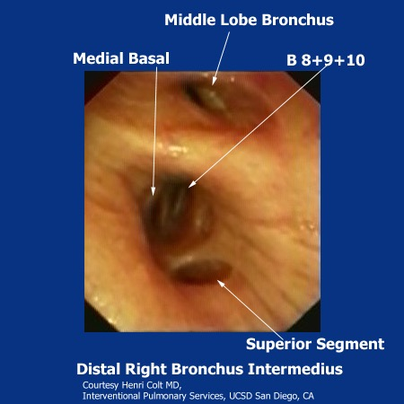
Bronchus intermedius and Right lower lobe bronchus
RB 7
B 4, 5
RB6
RB7
RB 8, 9 and 10
B 6
5/26/17
All Rights Reserved, 2017

Slide 23
Using the figure below, and imagining the interior of the airway as a clock face and using the carina as the central reference point. Where is the superior segment of the lower lobe bronchus?
3 o’clock
7 o’clock
5 o’clock
9 o’clock
Posterior
Anterior
Click here for correct answer:
D
5/26/17
All Rights Reserved, 2017

Slide 24
Horizontal and vertical main bronchi Focus on Left main bronchus
Seen from head of patient
Vertical Right main bronchus
Seen from in front of patient
5/26/17
All Rights Reserved, 2017

Slide 25
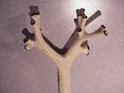
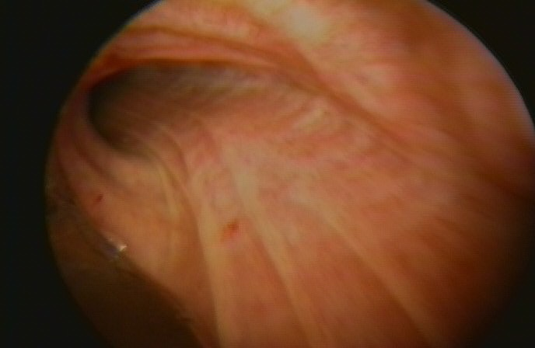
Left bronchial Anatomy
The left main bronchus is usually 4-5 cm long. its lumen is narrow and relatively horizontal. The usual length of the left lower lobe bronchus beyond the origin of the superior segmental bronchus is 1 cm.
L
R
5/26/17
All Rights Reserved, 2017

Slide 26
Left Bronchial Tree Classification and nomenclatures
JACKSON-HUBER | JAPANESE SYSTEM
Left upper lobe
Upper division
Apical-posterior | B^{1 & 2}
Anterior | B³
Lingular/division
Superior | B⁴
Inferior | B⁵
Left lower lobe
Superior | B⁶
Anteromedial | B^{7&8}
Lateral basal | B⁹
Posterior basal | B¹⁰
5/26/17
BI, All Rights Reserved, 2005

Slide 27
The Left main bronchus
Divides into a upper and lower lobe bronchus
The upper lobe bronchus divides into a upper division and lingular bronchus
The lingular bronchus divides into a superior and inferior segmental bronchus
5/26/17
All Rights Reserved, 2017

Slide 28
Left upper lobe bronchus
LC-1
LC-2
5/26/17
All Rights Reserved, 2017

Slide 29
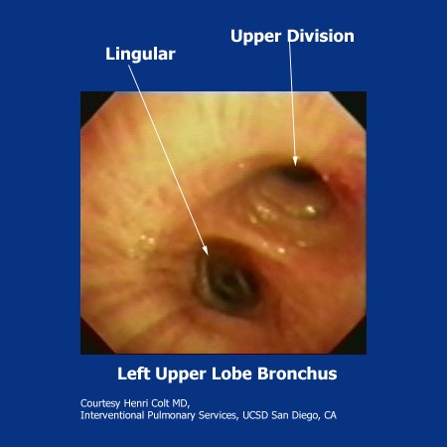
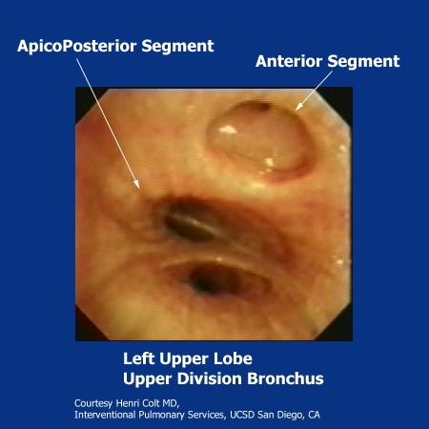
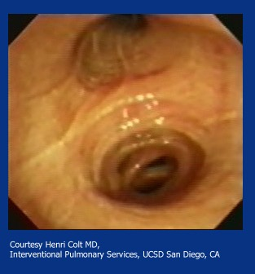
Left upper lobe bronchus: Upper division and Lingula
Lingula
Superior segment LB 4, LB 5
Inferior segment
LB 1-2, LB 3
5/26/17
All Rights Reserved, 2017

Slide 30
The Left lower lobe bronchus
The left lower lobe bronchus is longer than the right lower lobe bronchus, and there is a greater distance between its superior segment and its basal pyramid bronchi (three musketeers).
The basal pyramid bronchi are in mirror shape compared to those on the right, and the medial basal segmental bronchus is usually but not always absent.
5/26/17
All Rights Reserved, 2017

Slide 31
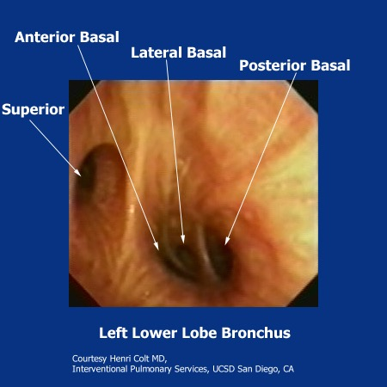
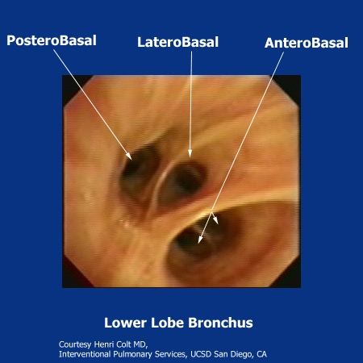
Left lower lobe bronchus
From the head
From the front
LB 6, LB 8, LB 9, LB 10
LB 10, LB 9, LB 8
5/26/17
All Rights Reserved, 2017

Slide 32
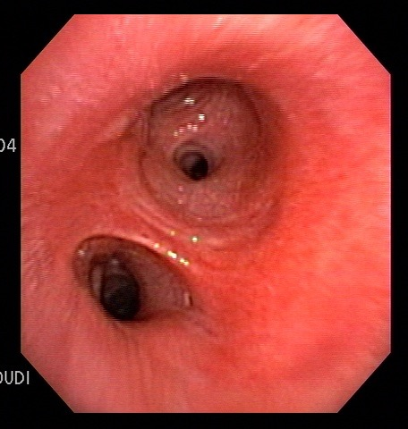
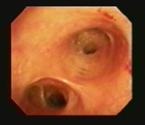
Anatomy: secondary carina left side
The carina separating the anterior segment of the upper division of left upper lobe bronchus from the lingula is termed LC-1.
From in front
On the left, the carina separating the lingular segment of the left upper lobe from the left lower lobe bronchus is called LC-2.
5/26/17
All Rights Reserved, 2017

Slide 33
All of the following approximate airway dimensions are correct except
The usual length of the left lower lobe bronchus beyond the origin of the superior segment is 1 cm.
B) The usual length of the right upper lobe bronchus is 1.0 cm.
C) The usual length of the left main bronchus is 4-5 cm. It bifurcates sharply from the midline of the trachea at an angle of 45 degrees.
D) The usual length of the right main bronchus is 1.0 cm. It bifurcates at an angle of 25 degrees from the midline of the trachea.
Click here for correct answer:
D
5/26/17
All Rights Reserved, 2017

Slide 34
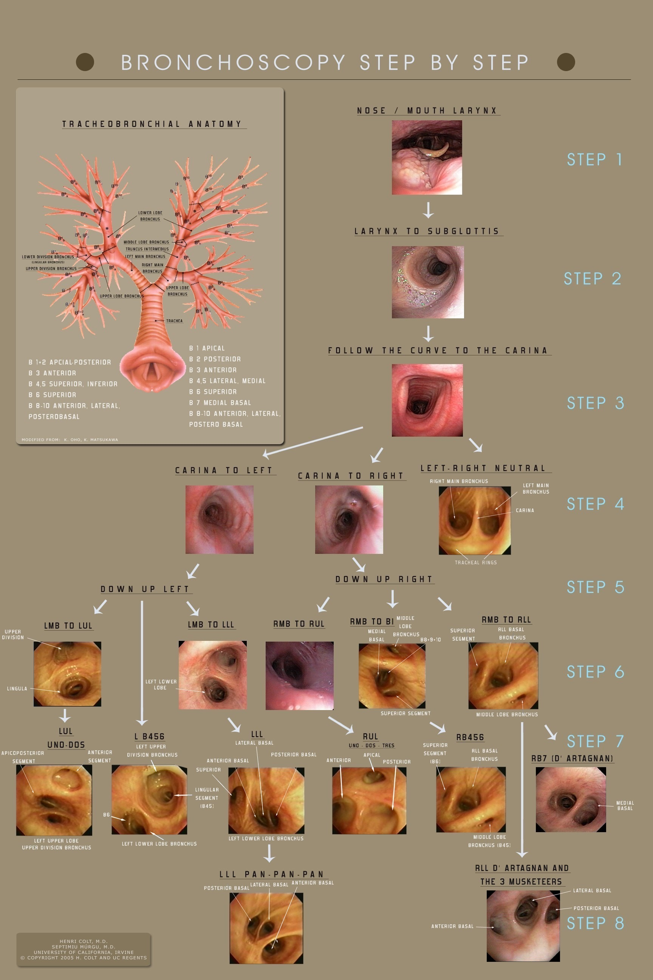
This presentation is part of a multidimensional competency-oriented curriculum for Flexible Bronchoscopy.
Our goal is to eliminate patient suffering caused by unequal physician expertise and on-the-job training.
Step by Step©
BRONCHATLAS©
& YouTube Instructional videos
5/26/17
All Rights Reserved, 2017

Slide 35
Thank you
All efforts are made by Bronchoscopy International to maintain currency of online information. Multimedia presentations and videos can be cited as:
Bronchoscopy International: BronchAtlas©, an Electronic On-Line Multimedia Slide Presentation. http://www.Bronchoscopy.org/Bronchatlas/htm. Published 2017 (Please add “Date Accessed”).
BRONCHATLAS©
5/26/17
All Rights Reserved, 2017

Slide 36
www.Bronchoscopy.org

